Slide 1
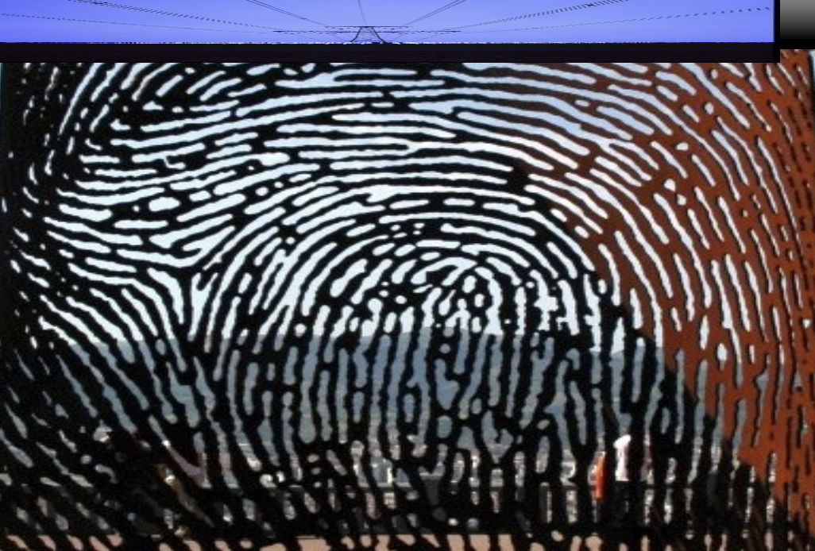

in the wake
[of]
emergence
Speaking to Ancestors
Berlin
27 June 2023
Professor Johnny Golding, director
proto-Centre for Radical Matter:
Art. Philosophy. Wild Science
Royal College of Art, London, UK
Notes:
Fingerprint of Bilbao by the sculptor, Juanjo Novella. It lies on the top of Mount Artxanda, overlooking the city of Bilbao. In honour of the workers who were murdered in the Spanish Civil War
Our research interests are wide-ranging and reflect the expertise of our staff, focusing on arts, humanities and material practices, their scholarship and dissemination. The School’s distinctive research culture encompasses a broad range of activities from highly individuated scholarly and creative enquiries to projects that concern public policy and evaluation, collections and archival research, material and technical explorations as well as more speculative arts practice-focused projects.

Slide 2
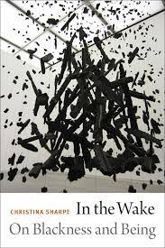
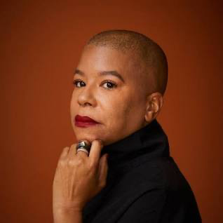
Wake work the wake the ship the hold the weather
Christina Sharpe, In the Wake – On Blackness and Being

Slide 3
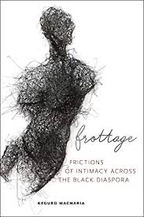
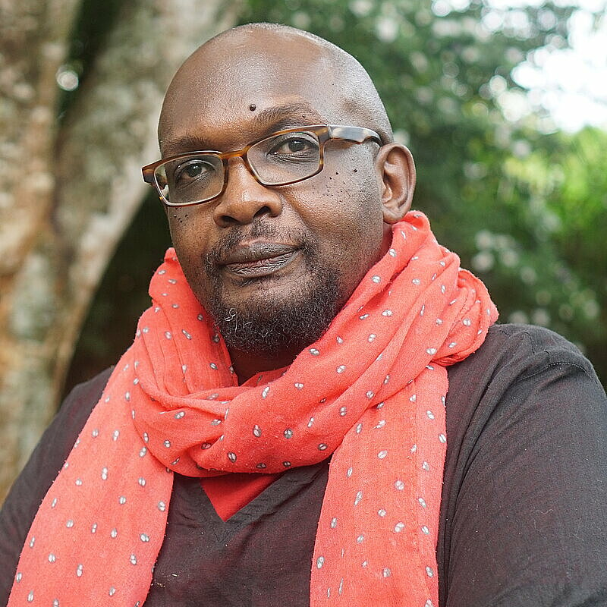
Frottage work (and play) – in 7 movements
Keguro Macharia, Frottage: Frictions of Intimacy Across the Black Diaspora
Rubbing along: silence mingling with conversation
Begins with your fingers touching pages, scratching your head; creating geographies that start and stop and have a beat
What is touching you now? How do you want to be touched?
Present as past, future as presentFrom the afterlife of slavery – cartographies of the world’s waterways continue to be saturated with black people’s suffering
Rubbing the tongue against the mouth’s soft palate
Wool scratch on skin
My words in your mouth

Slide 4
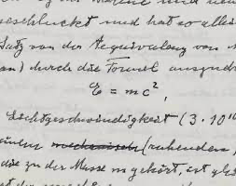
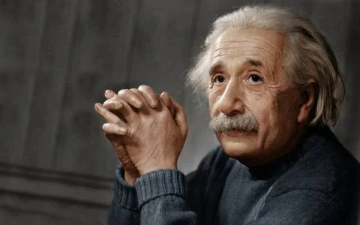
E = mc²
a familiar equation
Albert Einstein, Does the inertia of a body depend upon its energy-content. Fourth paper in a series of 4; September 27, 1905

Slide 5

Vital takeaway no. 1: encounter
E = MC²
Or even better:
E MC²
hint:
The topological surface is the = sign

Slide 6
Vital takeaway no. 2: sticky cohesion(s)
These ‘topological surface structures’ can be called ‘sticky cohesions’ 😅
These cohesions have a ‘thickness’ (without having a thickness) 😖
This ‘=‘ sticky cohesion goes out in all directions (forever expanding, forever contracting ) 😬
And it has been (re-)named as….
And it has a name …

Slide 7
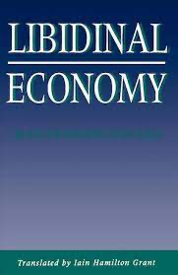
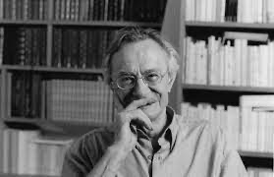





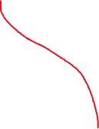



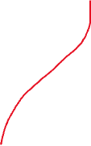
they can form libidinal economies and bring with them weird things around thickness circulation and logics of sense
[what we might call: topological surface ‘aliveness’]
present
Past/future
Jean François Lyotard, Libidinal Economy
future
elsewhere
present
möbius strip
past
Maxwell’s ‘cone of time’

Slide 8
zero

Slide 9





⇌encounter ⇌cohesion ⇌emergence⇌wake ⇌frottage
Zero as topological aliveness:
[here emergence does not mean what one ends up becoming;
it simply is the ‘is’ (eg: the ‘wake’ or ‘frottage’ or ‘event’)- a
collective self-assemblage).
But now also:

Slide 10

Topological aliveness as mark [or segment]
⇌encounter ⇌cohesion⇌emergence ⇌ wake ⇌ frottage
Now as a mark, as rhythm, as beat for example – it is the ‘limit’ of the edge – a kind of portal to an infinitely expanding or contracting ‘is’
(In coding we can now see a very different ‘o’ and a very different ‘1’)

Slide 11
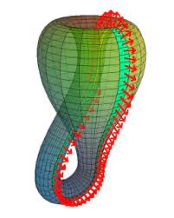
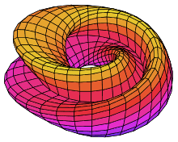
Its pseudomorphic edges can look like this:
Or this:
Or this….

Slide 12
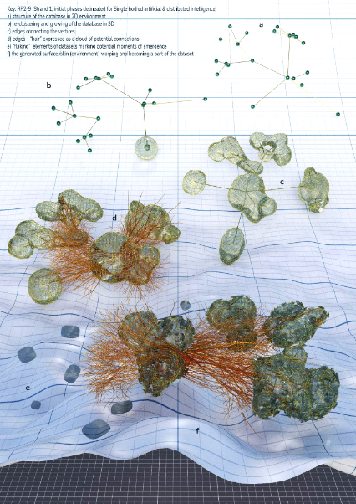
Title (Red heading text)
CREDIT:
SONIA BERNAC
Oh, the joys of zeroes and ones in generative AI

Slide 13
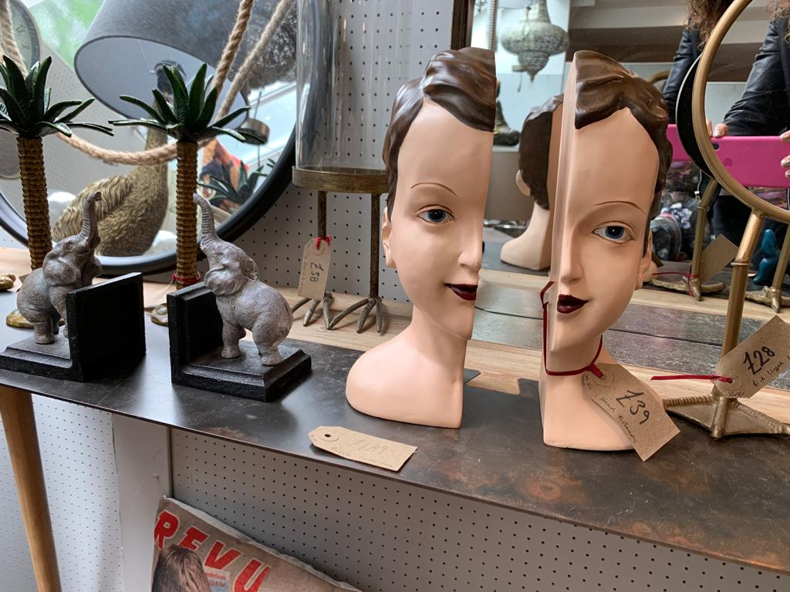
Memory not only circulates, but proliferates, forms sticky cohesions, and makes its mark
[and sometimes the ‘mark’ travels
And sometimes the ‘sticky cohesion’ travels
And sometimes neither do; and sometimes
Something else happens altogether.
That something else we can call (sometimes): art
or politics or agency or not giving up].

