Slide 1
Artificial and Distributed Intelligence for a better Lifestyle
Prof. Johnny Golding, Director proto-Centre for Radical Matter:
Art. Philosophy. Wild Science.
Royal College of Art, London, UK
AiDLab Innovation in Design Summit
19 April 2023

Slide 2
Key task:
Preparing for a disruptive future by adopting AI and advanced technologies
Emphasising: the relation between and amongst Human-Machine-Interspecies co-evolution
Impact of the 4th / 5th Industrial Revolution within culture, imagination, and creative industry.

Slide 3
The Essentials: method as model
emphasis: ‘radical matter’
  based on emergence <=> entanglement / encounter
  the logics of sense: a different ‘reward’ system
→ AI re-configured: as ‘distributed intelligence’
  collective self-assemblage as a ‘single agent’
  importance of ‘noise’, ‘dither’, ‘flaking’, ‘asemic’ poetics
→ impact – from pedagogy to co-evolutionary ethics
  research & development
  commercialisation

Slide 4
Essential no. 1: Understanding Radical matter as a function of ‘emergence’
Proliferation of Data requires a knowledge system that can adapt to
the wild exponential explosion of data.
This means, in part: getting beyond ‘indexing’ and ‘exclusion’ in LLM
It means, also: to focus on ‘unknowing’, ‘undecidability’ (Gödel’s meta-mathematics) and fractals (sliced repetitions via scale – Mandelbrot)
It means finally: foregrounding ‘topological surface structures’

Slide 5
E = mc²
A familiar equation

Slide 6

Essential no. 1:
The topological surface is the = sign
E = MC²

Slide 7
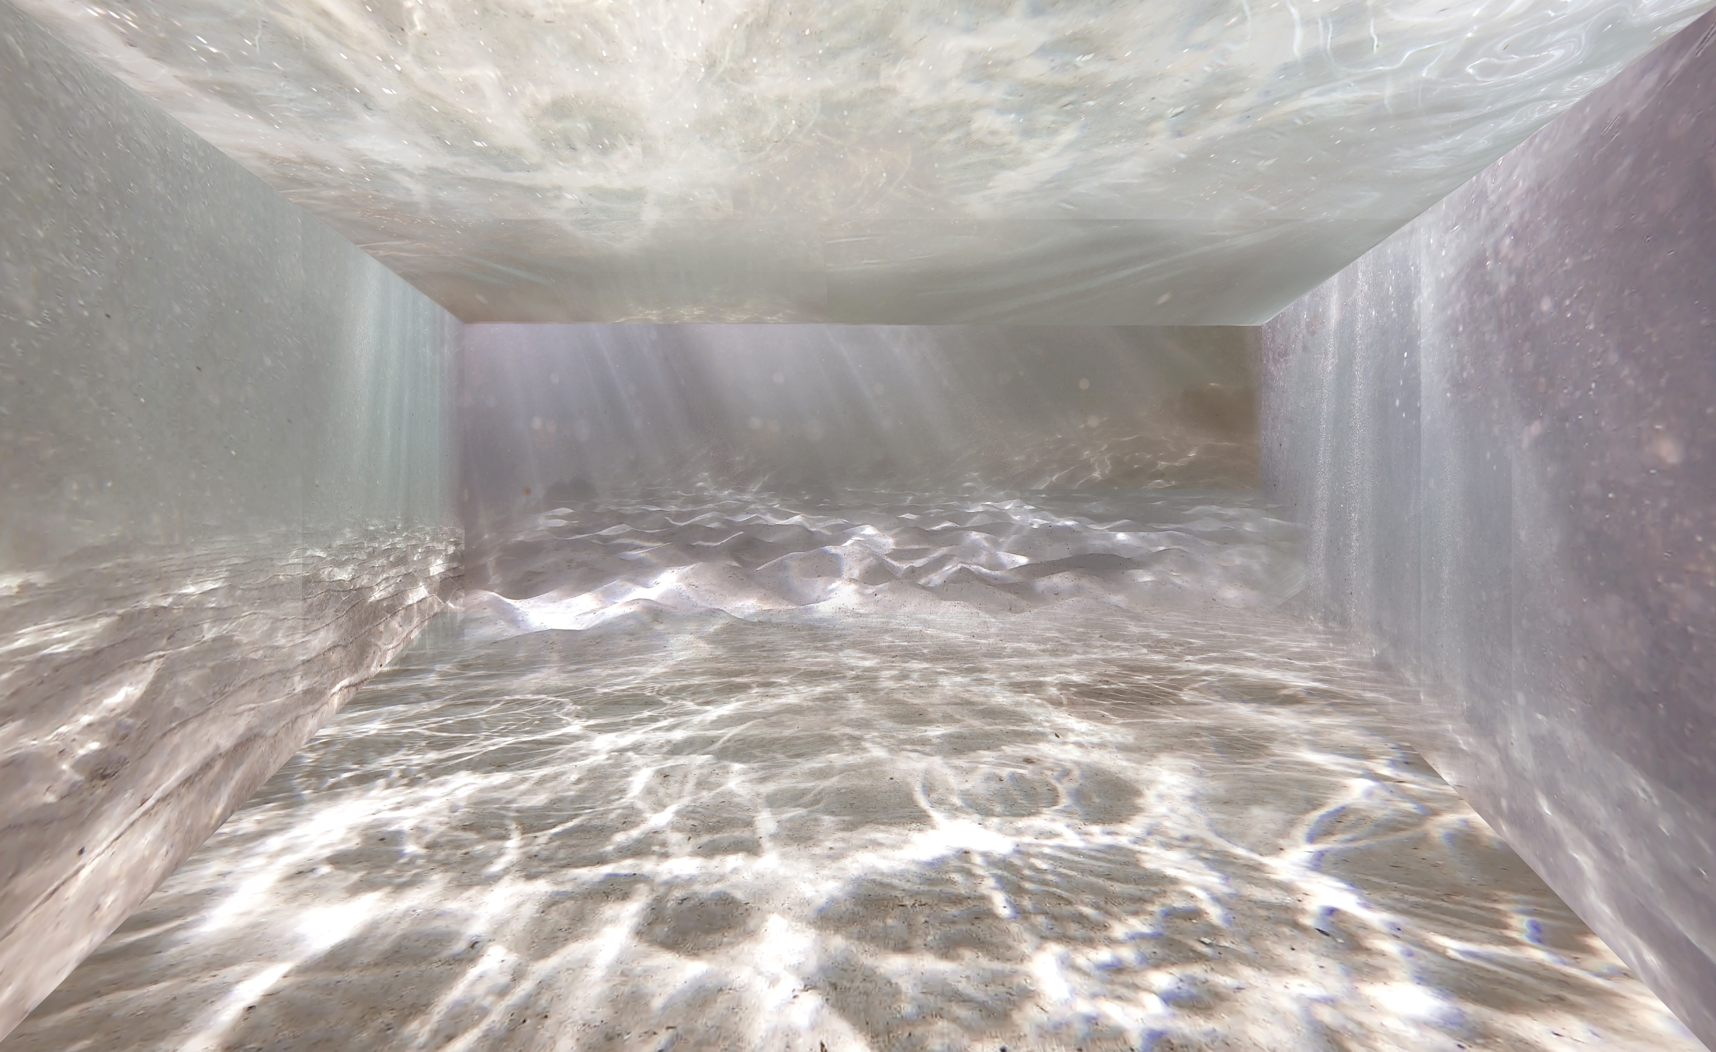
TANK – LIGHT / WAVES PATTERN REPETITIONS

Slide 8
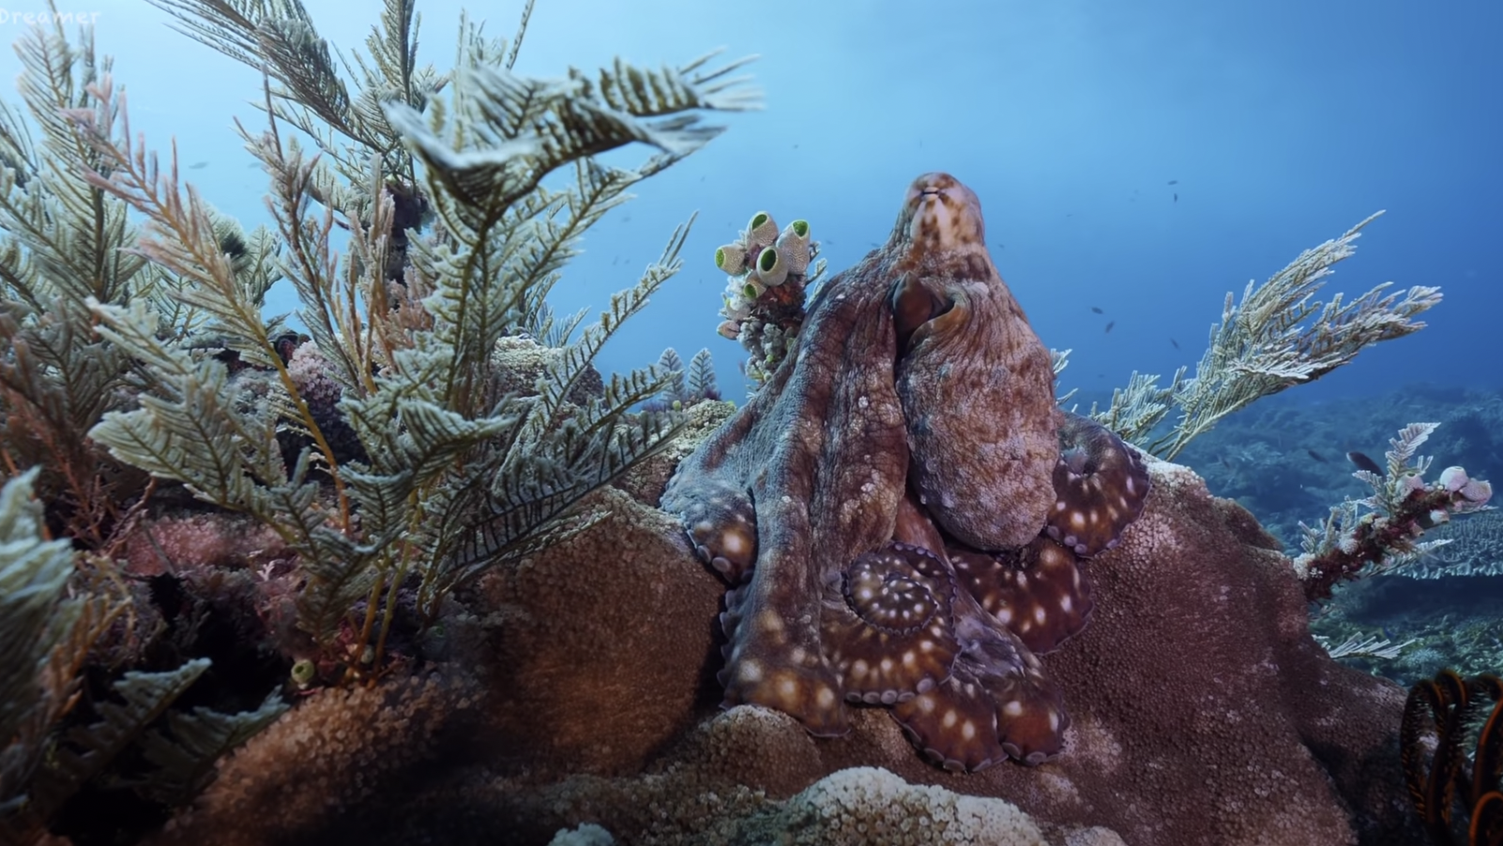
THE COMMON OCTOPUS –REPETITION/ PATTERN /CAMOUFLAGE

Slide 9
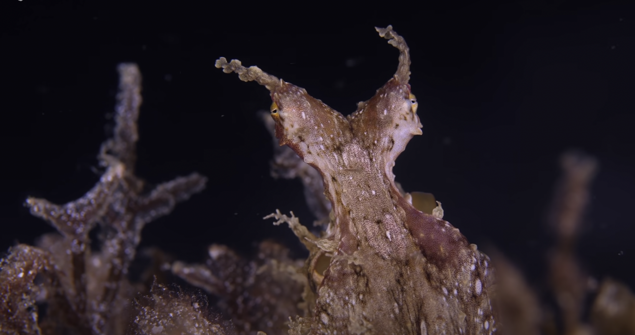

Slide 10
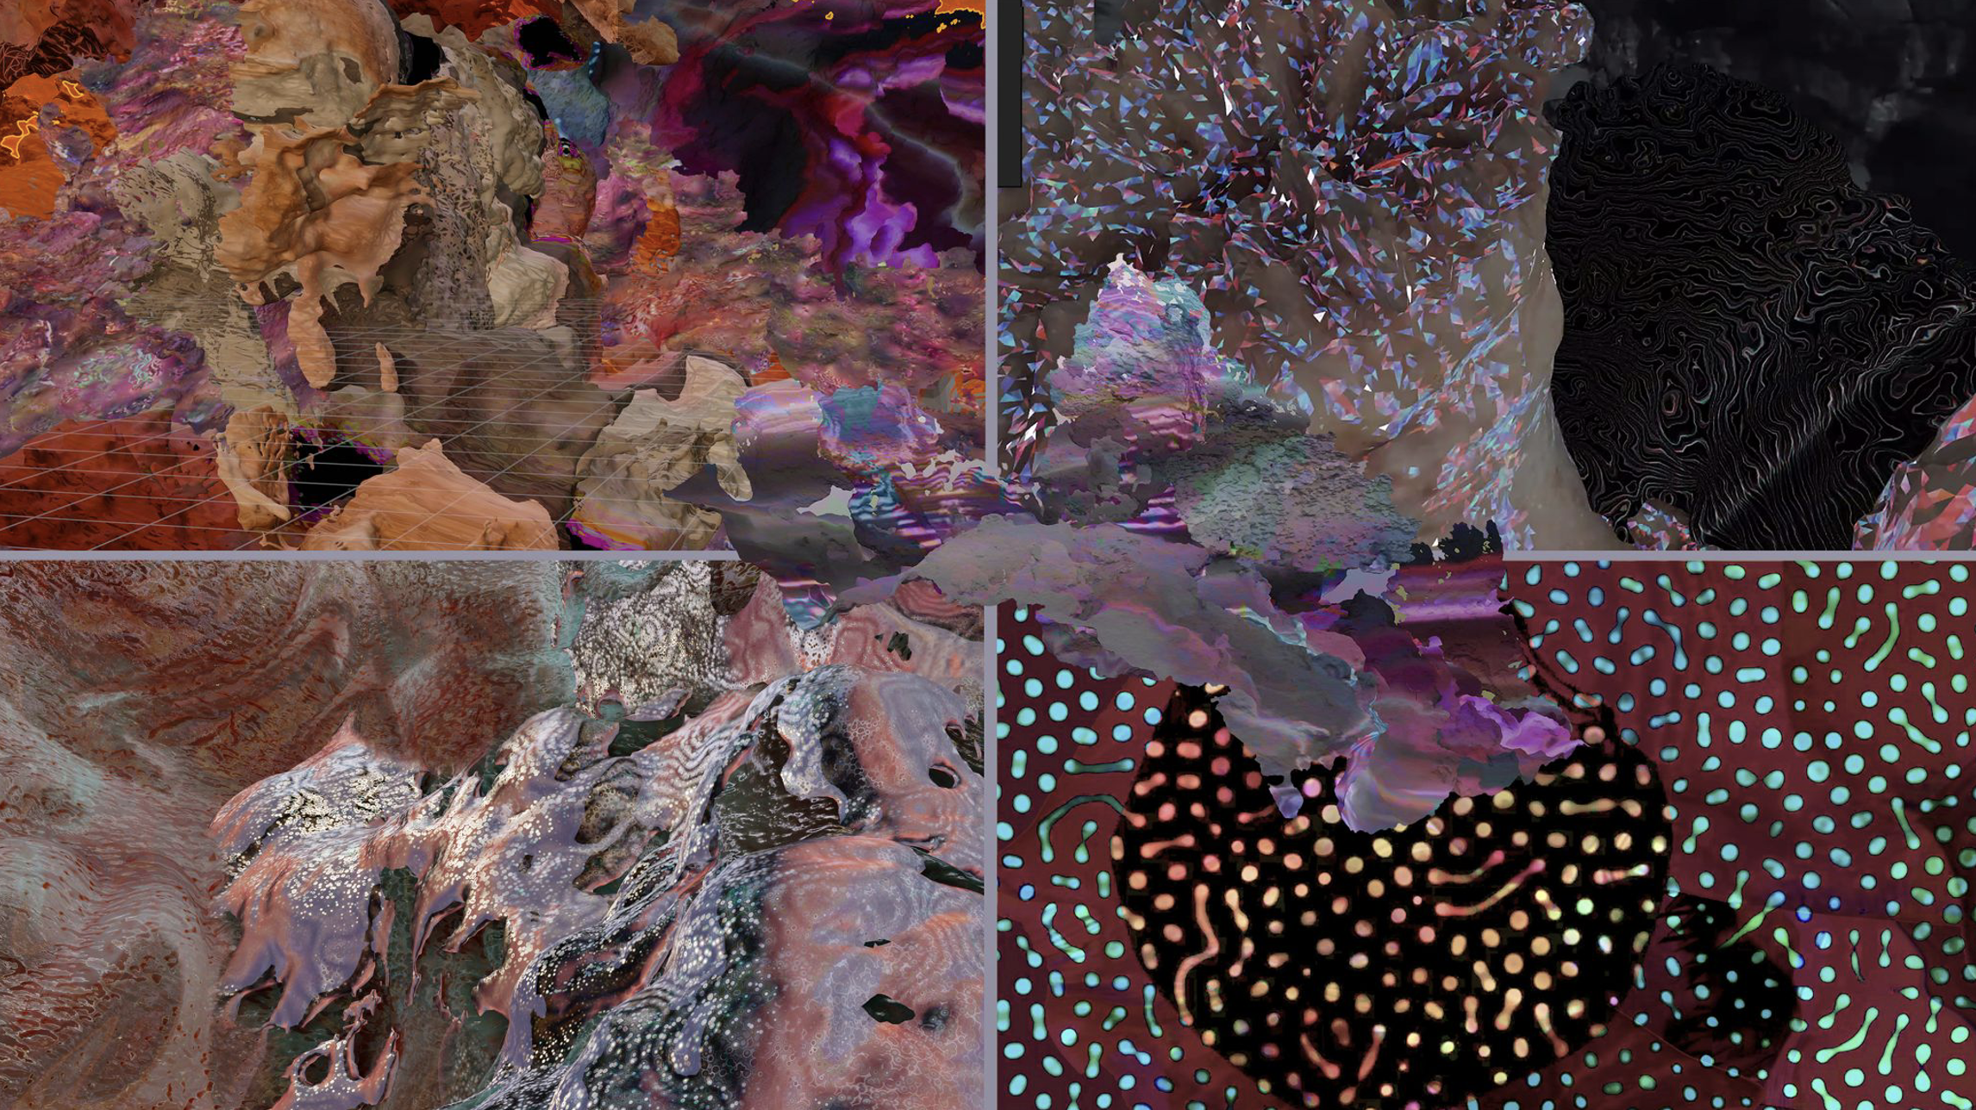
COMMON OCTOPUS / CAMOUFLAGE IMAGE CREDIT: 0RPHAN DRIFT & MAGGIE ROBERTS

Slide 11
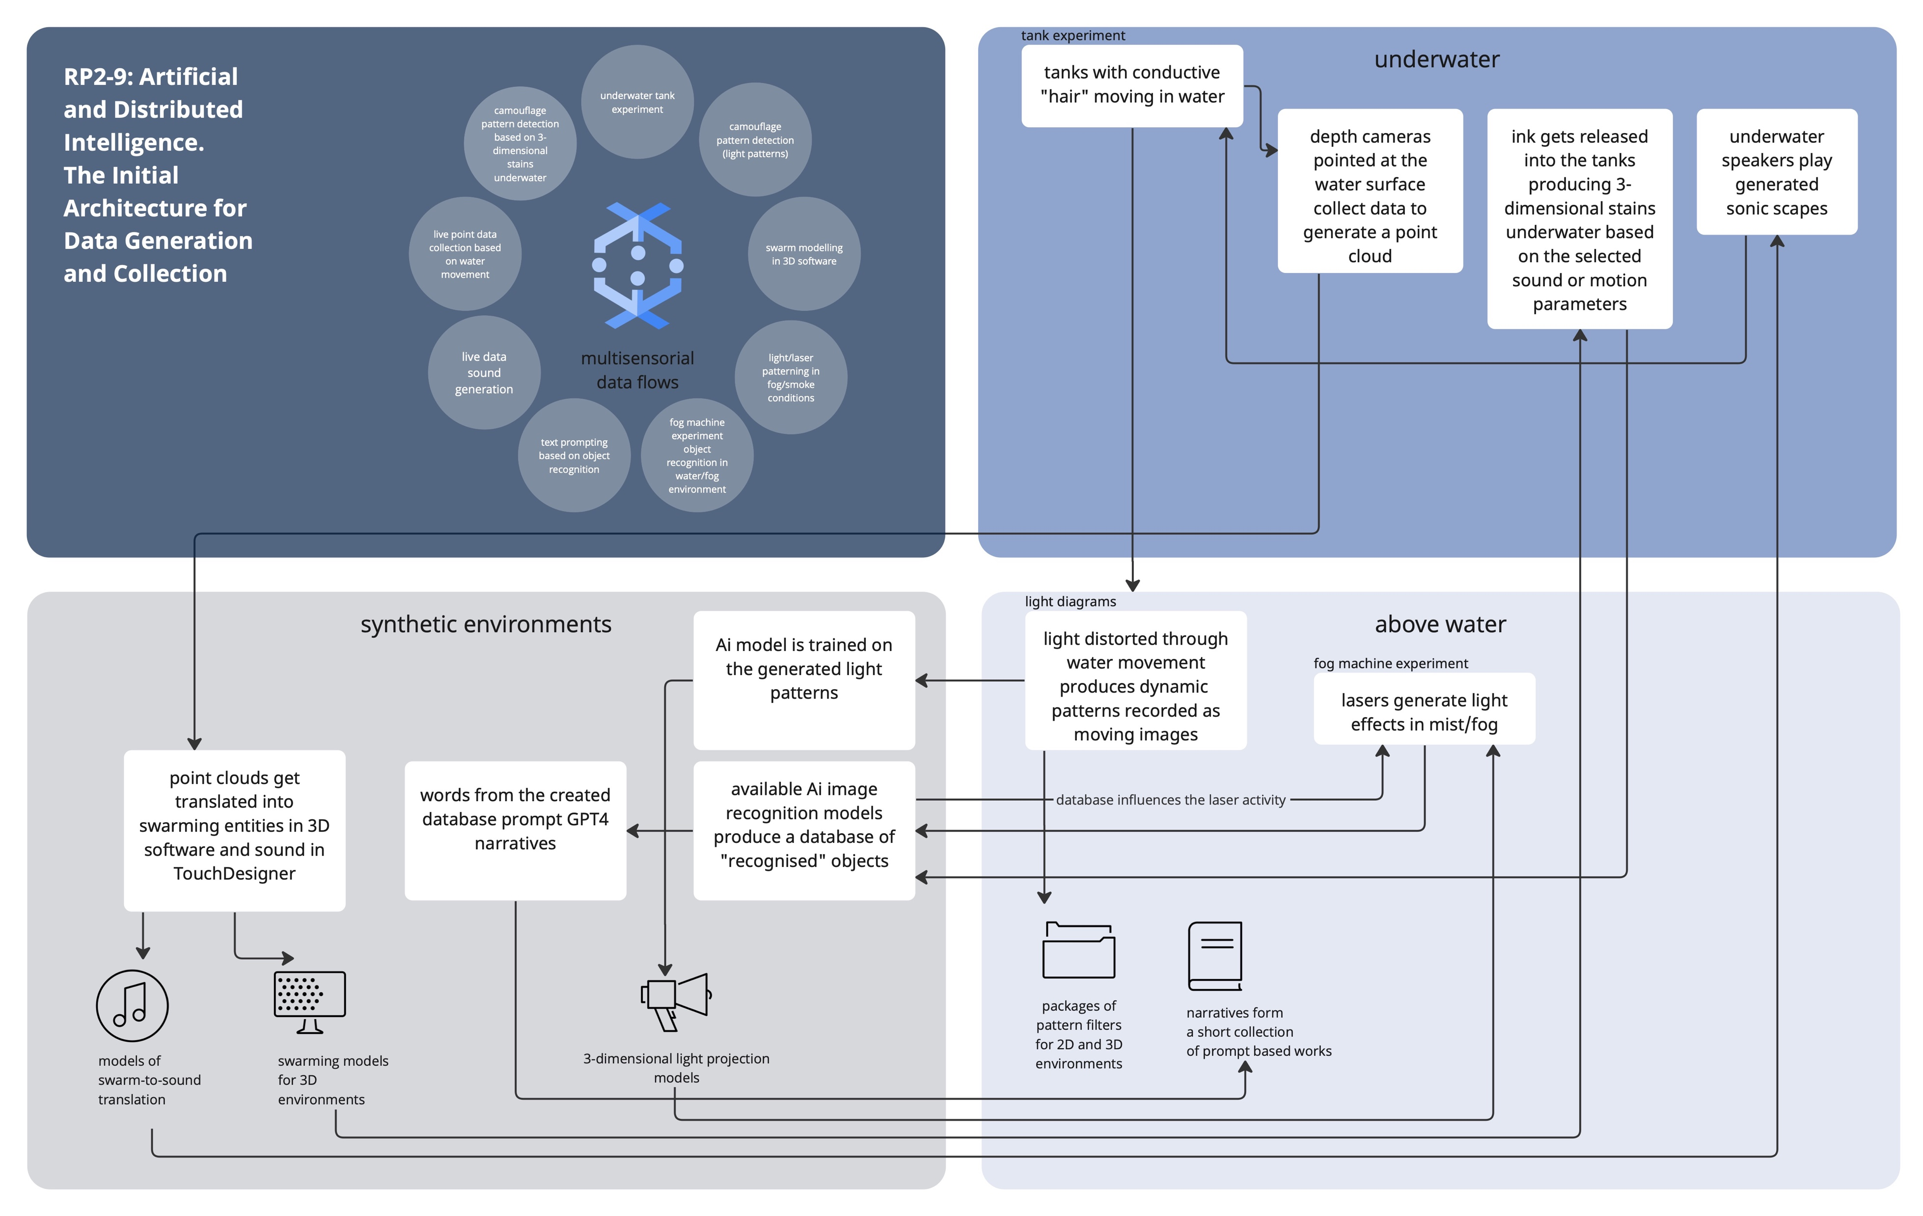
ESSENTIAL NO. 2: Our EMERGENT-Complex adaptive system

Slide 12
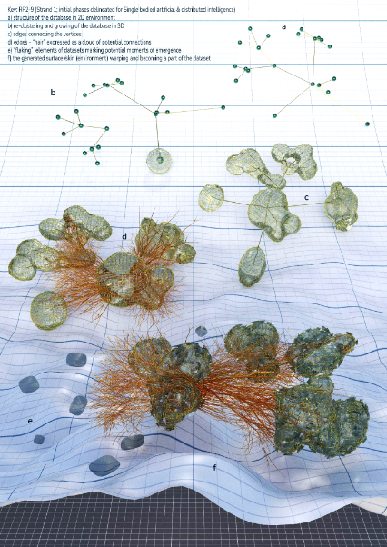
Title (Red heading text)
CREDIT:
SONIA BERNAC

Slide 13
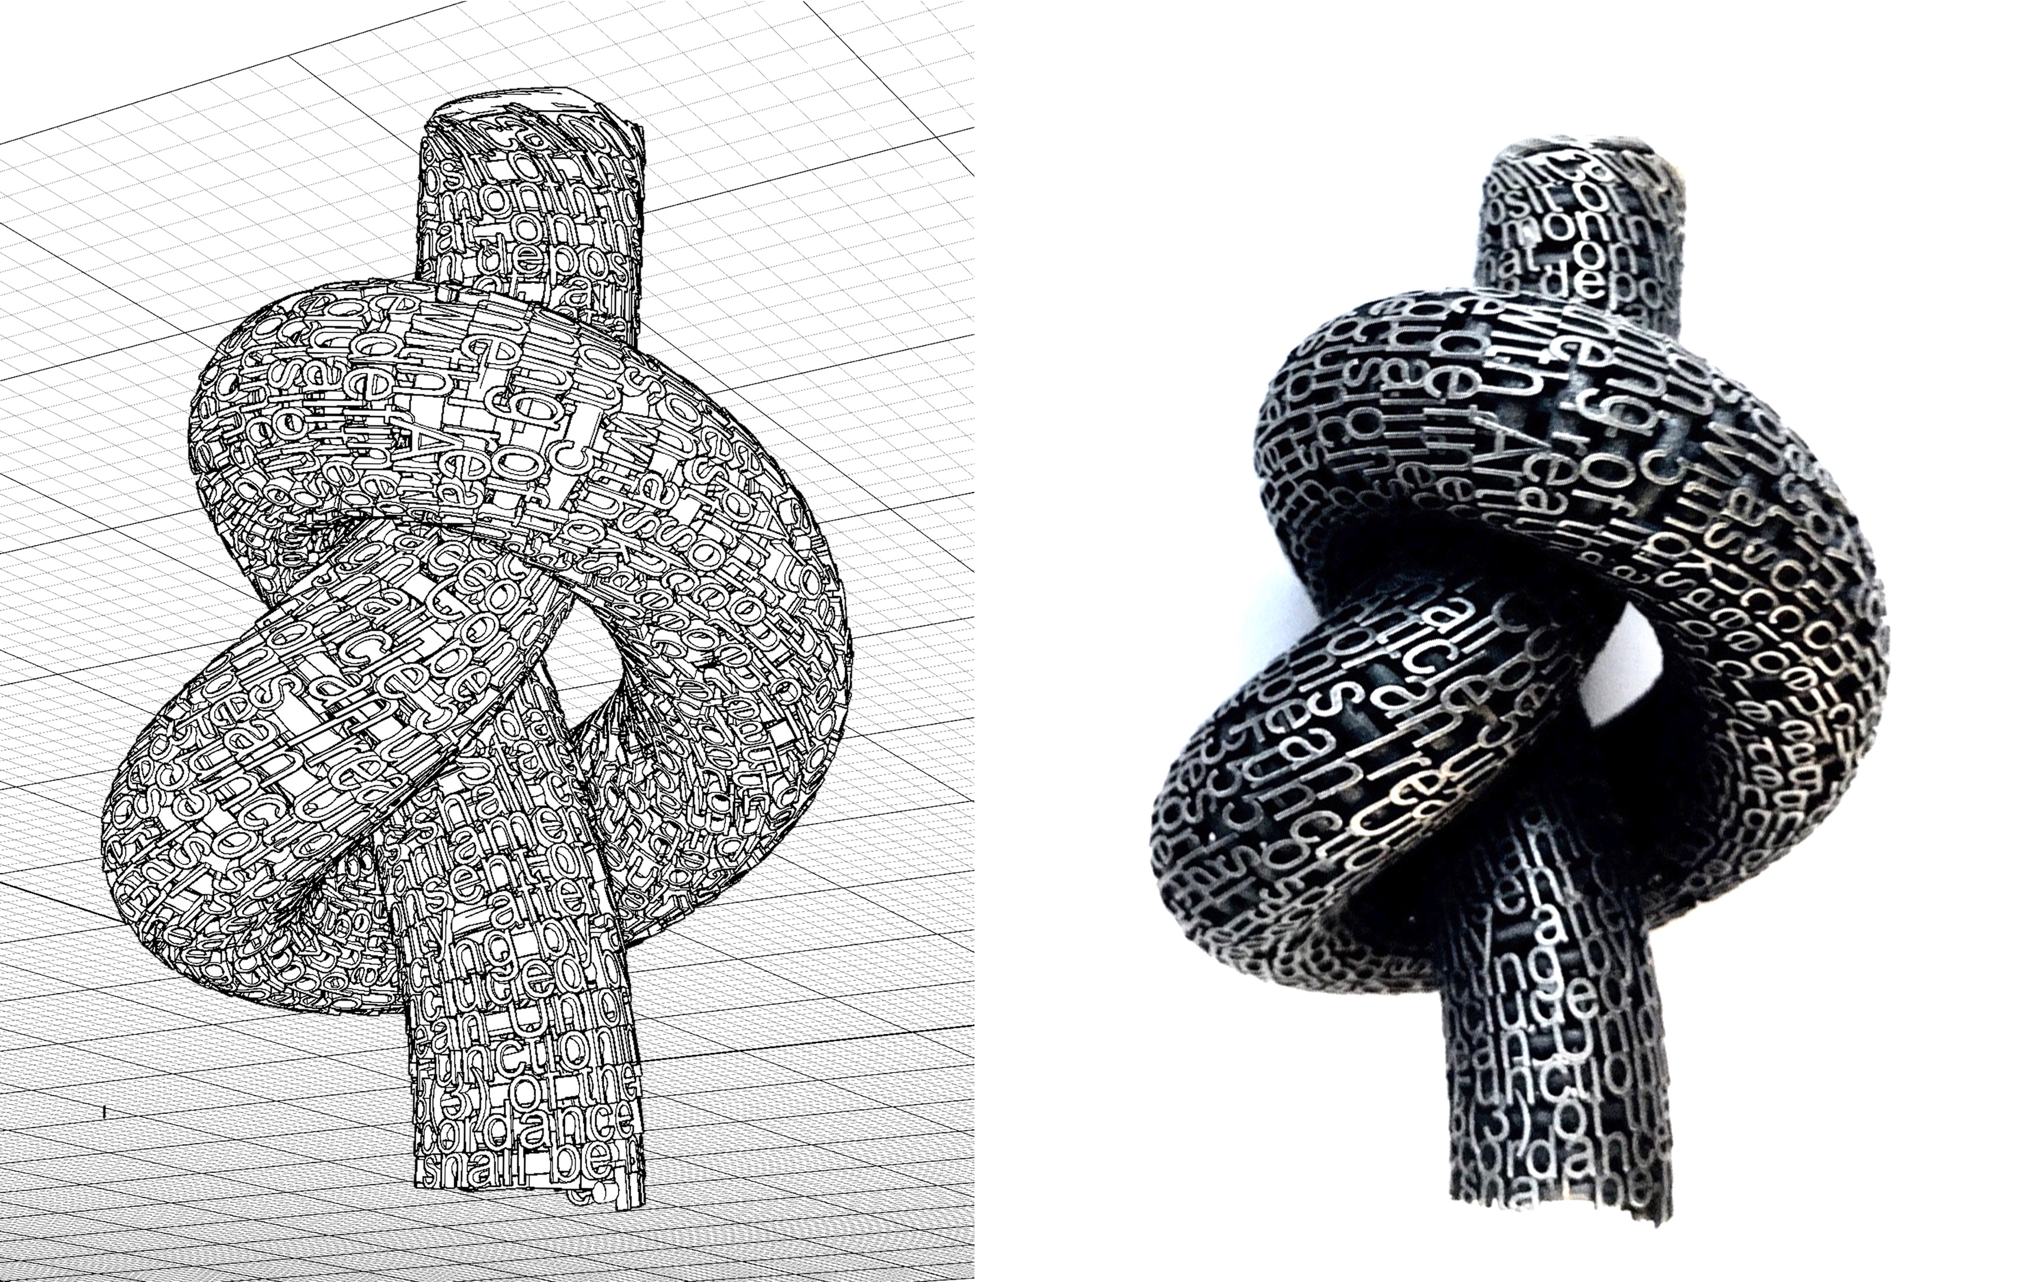
Knotted
Narratives
Jonathan
Boyd

Slide 14
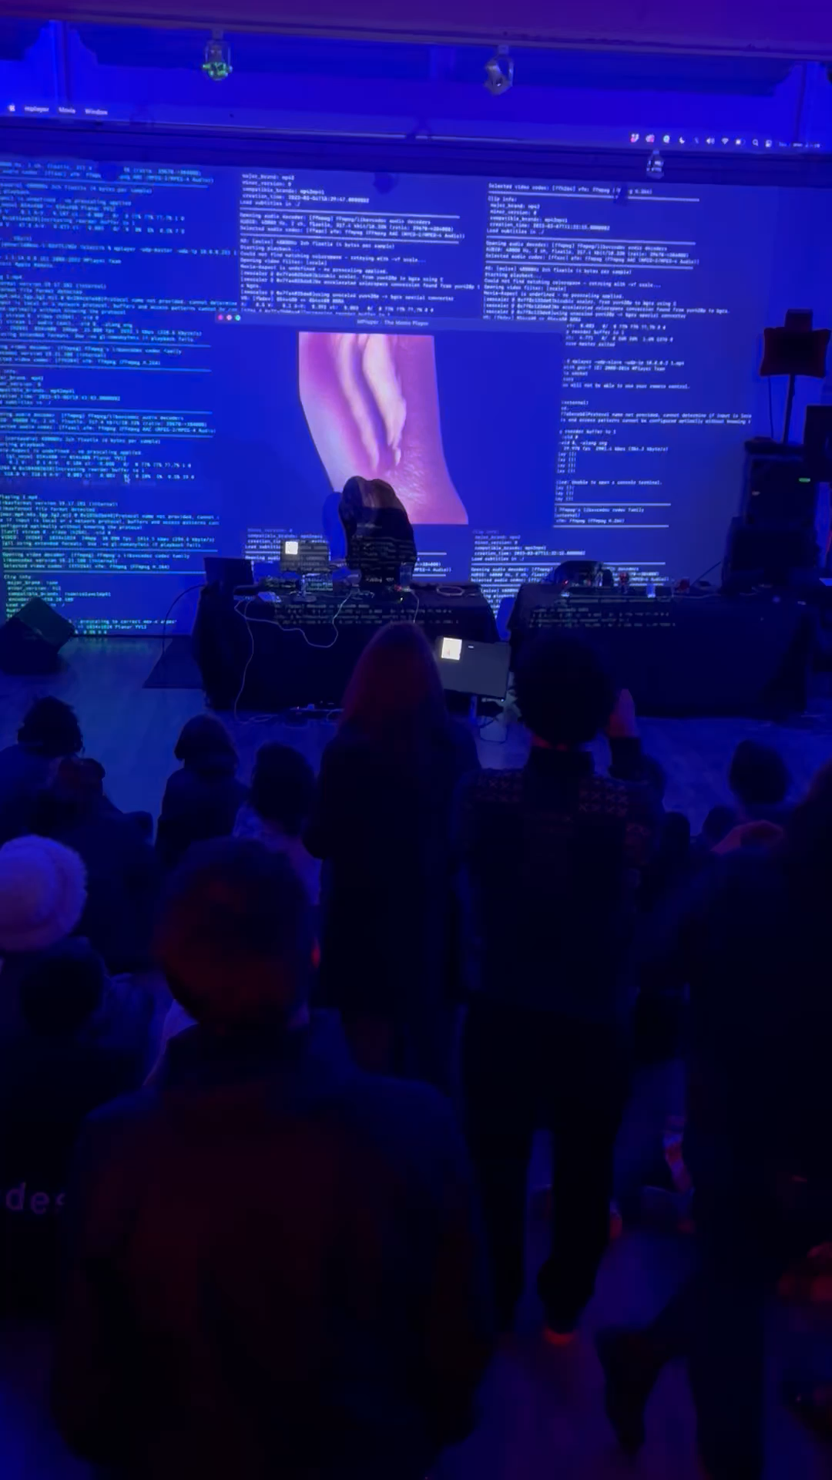
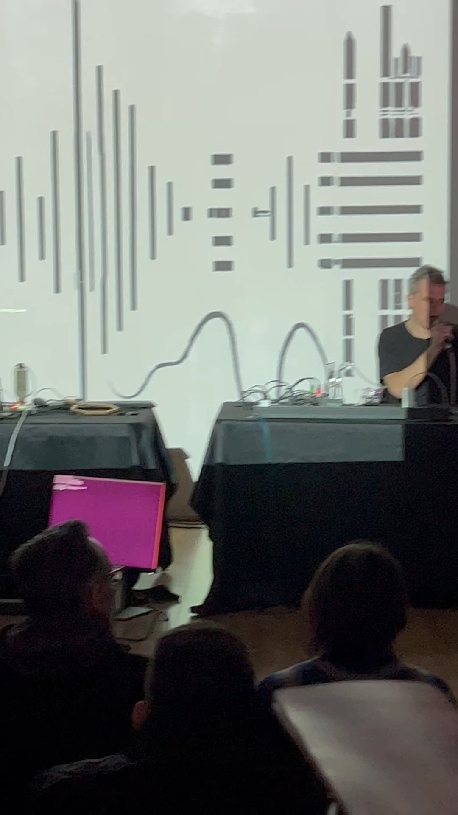
SONIC COLLECTIVE INTELLIGENCE NARRATIVES.
JOHN WILD MATT LEWIS

Slide 15
ESSENTIALS: NO. 3. COMMERCIALISATION
Web platforms: offering an educational resource with access to cutting edge / critical insight and a showcase for our work within the AI sector.
Consultancy: working with the AI industry to develop new social imaginaries that concentrate on the new topologies of the 5th Industrial Revolution.
Critical product insight and analysis for the AI sector, from story telling to gaming to new forms of moving image production, offering critical perspectives on new AI systems before deployment.
Public Policy-making - Narratives are a helpful tool to discuss and move forward public policy-making processes.
Graphic Novel - a graphic novel with technical value to AI/XR developers and communities.

Slide 16
THANK YOU.

