Slide 1

Enabling local people to participate in the design of civic and public life
Gail Ramster, The Helen Hamlyn Centre for Design, Royal College of Art
Mike Saunders, Commonplace
Notes:
Hello - My name is Gail from the Royal College of Art and I’m presenting today along with Mike from Commonplace …

Slide 2
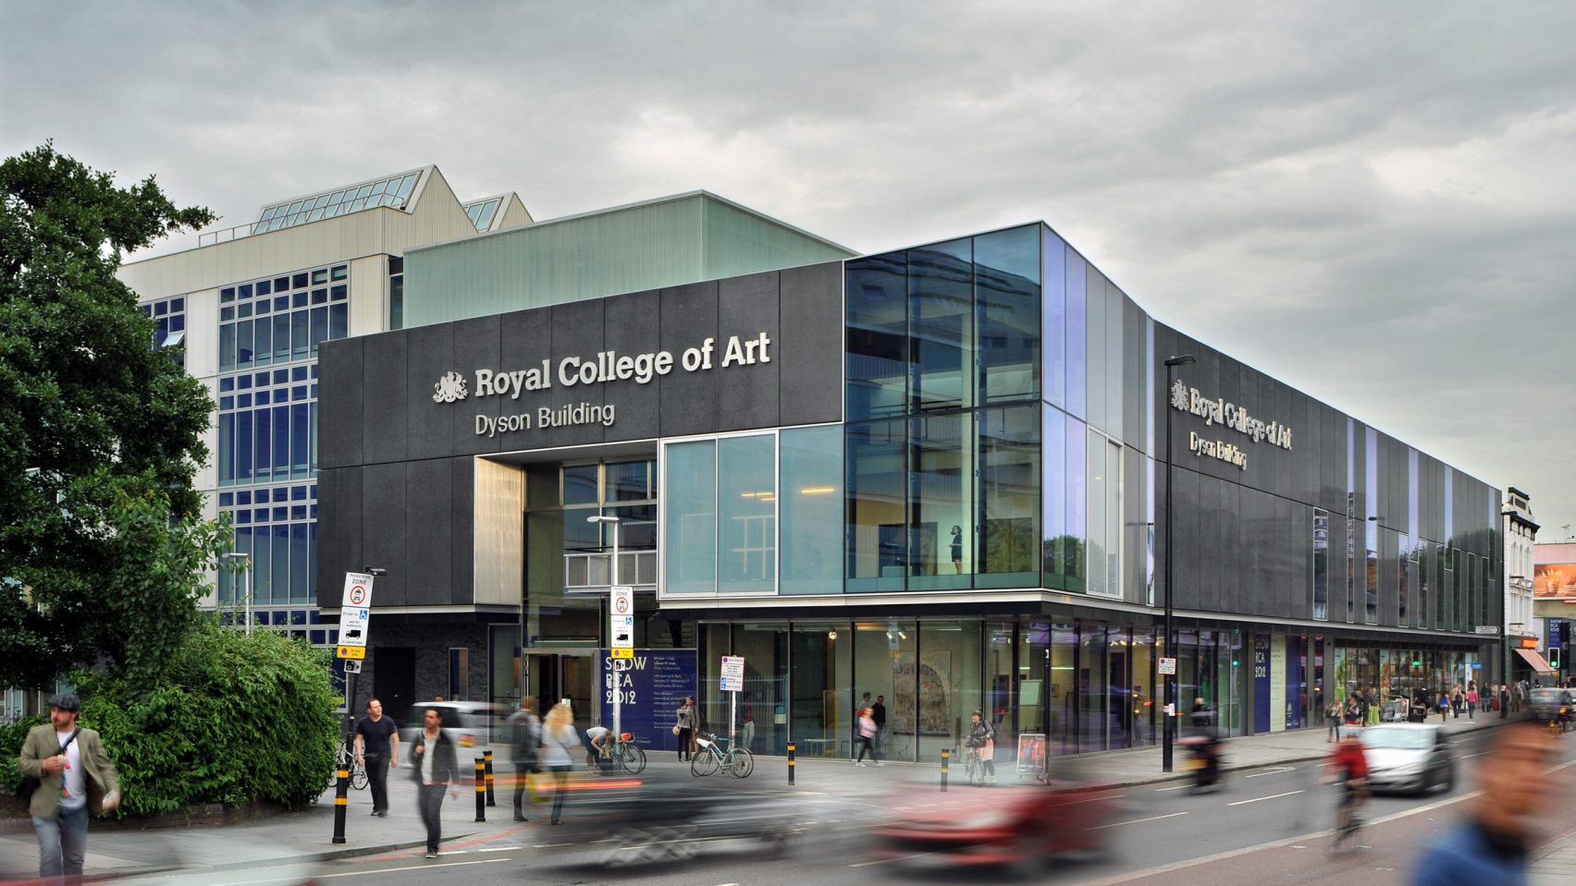
Notes:
I’m a researcher within the Research Area of Design for Social Good at the Helen Hamlyn Centre for Design, part of the RCA based in Battersea

Slide 3
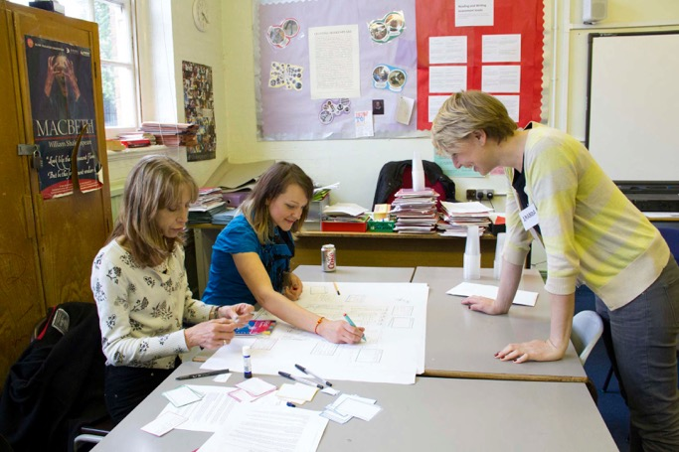
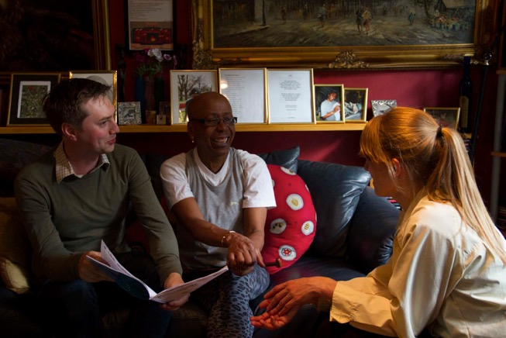
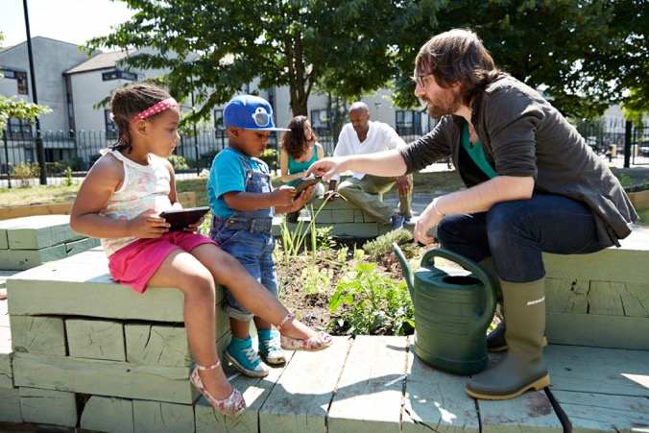
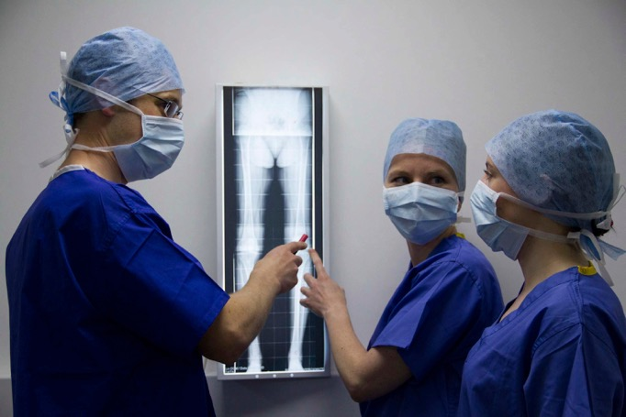
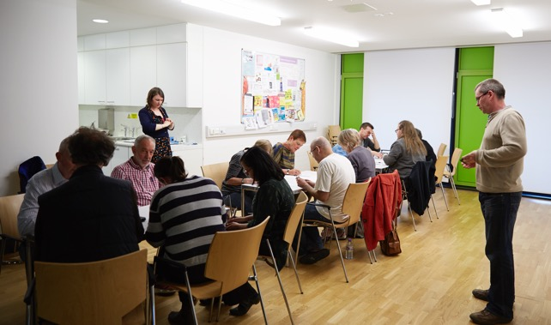
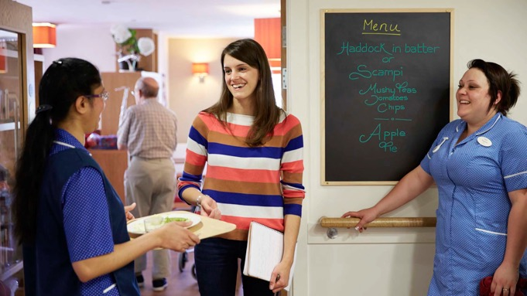
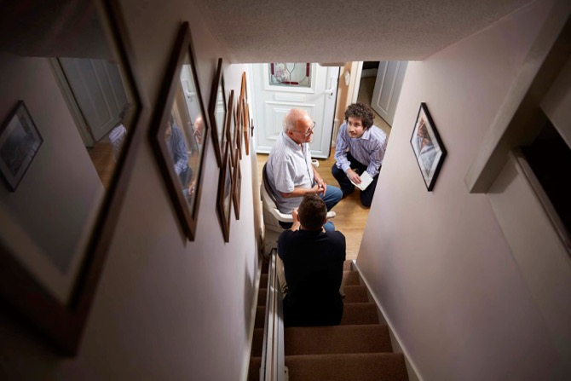
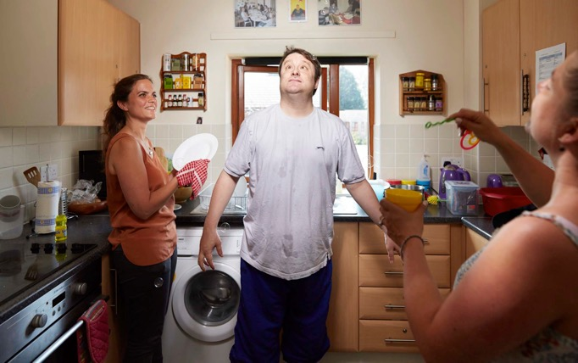
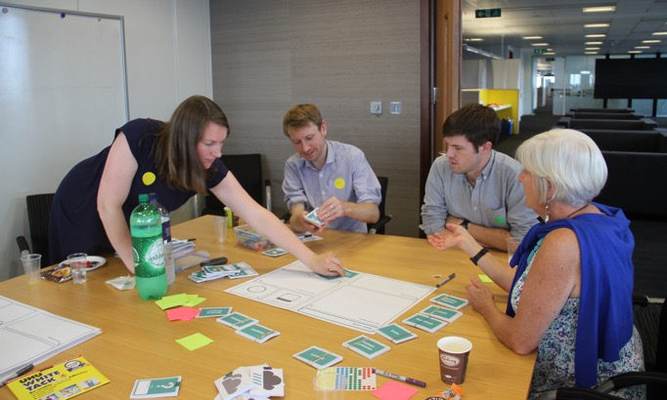
Notes:
Where we practice inclusive, people-centred design, where we don’t focus on the average person, but look at people across a diversity of needs, recognizing that everyone is different and people are the experts of their own lives – so we explore ways to design with people. Designing ways to involve people in the research and engagement is key to what we do.

Slide 4

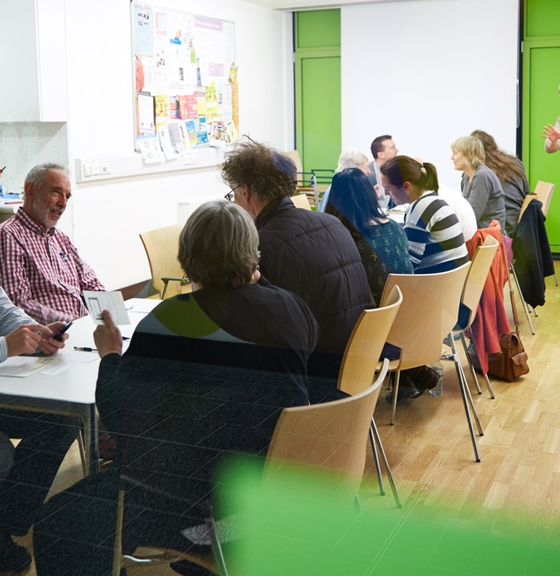
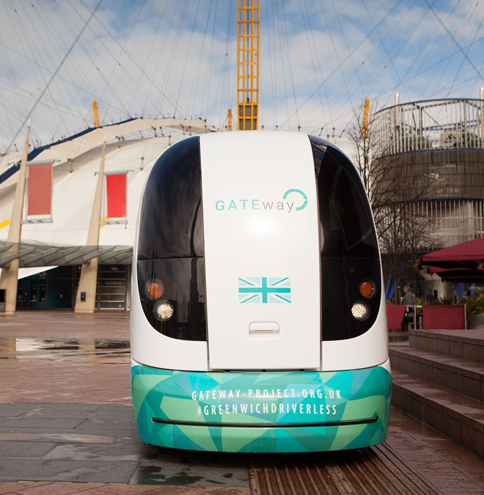
Notes:
Today I’m going to talk about 2 past projects where we used civic technology to better engage the public. Firstly Creative Citizens about community projects where we worked with the engagement platform Confers, then GATEway about Autonomous Vehicles where we partnered with Commonplace, then I’ll had over to Mike to talk more about Commonplace’ work and research.

Slide 5
Research question:
How can local residents running ‘community-led design projects’ use digital tools to engage more people’?
Notes:
In Creative Citizens we asked “How can local residents use digital tools to engage more people in their community-led projects?”

Slide 6
Research question:
How can local residents running ‘community-led design projects’ use digital tools to engage more people’?
Community-led design:
Where local people come together to design spaces or services for use by the local neighbourhood.
Notes:
What do we mean by ‘community-led design projects’ – any local project where local people have come together to create spaces or services for use by the local neighbourhood.

Slide 7
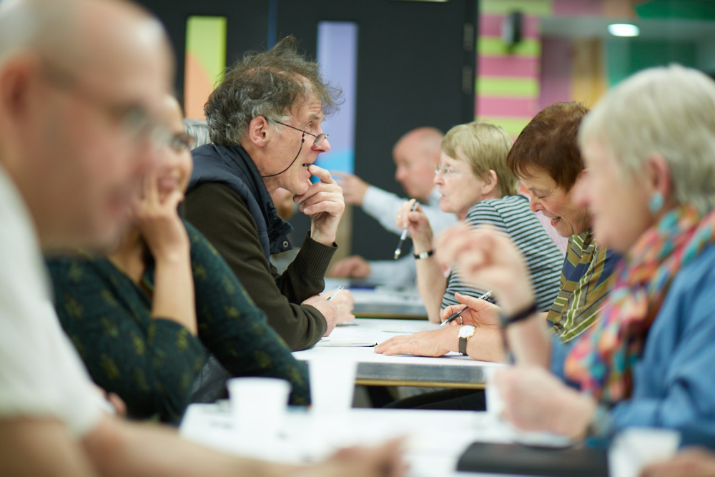
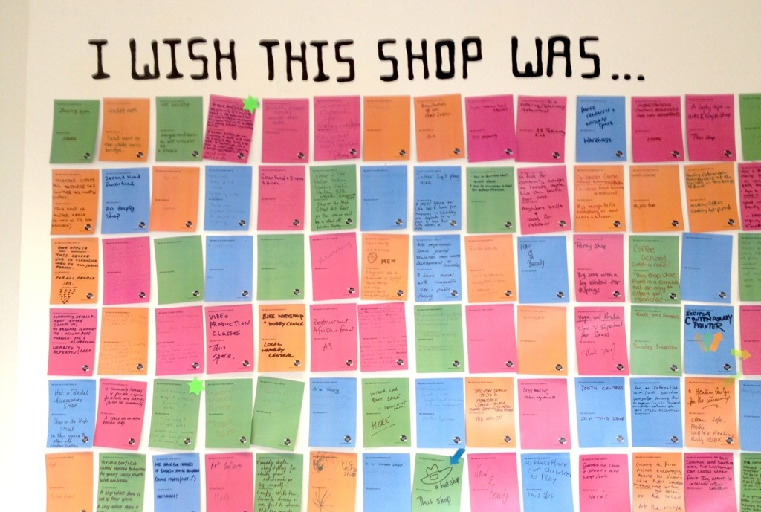
Community-led design
Notes:
For example, Kentish Town Neighbourhood Forum, are a group of local residents who were creating a Neighbourhood Plan for Kentish Town in North London. Neighbourhood Plans are a set of planning policies created by communities as a way of giving them more say over a future vision for their neighbourhood, such as greater control over what planning applications are permitted.
But in order to create a neighbourhood plan, first the forum needs to exist and grow, and the decide what is the shared vision held by the community for the future development of their neighbourhood.

Slide 8
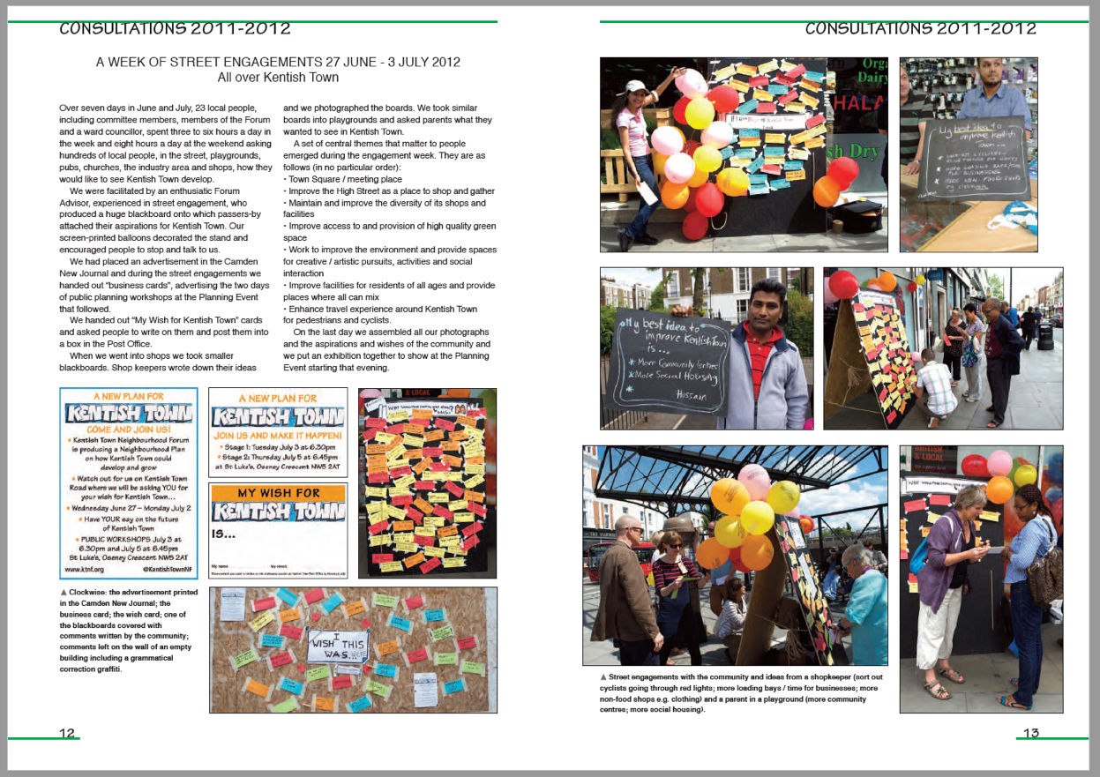
Community-led design
Image: Excerpt from KTNF Consultation Statement
Notes:
The core participants in the forum had already done a fantastic level of public engagement through street stalls, fetes and public meetings, but they wanted to engage a wider representation of Kentish Town’s 15 000 residents. This was both to hear their views to make sure the plan did represent local people (and not just those who had the time and inclination to produce a planning document), and also to increase awareness of the plan as when it was completed it would need to pass a local referendum before it would become part of the local planning policy.

Slide 9
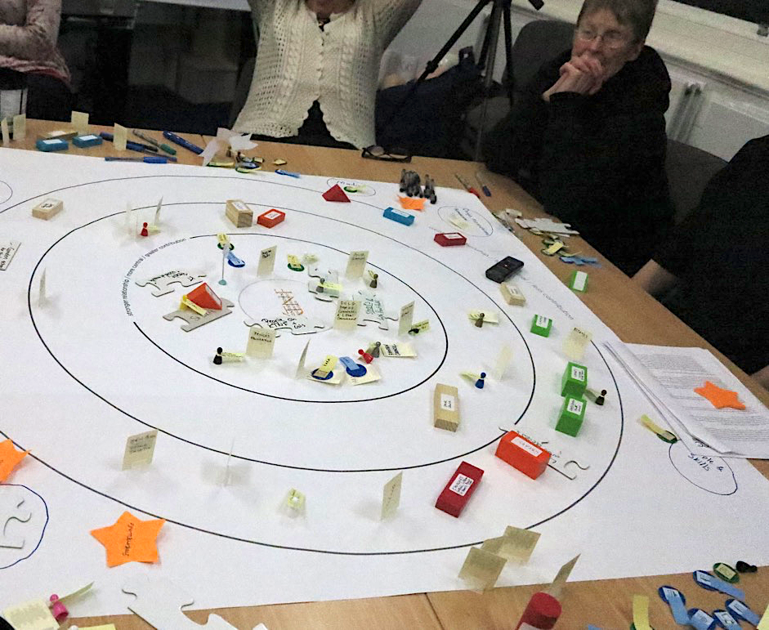
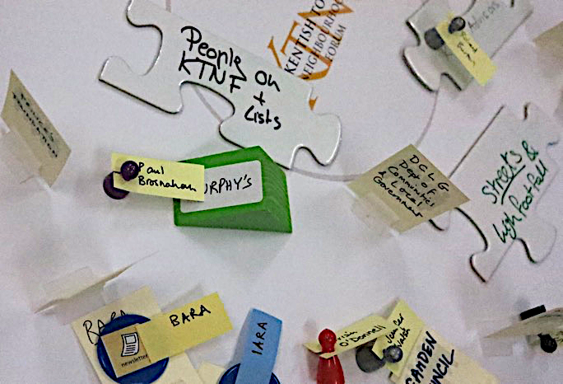
Creative Citizens Asset Mapping Workshop with KTNF
Notes:
So in order to explore how digital tools could help them with wider engagement, we ran a programme of activities with them over the course of a year.
First we ran an asset-mapping activity.
This was to identify the strengths within Kentish Town that KTNF might have or could develop links to, and it included not just physical assets such as buildings and spaces but also local groups, people, their time and skills, infrastructure and local media, as well as the forum members’ personal networks, to unearth how these assets were connected, and where there was untapped-potential.

Slide 10
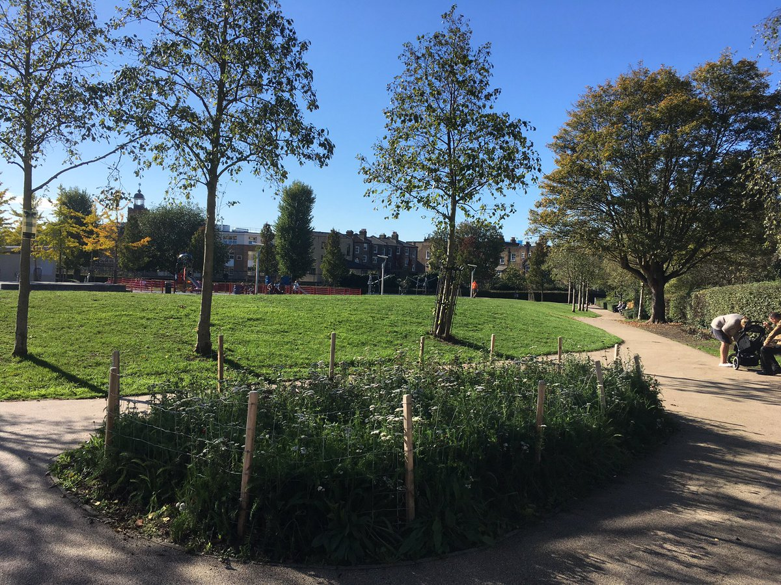
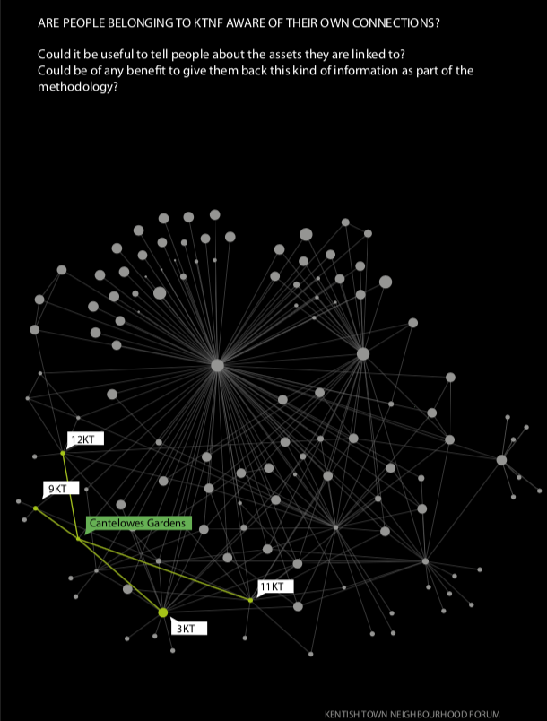
Potential assets and shared connections
Democratise the forum’s activity
Increase the available resources (people)
Increase the reach and range of the forum
Reducing strain on central team
Image: @CantelowesGrdns
Notes:
The asset mapping was a group activity with a lot of discussion, which helped the forum to reflect on their activity so far. One thing that became clear was that a lot of the local connections and promotion had been built up by a very small number 3-4 central people, and mostly by the chairperson.
By revealing more about other forum members’ interests, and using these as ways for people to get more involved, we could democratize the forum’s future activity; this in turn would increase the resources available – that is through the time, skills and interests of the members.
The extra resources and activity would increase the reach and range of the forum, and finally this would reduce the considerable strain on that core team of people, all volunteers, ultimately making the forum more robust.
For example, by exploring their personal networks, we found shared interests between 4 unconnected forum members through their different uses of the same local park, Cantelowes Gardens (for dog walking, for their children’s use of the skate park). Could these individuals become a team focused on using the park for engagement activities? Could those activities then feed into the plan around the future of Kentish Town’s parks and green spaces?

Slide 11
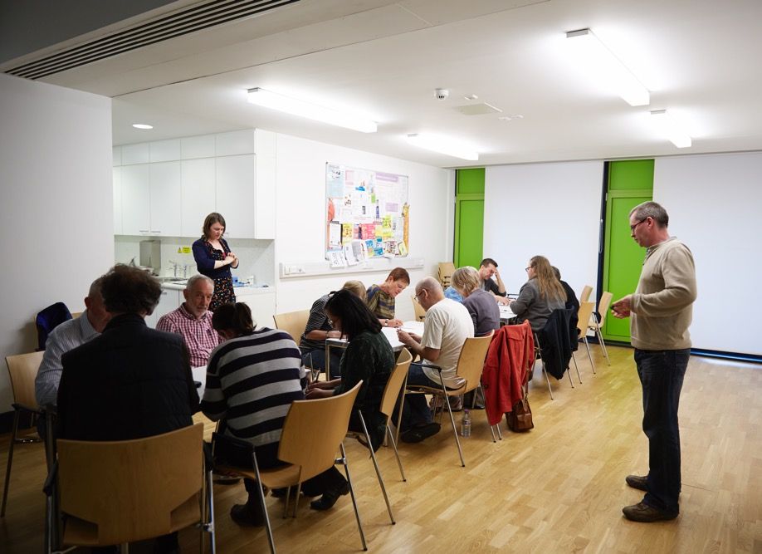
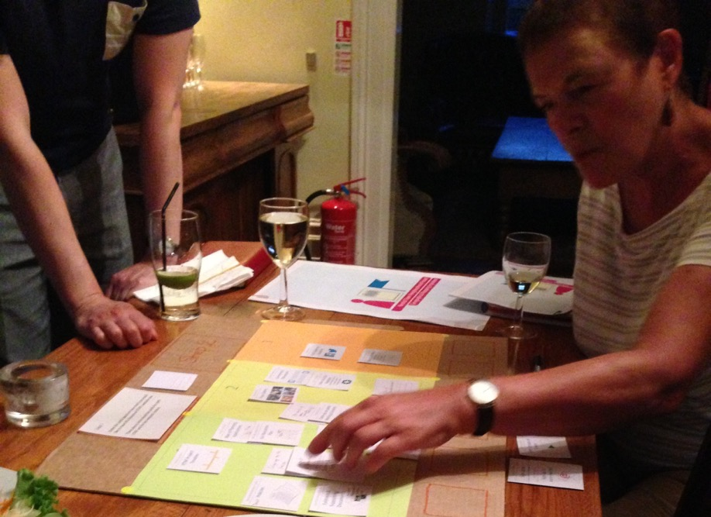
Creative Citizens KTNF Co-Design Workshops
Ideas generation
Digital tools design iteration
Notes:
We went on to run a series of co-design workshops, focusing on digital tools and generating ideas for these , and how they could assist the Forum in getting a wider audience, more representative views and ultimately stronger support for their Neighbourhood Plan.

Slide 12
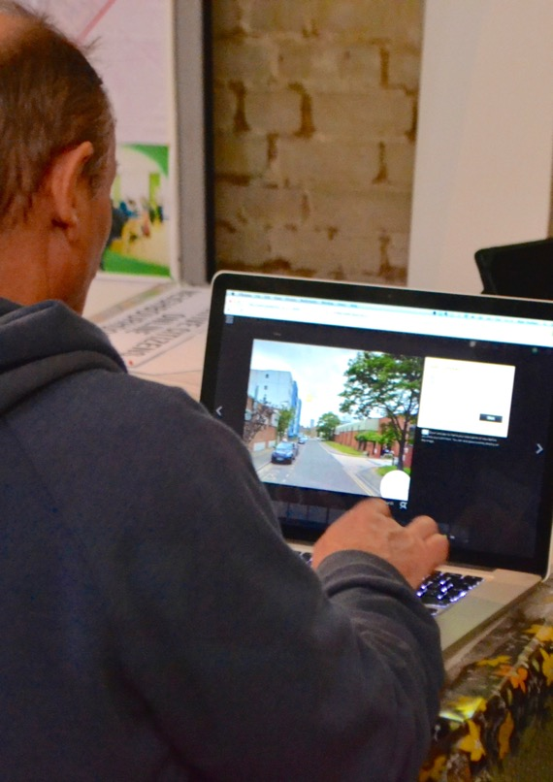
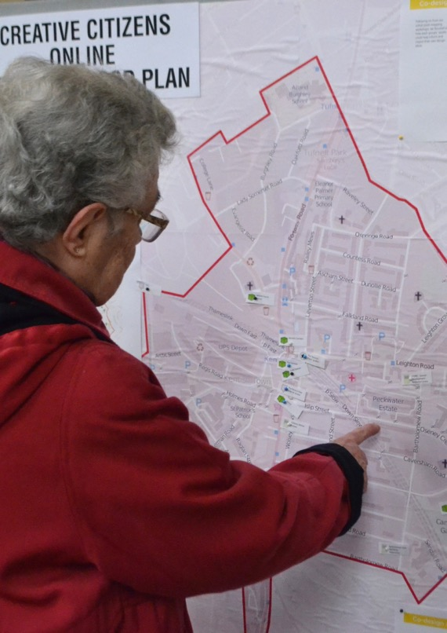
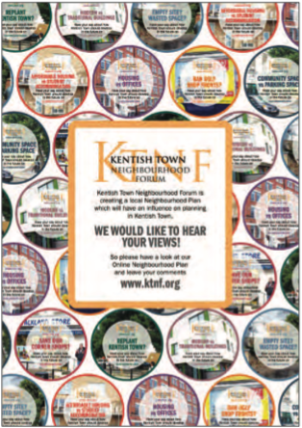
1. Online engagement platform
2. Further face-to-face engagement
3. Promotion in built environment
Notes:
Through our series of workshops we identified three key actions –
The need to get the draft plan online through an online engagement platform. There were plenty of people that would be interested in this future vision of Kentish Town but who were simply unable or unwilling to go to a community meeting in a community centre or church hall, which was where the core meetings took place. An online platform would allow the forum to invite a wider audience to be more involved but in their own time and on their own terms.
The second action was for further offline engagement, by us, to get the questions and the language right for the online engagement platform, to make sure it was effective.
And finally we needed a physical way to promote the online plan within the built environment.

Slide 13
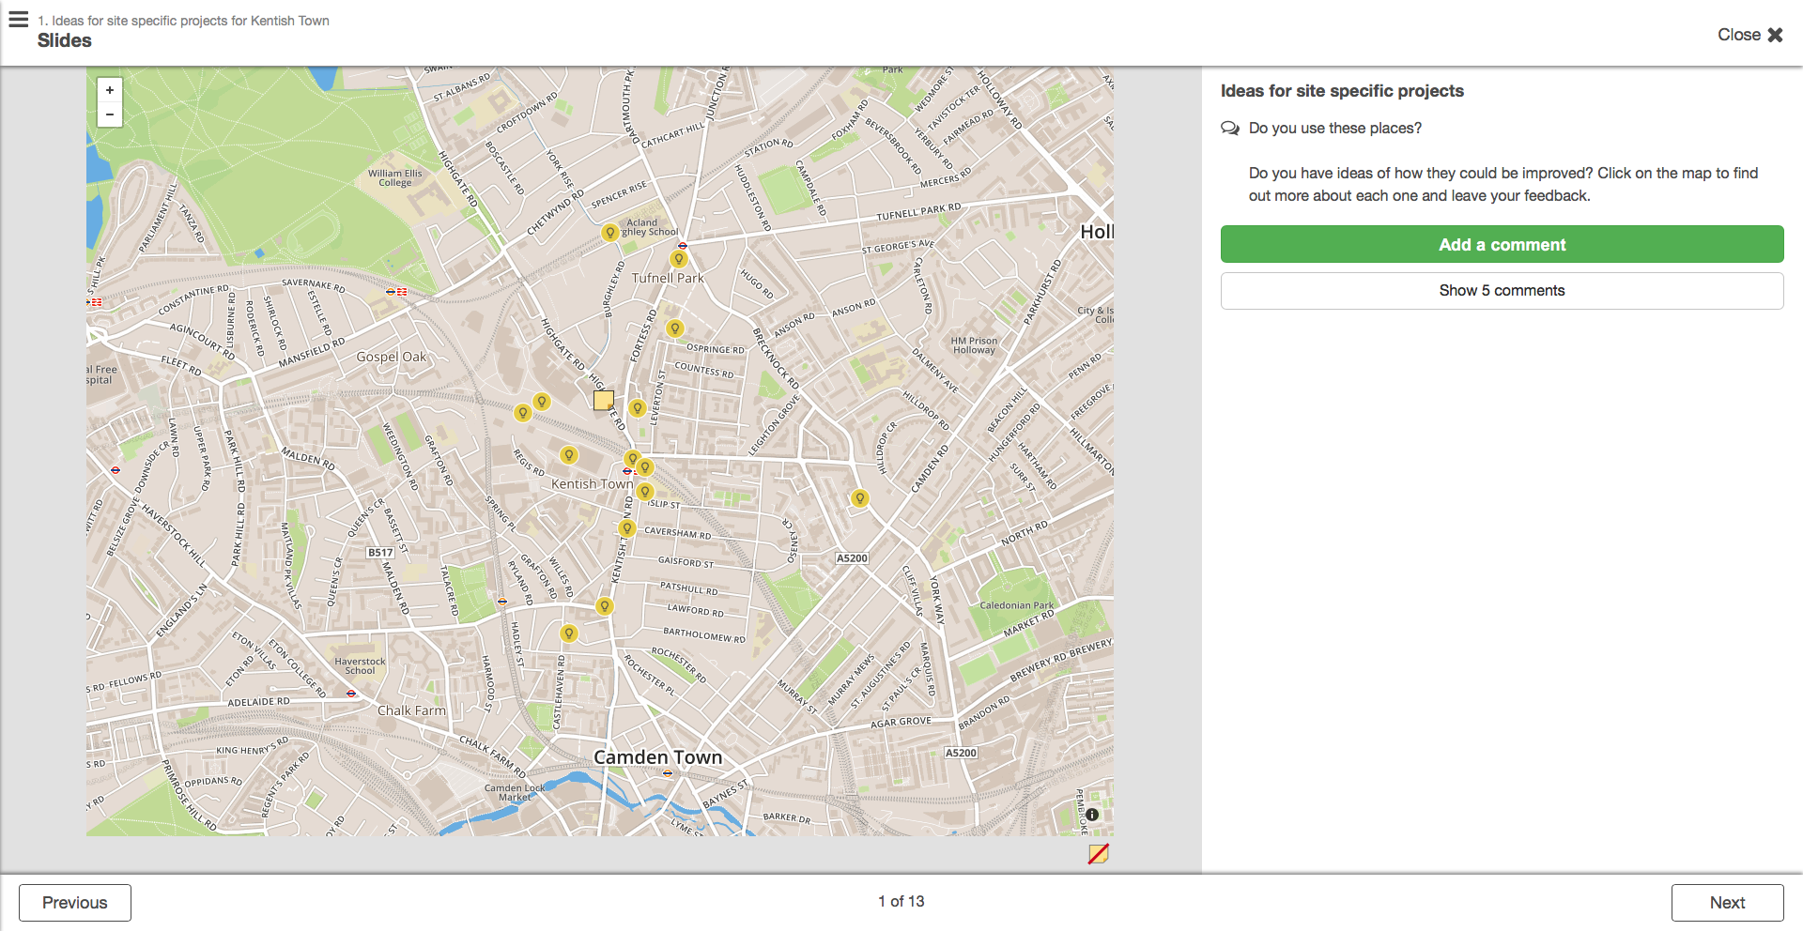
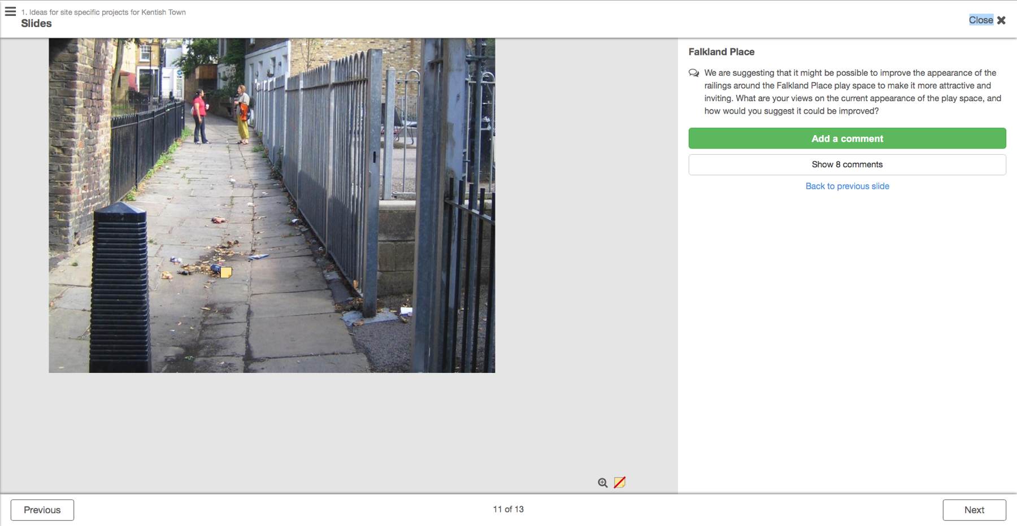
Notes:
So we worked with them to create an online version of their plan using the engagement platform Stickyworld, now called Confers. This platform allows to hosts, in this case the forum, to create 360 degree photographs of the local area, and for the audience, the people of Kentish Town, to tag these photos with their comments.

Slide 14
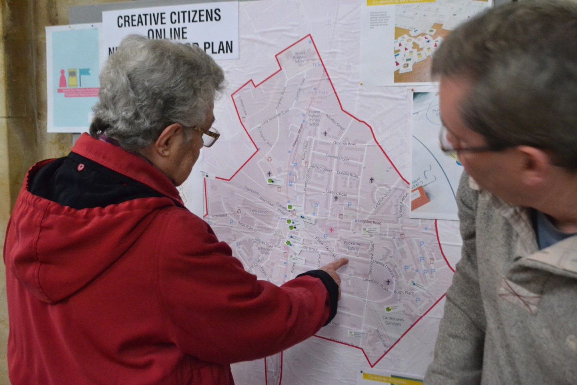
Notes:
We continued to engage with the public to find out what issues would attract them to get involved in the online plan and how we could best word them to get the discussion going, whilst still making sure that these resulted in meaningful, useful contributions for what is ultimately quite a dry planning document.

Slide 15
Notes:
By choosing to partnering with us on a research project, Stickyworld had an opportunity test new features, such as map-based tagging and location-specific ideas, indicated by the lightbulbs. These screenshots are several years old so please take a look at Confers website to see the latest features and applications.

Slide 16
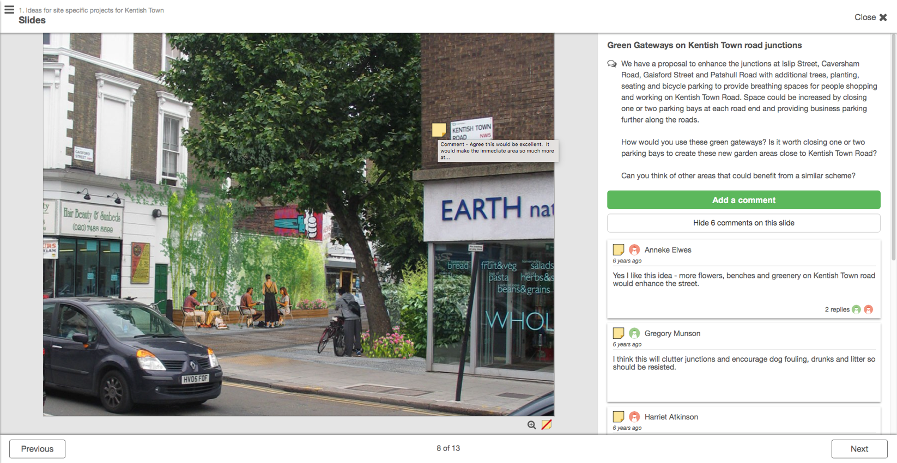
Digital media is often focused on as a cure-all solution for communities but we think it is important to recognise the value of other types of media. Put together these should be seen as complementary tools in the creative citizen’s toolbox.
Notes:
We could then bring these ideas to life by including visualisations in place of the photographs. The reason for including ideas which might be out of the scope of the plan itself was that we were encouraging the Forum to also think beyond the referendum, when they would continue to exist, but would need a new outlet for their interest in the local area that made the most of the connections – to social capital-created through this ardous process of creating a neighbourhood plan, such as campaigning for and realising their own local built environment projects.

Slide 17
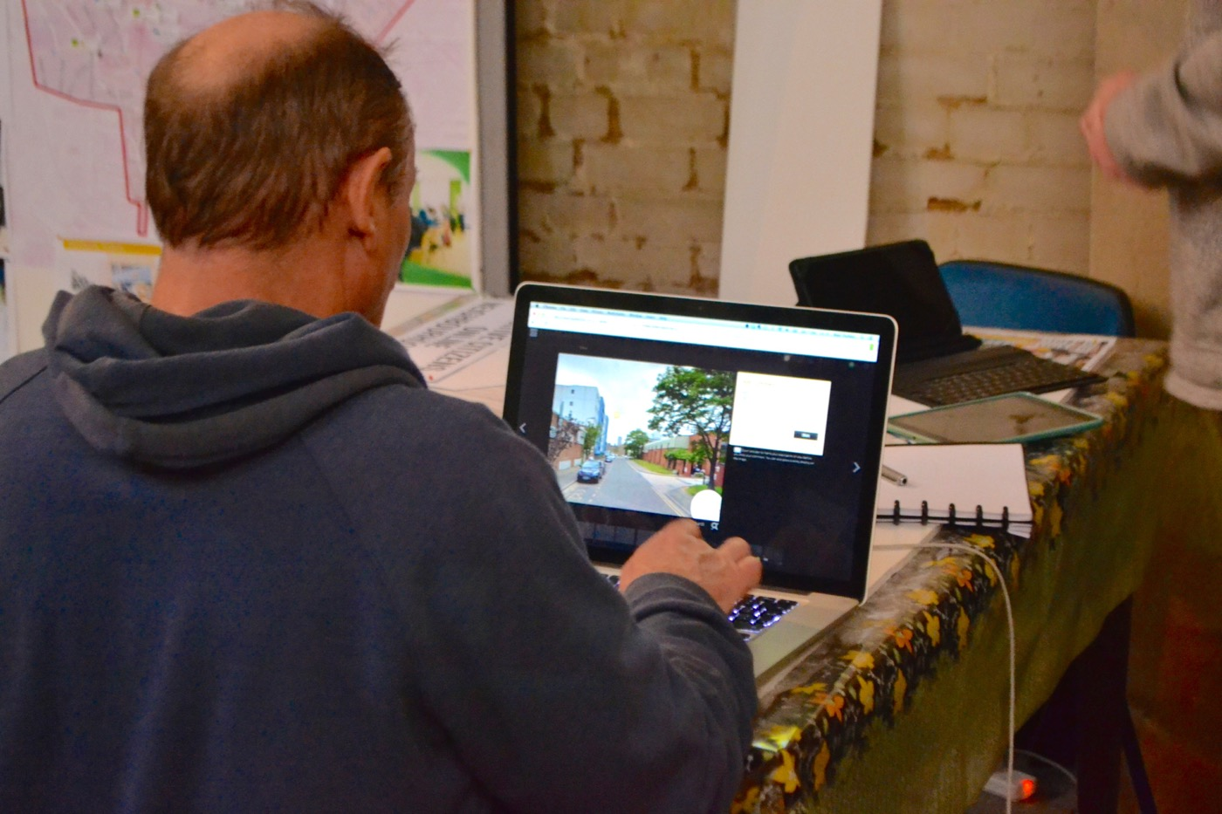
Notes:
We found that the benefits of digital media can beat odds with the real-life practicalities faced by communities in making them work in the way that they want.
So as hosts of the engagement platform, the forum required certain skills, time and commitment to make it work well, so the platform needs to be really simple for them to set-up as well as intuitive for the wider audience to use.

Slide 18
Notes:
Finally, one of the assets that emerged through our activities was the fantastic range of local pubs in Kentish Town. The Forum members were already well connected to them since they were always on the lookout for spaces that they could book to host their meetings and enjoyed trying new venues.
During our co-design activity, one forum member had the ideas of creating beermats to publicise the forum.

Slide 19

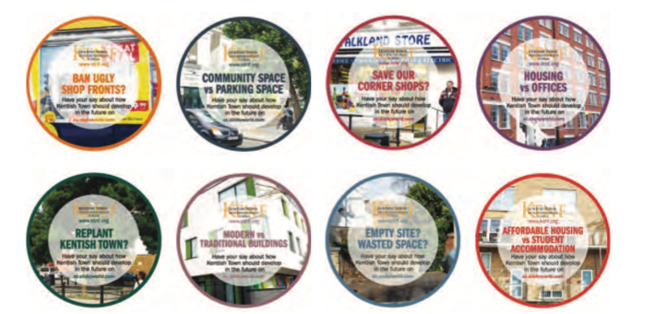
Notes:
We used the beer mats to pose the sorts of difficult questions that the forum had been grappling with since the start, and encourage people to visit the online forum and add their views. This, along with the face-to-face engagement when designing the platform questions, demonstrates how we don’t see online tools as replacements for face-to-face or print engagement, but as an additional tool to be woven into an engagement strategy where it is of added benefit.

Slide 20
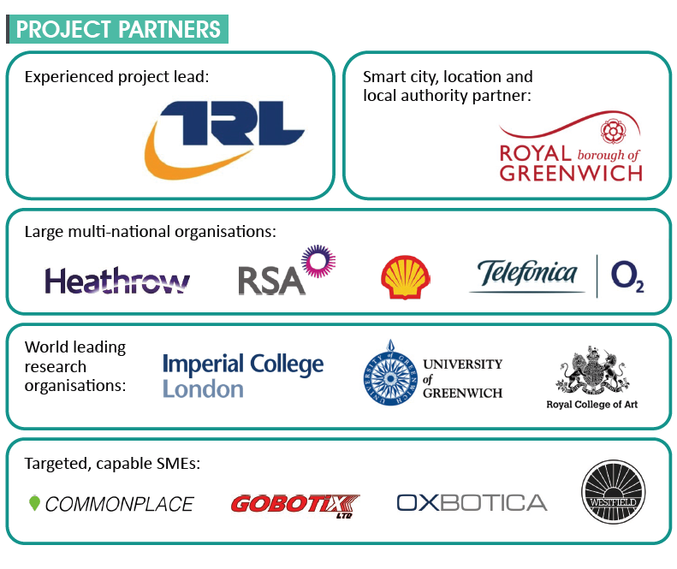

Notes:
GATEway - Greenwich Automated Transport Environment – was a multi-million pound project funded by Innovate UK to understand and overcome challenges of implementing automated vehicles in an urban environment
So it achieved this through trials of driverless cars, with the public, around the Greenwich Peninsula.
It was led by TRL, the Transport Research Laboratory, with many partners including the RCA and Commonplace

Slide 21
To engage with people to understand attitudes towards and perceptions of autonomous vehicles
To capture passenger and operator behaviour during public trials when travelling in autonomous vehicles
To use these insights to inform the design of future vehicles, services and infrastructure
Notes:
Our roles were both within the Engagement plan, predominantly engagement with the public.
We had three core objectives:
1. To engage with people to understand attitudes towards and perceptions of AV
2. Capture passenger behaviour when travelling in AVs during public trials.
3. Use these insights to inform the design of future vehicles, services and infrastructure.

Slide 22
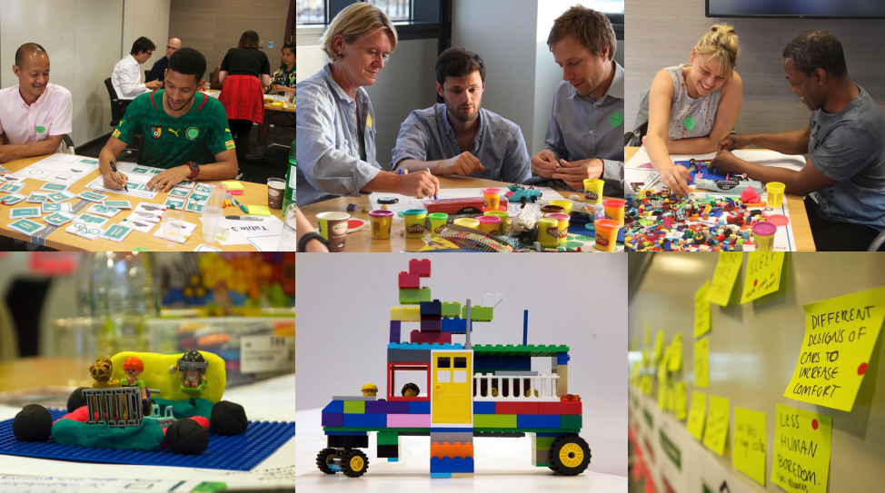
Notes:
The RCA ran 8 pre-trial co-design workshops with 110 people. These included people with additional needs, older people, parents, carers, driving enthusiasts, non-drivers, and technology enthusiasts.
They were designed to capture participants hopes and fears, and opportunity areas that autonomous vehicles could address. We then invited the participants back later in the year to take part in the driverless shuttle trials and see what affect that had.

