Slide 1
IJADE Conference
22-3 Feb/2019
DRAWING INCLUSIONS:
Strategies for Teaching Dyslexics and non-Dyslexics
Qona Rankin (Royal College of Art)
Howard Riley (Swansea College of Art)

Slide 2
Imagine an activity for which an ability to set language aside becomes a distinct advantage – a strength.
To be able to look without language; without words affecting what you see, an activity where words wither away, where visualcy, not literacy, becomes the most important asset: an activity in which dyslexics and non-dyslexics alike share a common ground.

Slide 3
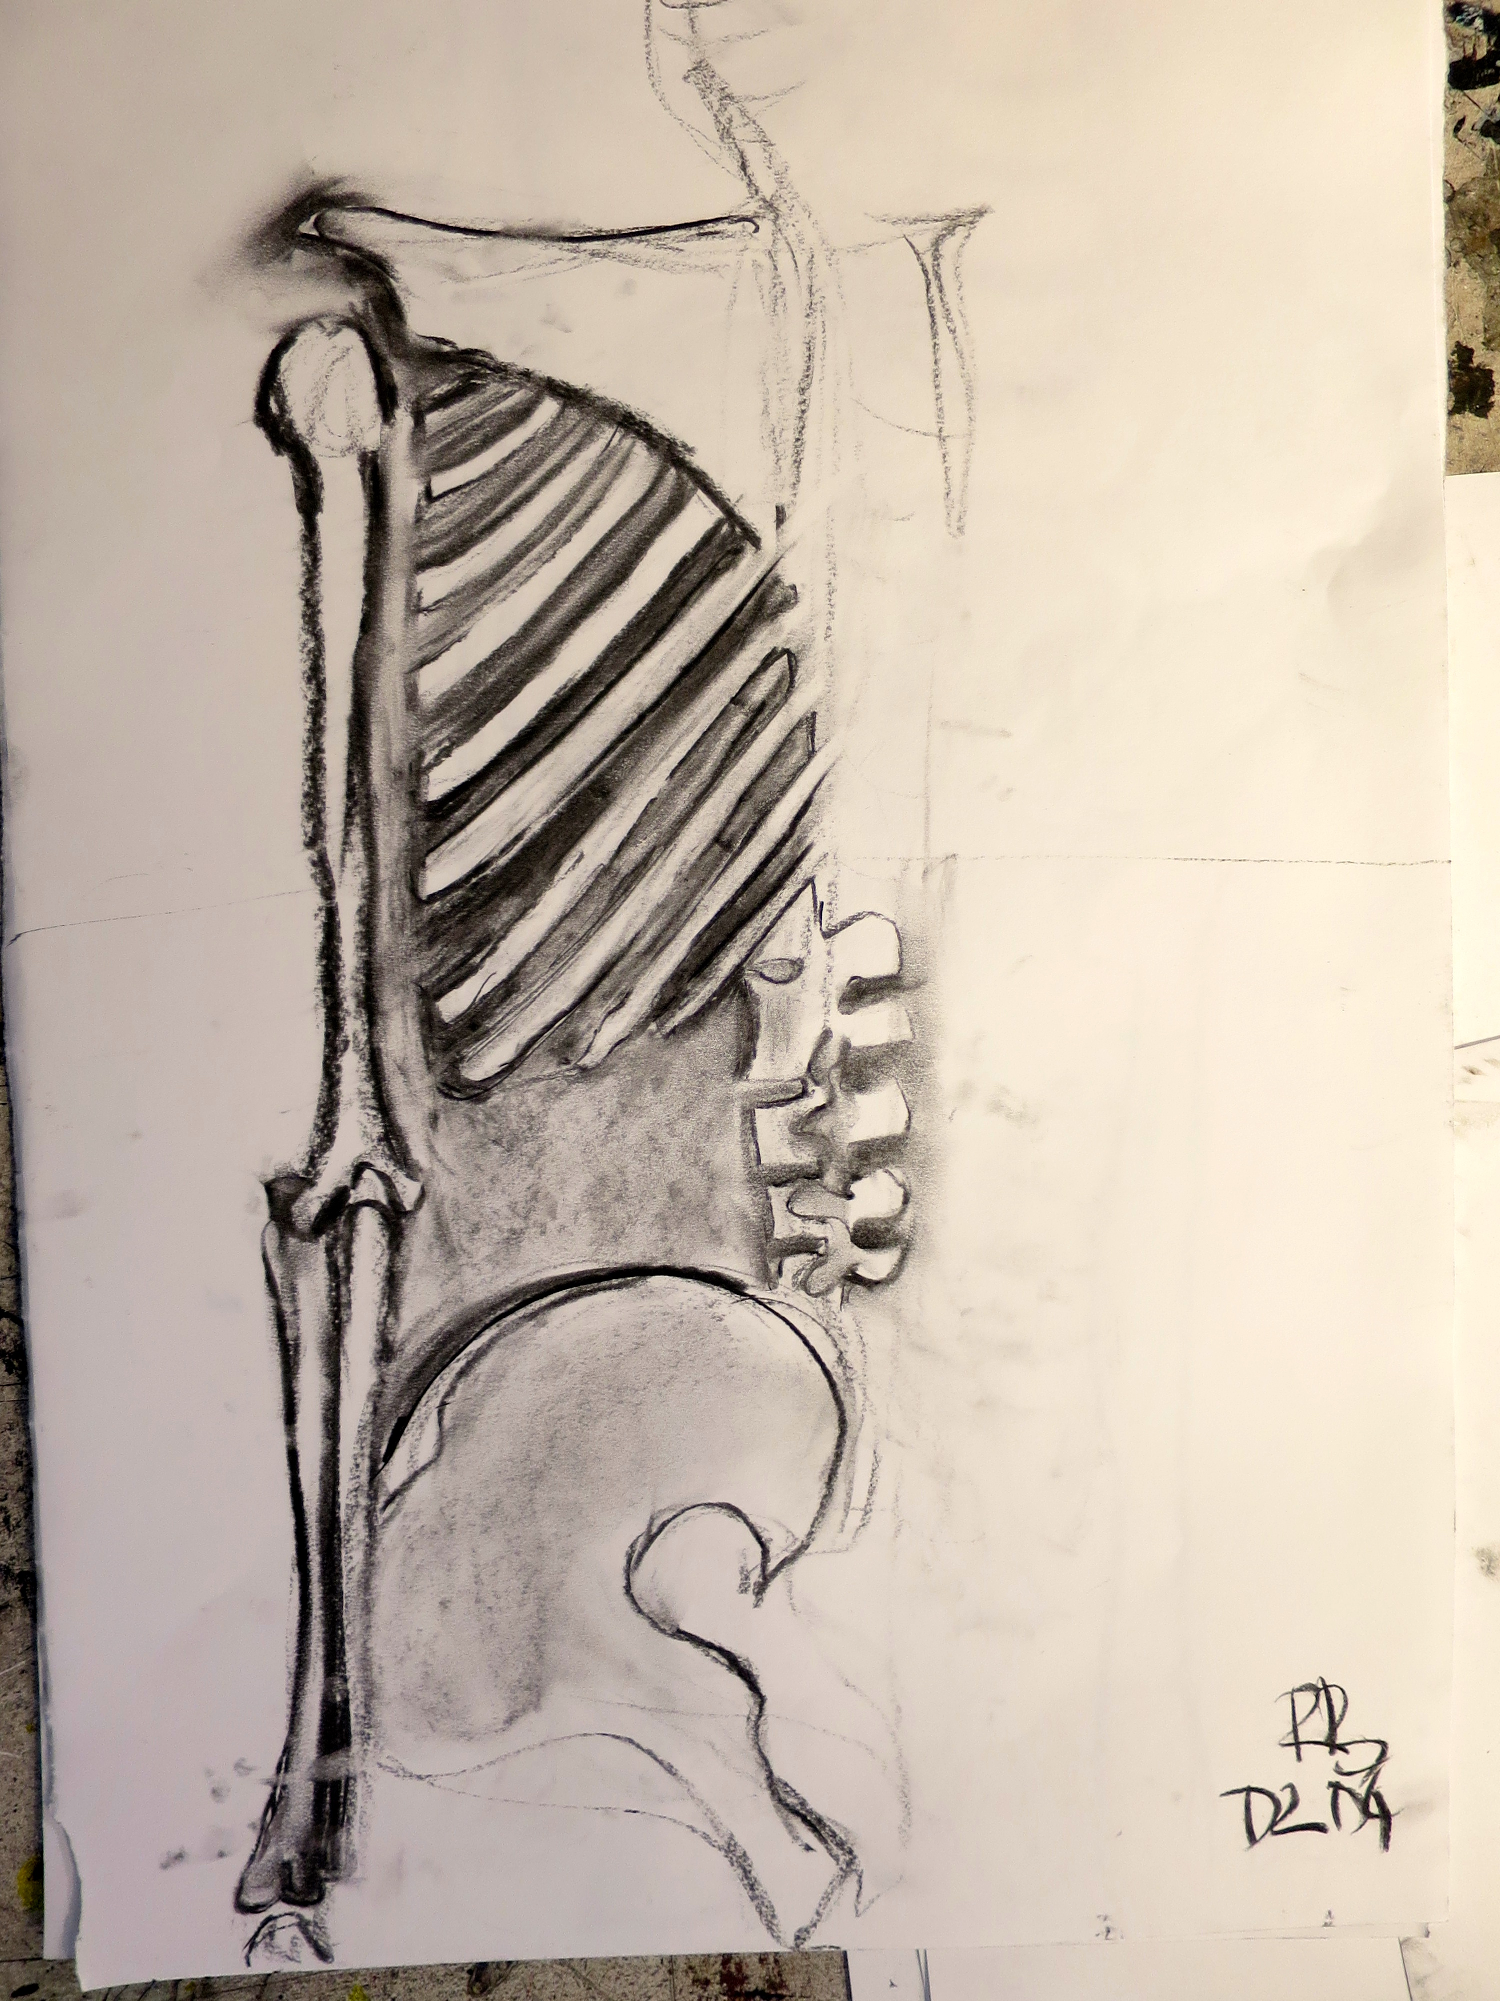
“I’ve made it look so flat that I can’t distinguish what is what anymore.”
“I’m trying to find out where things begin and things end and the relationship between the lines that intersect these spaces and I’m getting very tired and very confused.”
“I got distracted by all the surface detail.”

Slide 4
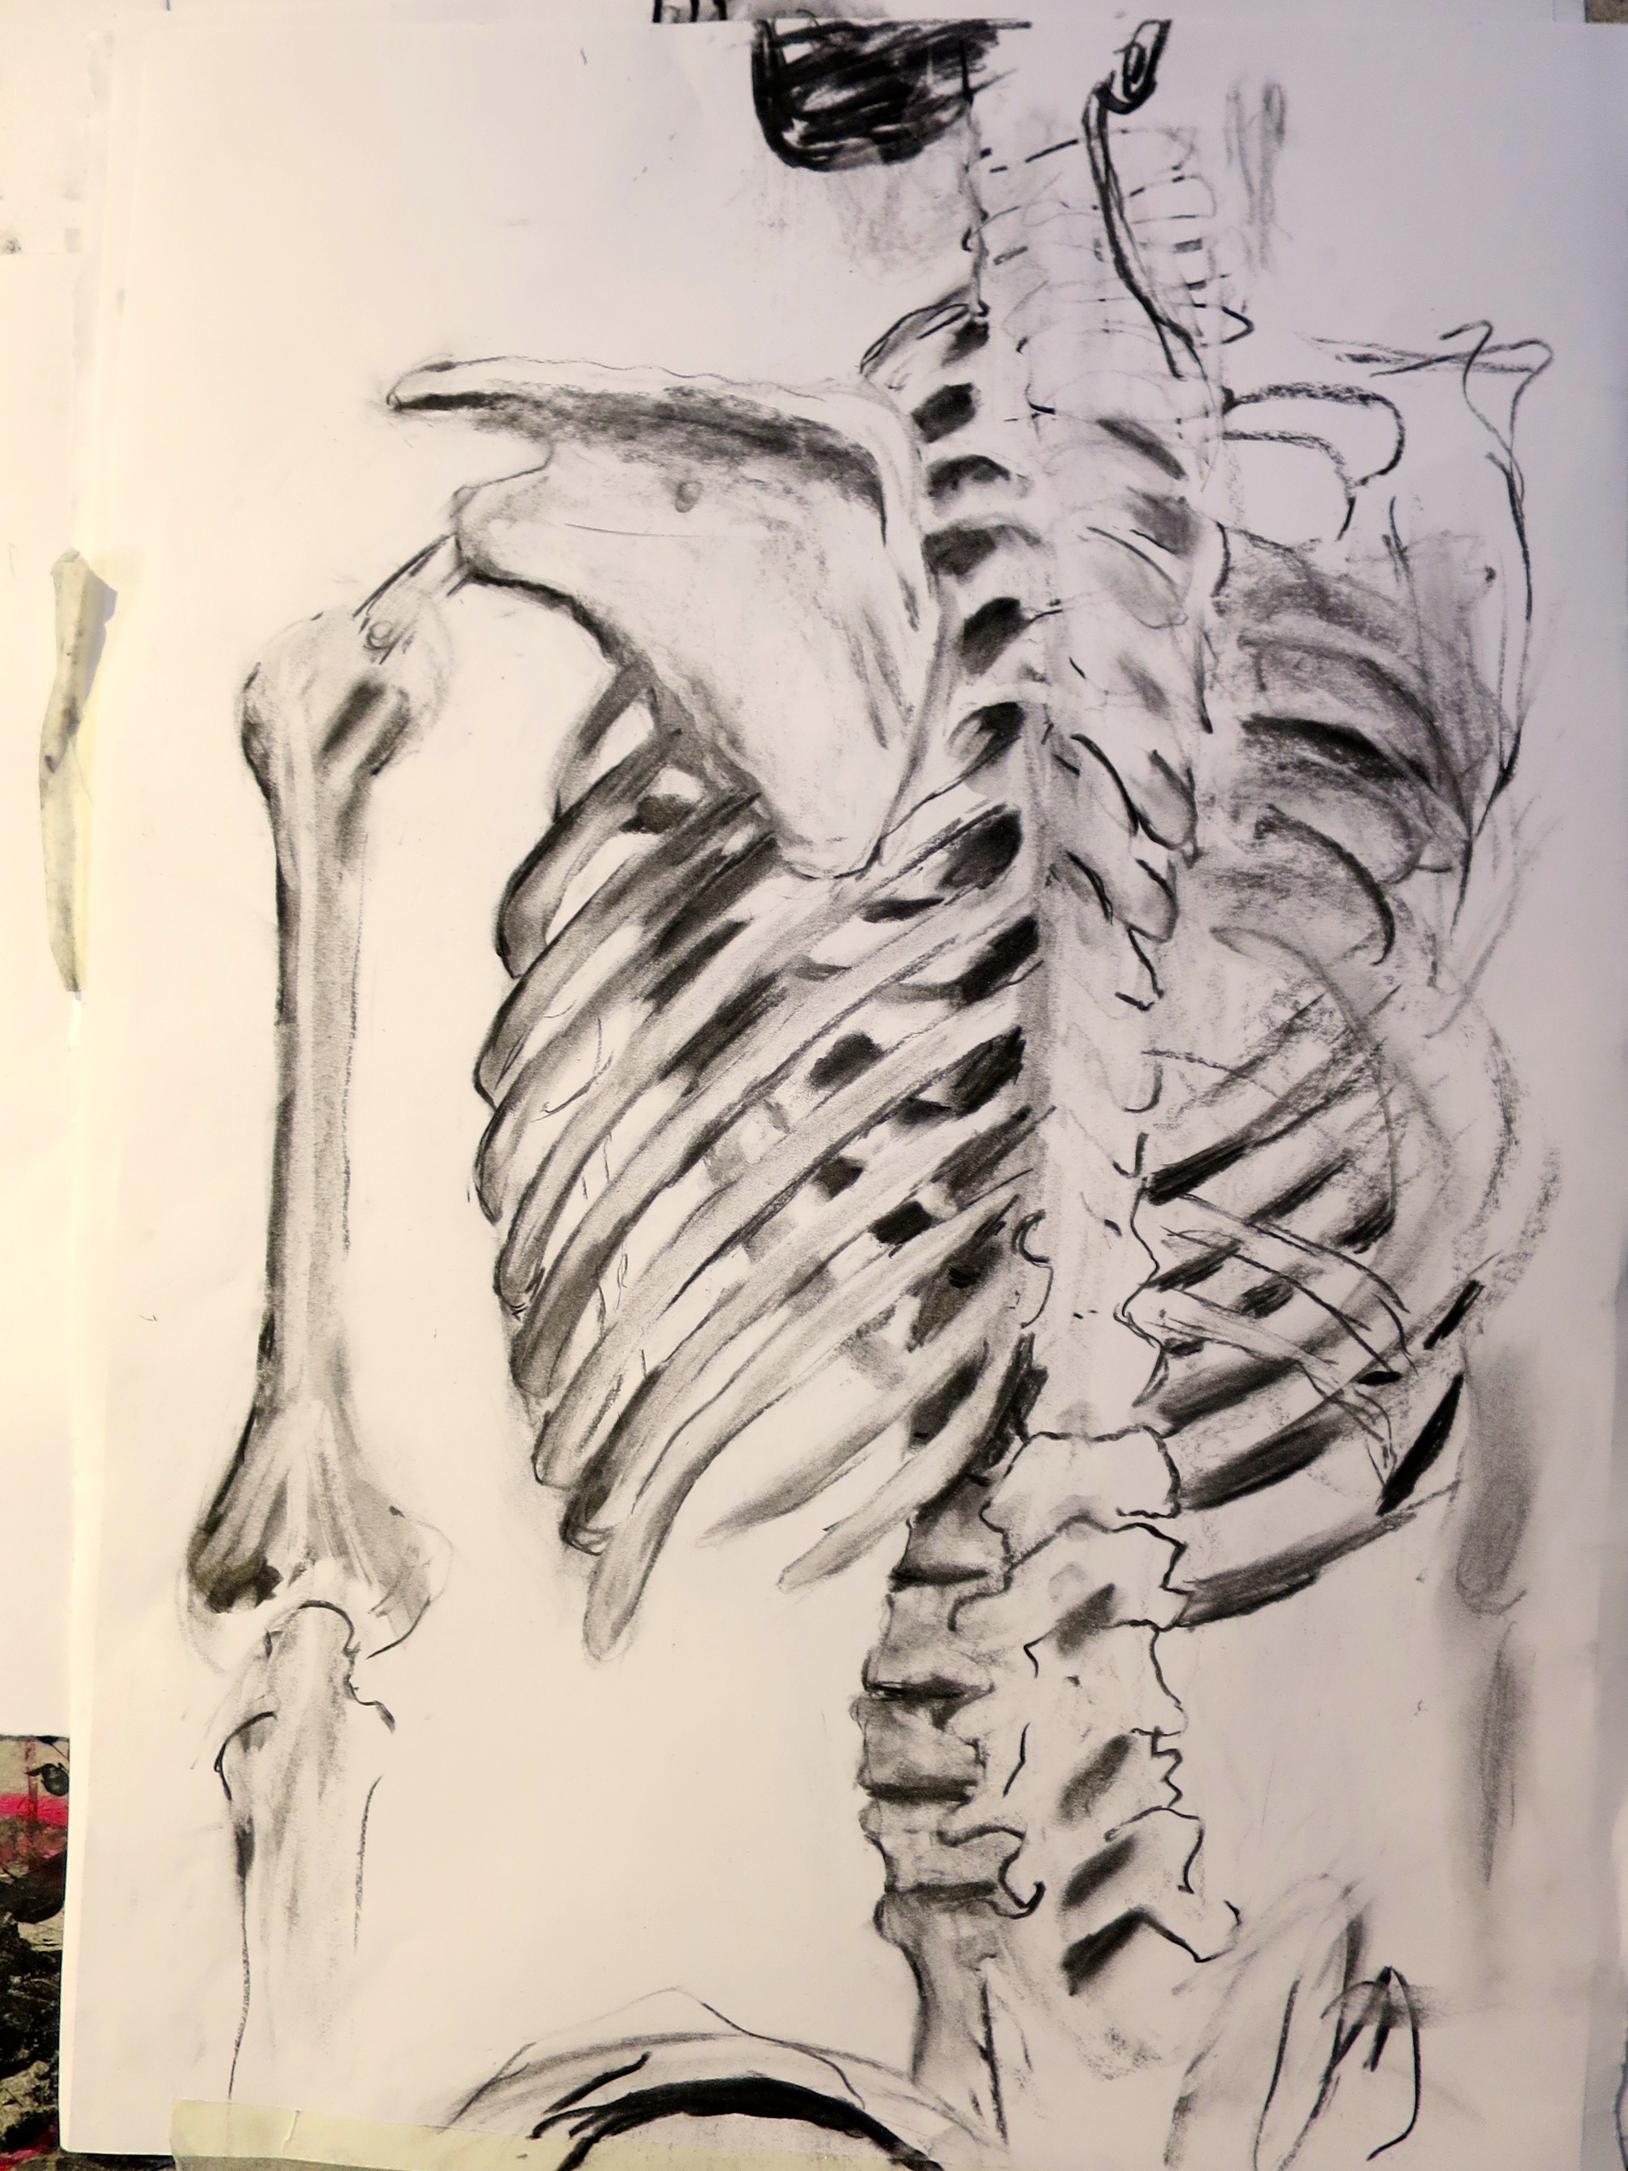
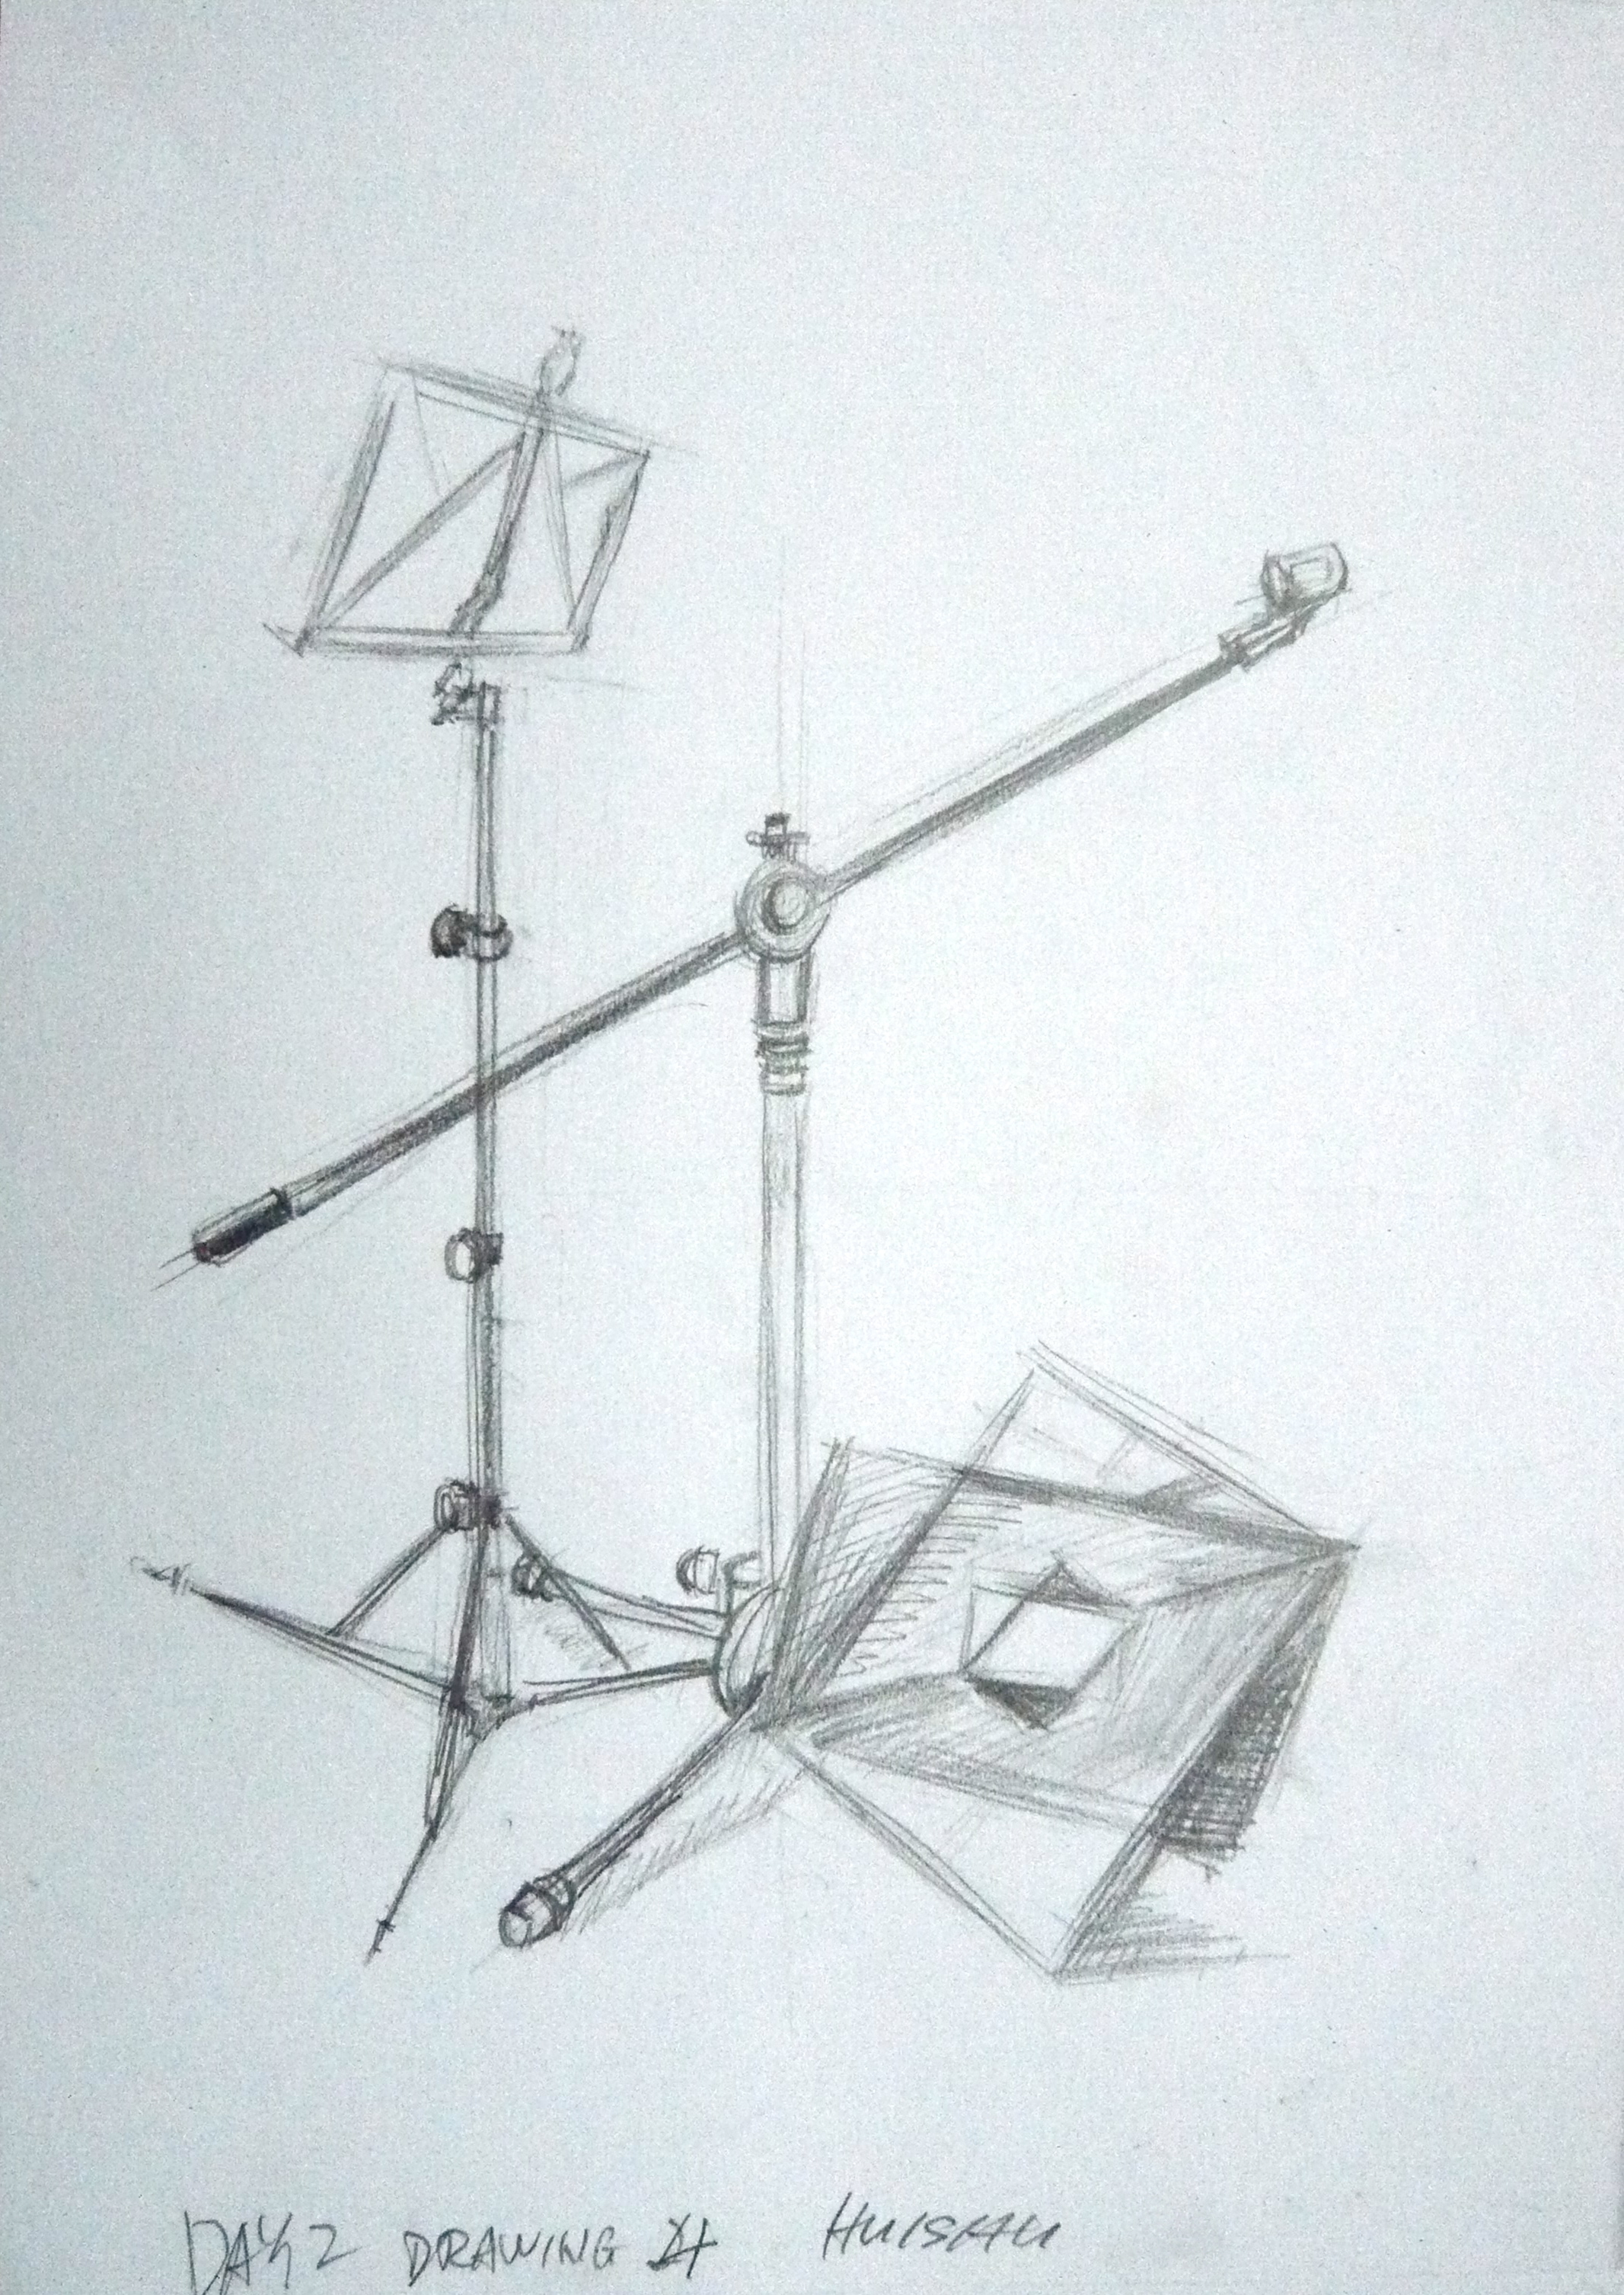
Eye-tracking, short-term memory and motor co-ordination.
.

Slide 5
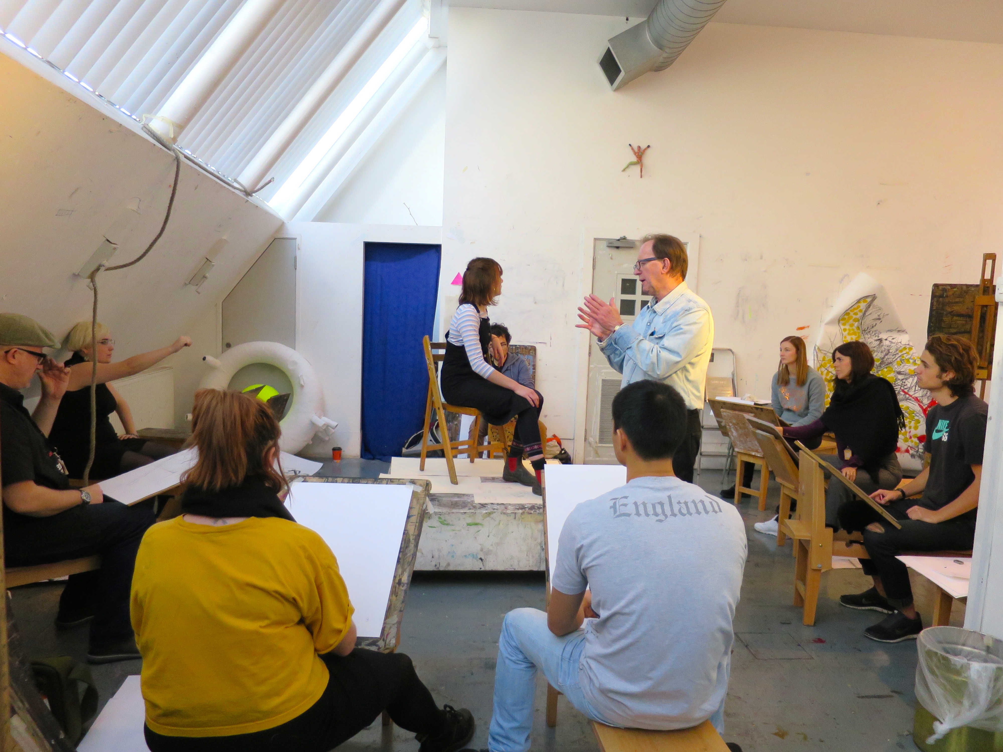

Slide 6
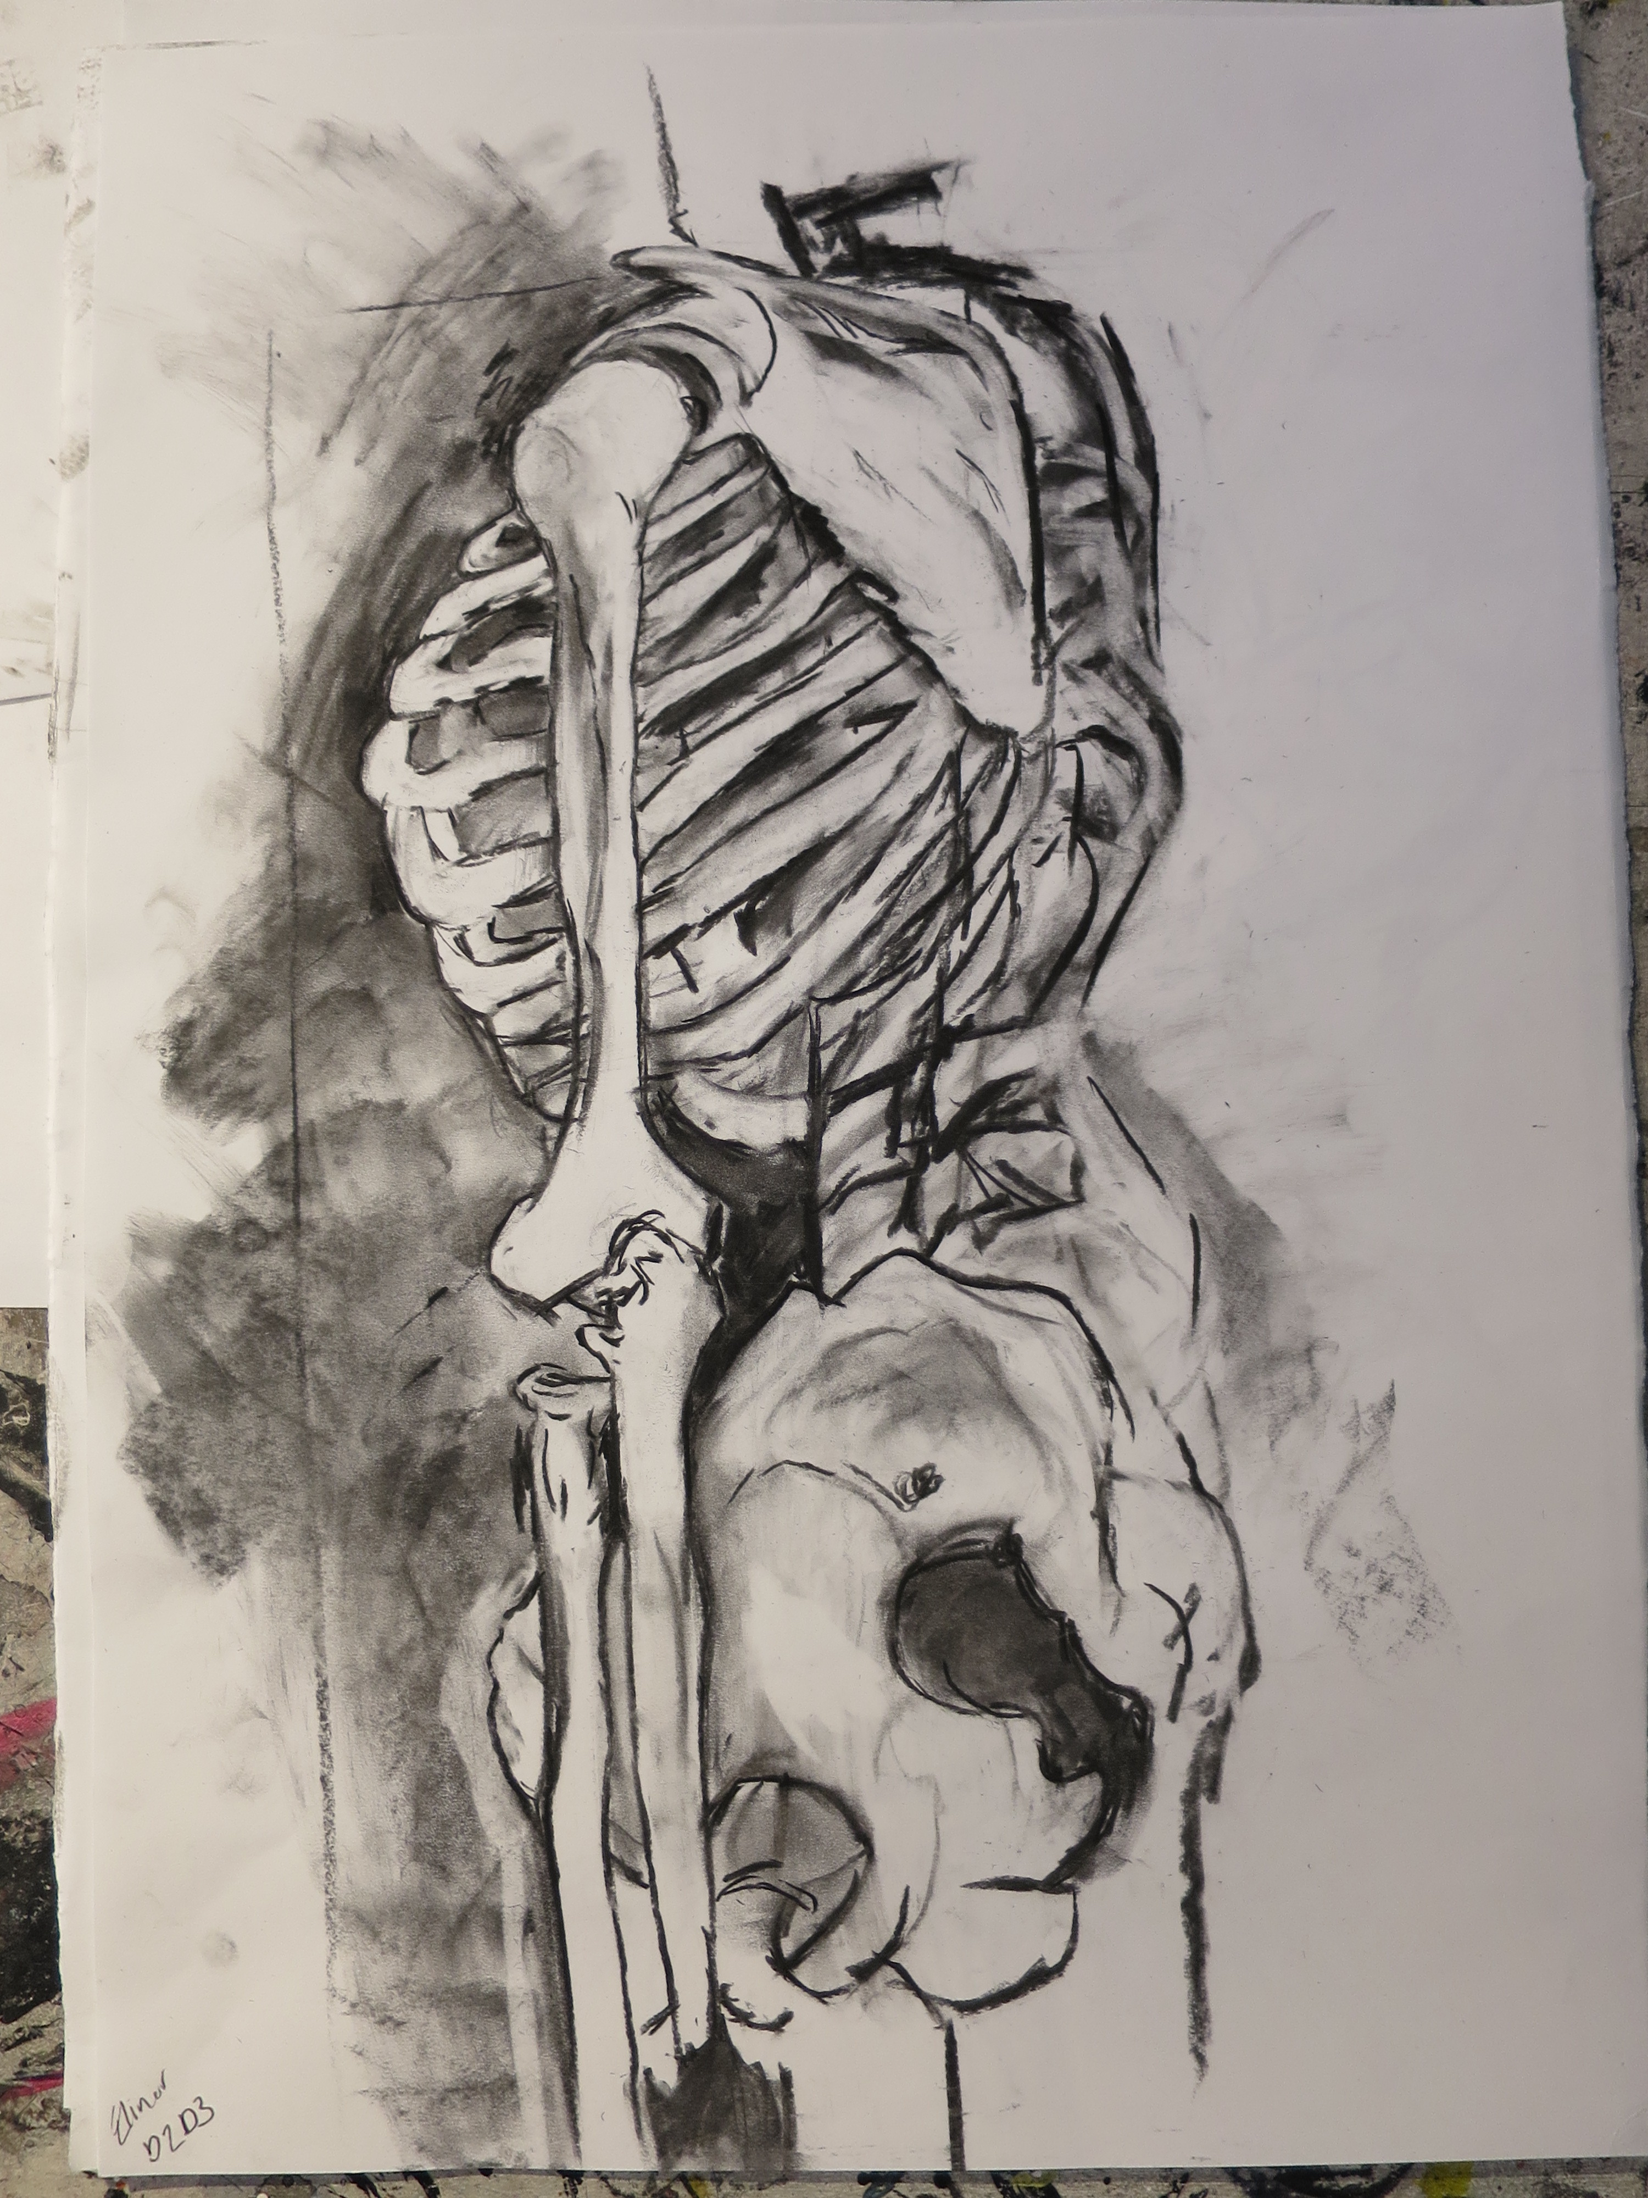
Drawing Inclusions

Slide 7
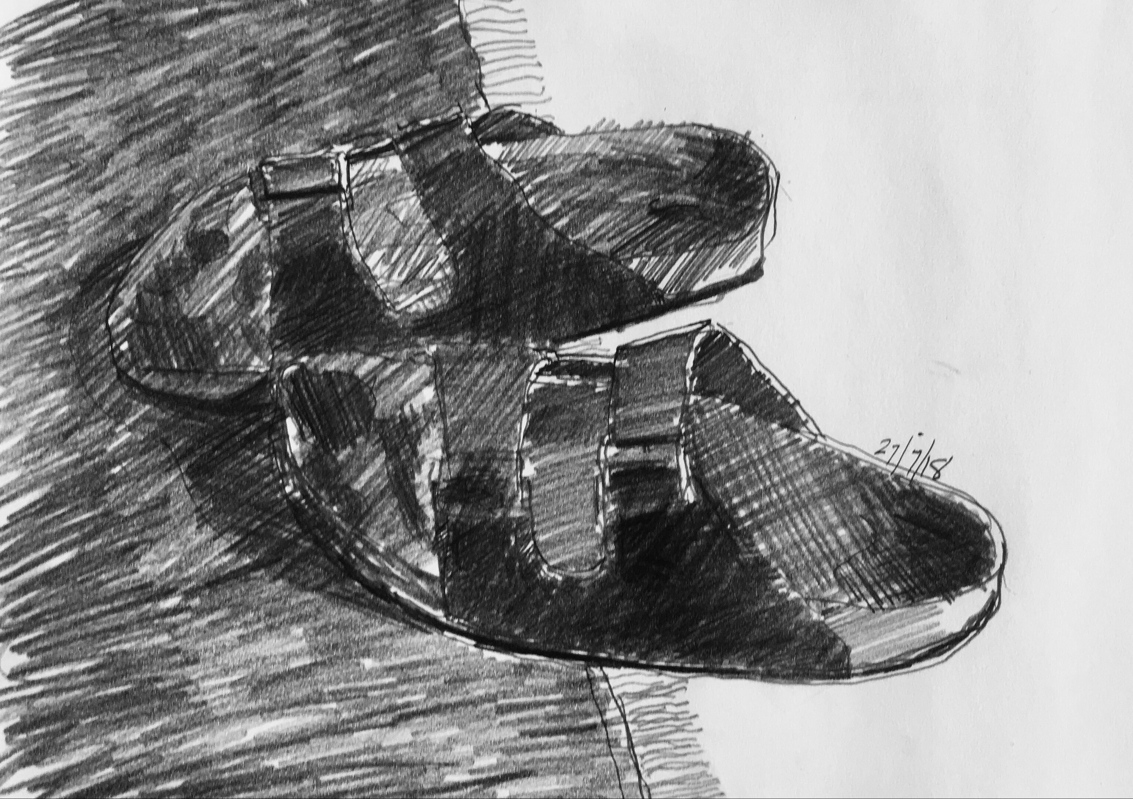
Format
Figure/Field
Main Axes of Sheet
Phase 1 Spend half an hour trying out different formats portrait/landscape/square, relative to subject-matter, and figure/field relationships in terms of balance, symmetry, axes of the paper. From these various formats, choose the one which you feel fits the subject matter best, in terms of how the subject-matter connects with the main axes of the sheet.

Slide 8
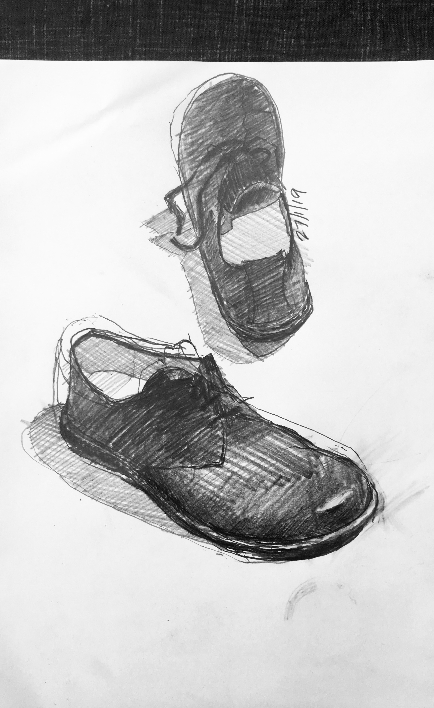
Format; Figure/Field Relationship

Slide 9
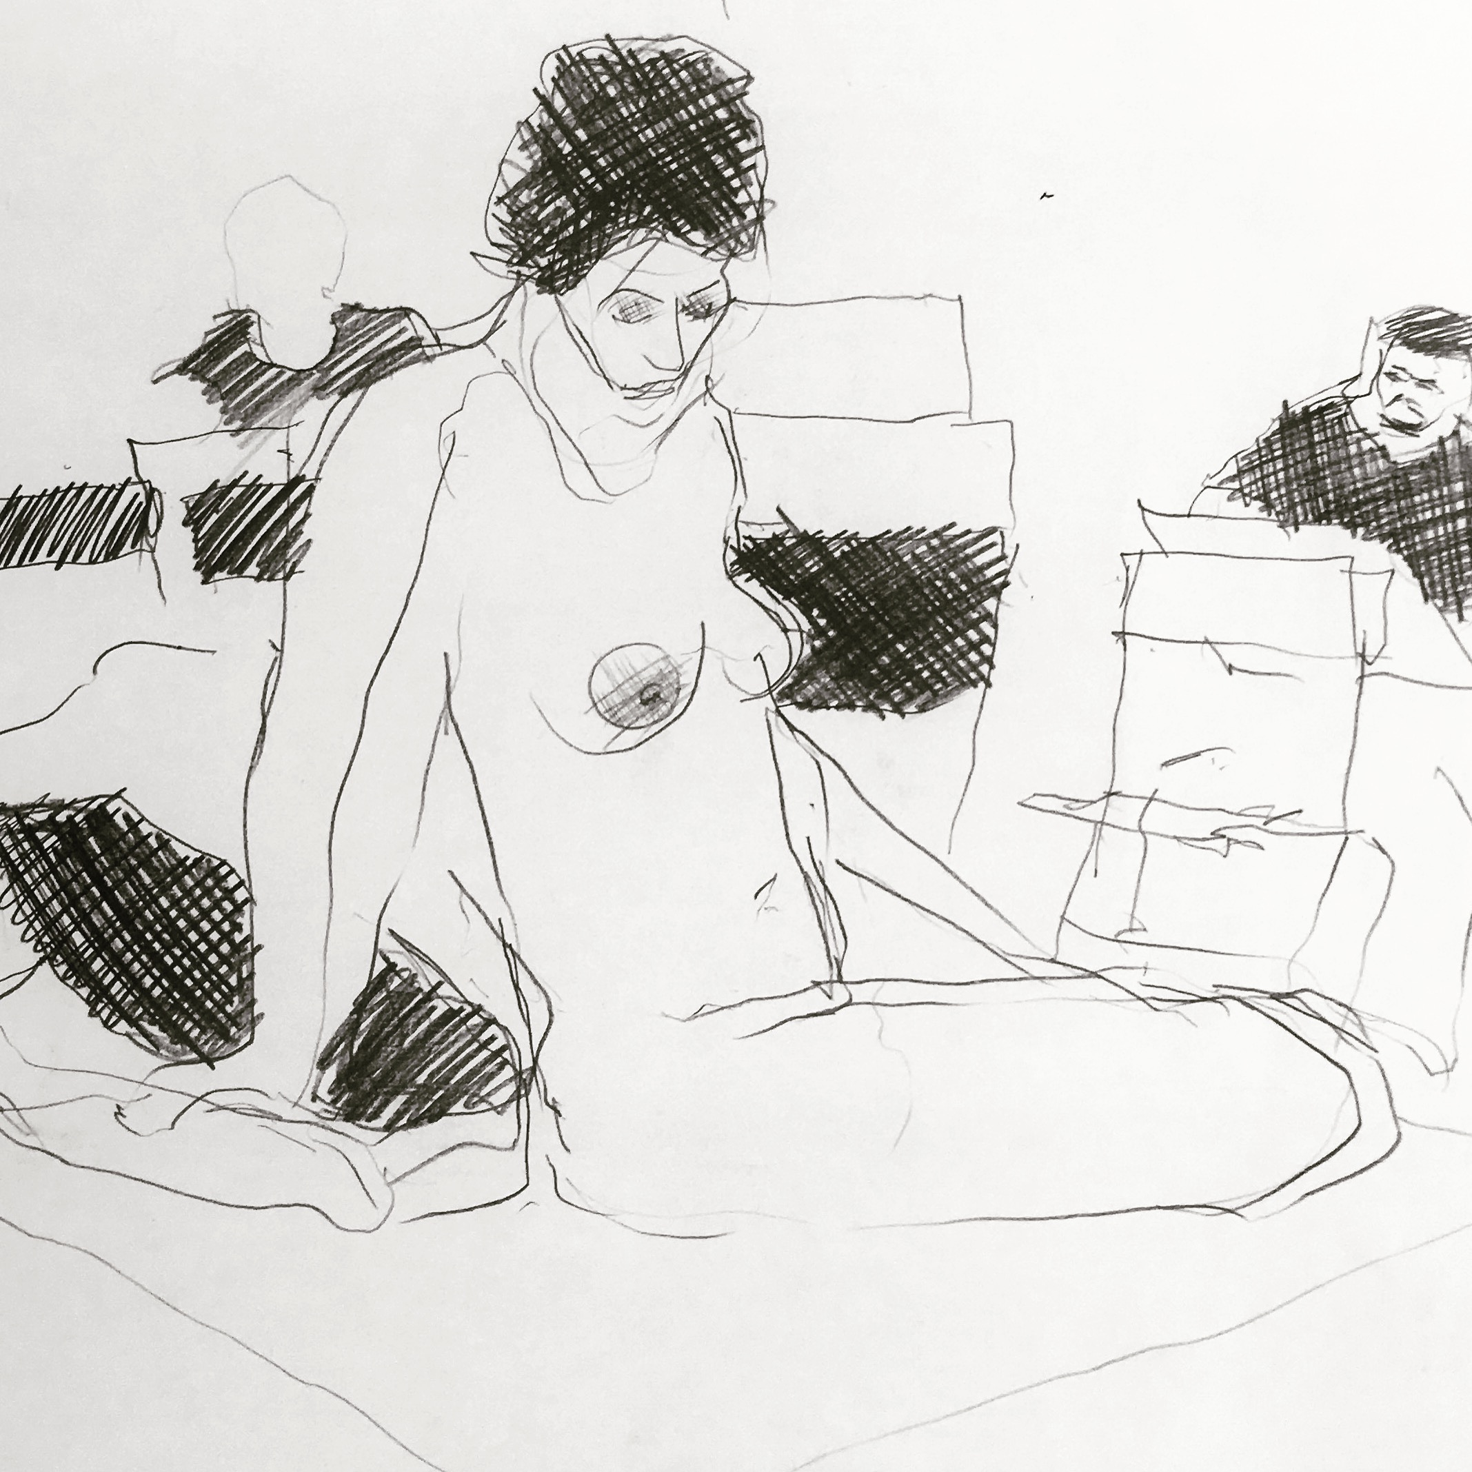
Looking without Language:
Negative Spaces
Phase 2 A half-hour concentrating on drawing the shapes of negative spaces. We tend to see these with heightened accuracy because we have no words for the spaces in between objects, and so we are looking without language.

Slide 10
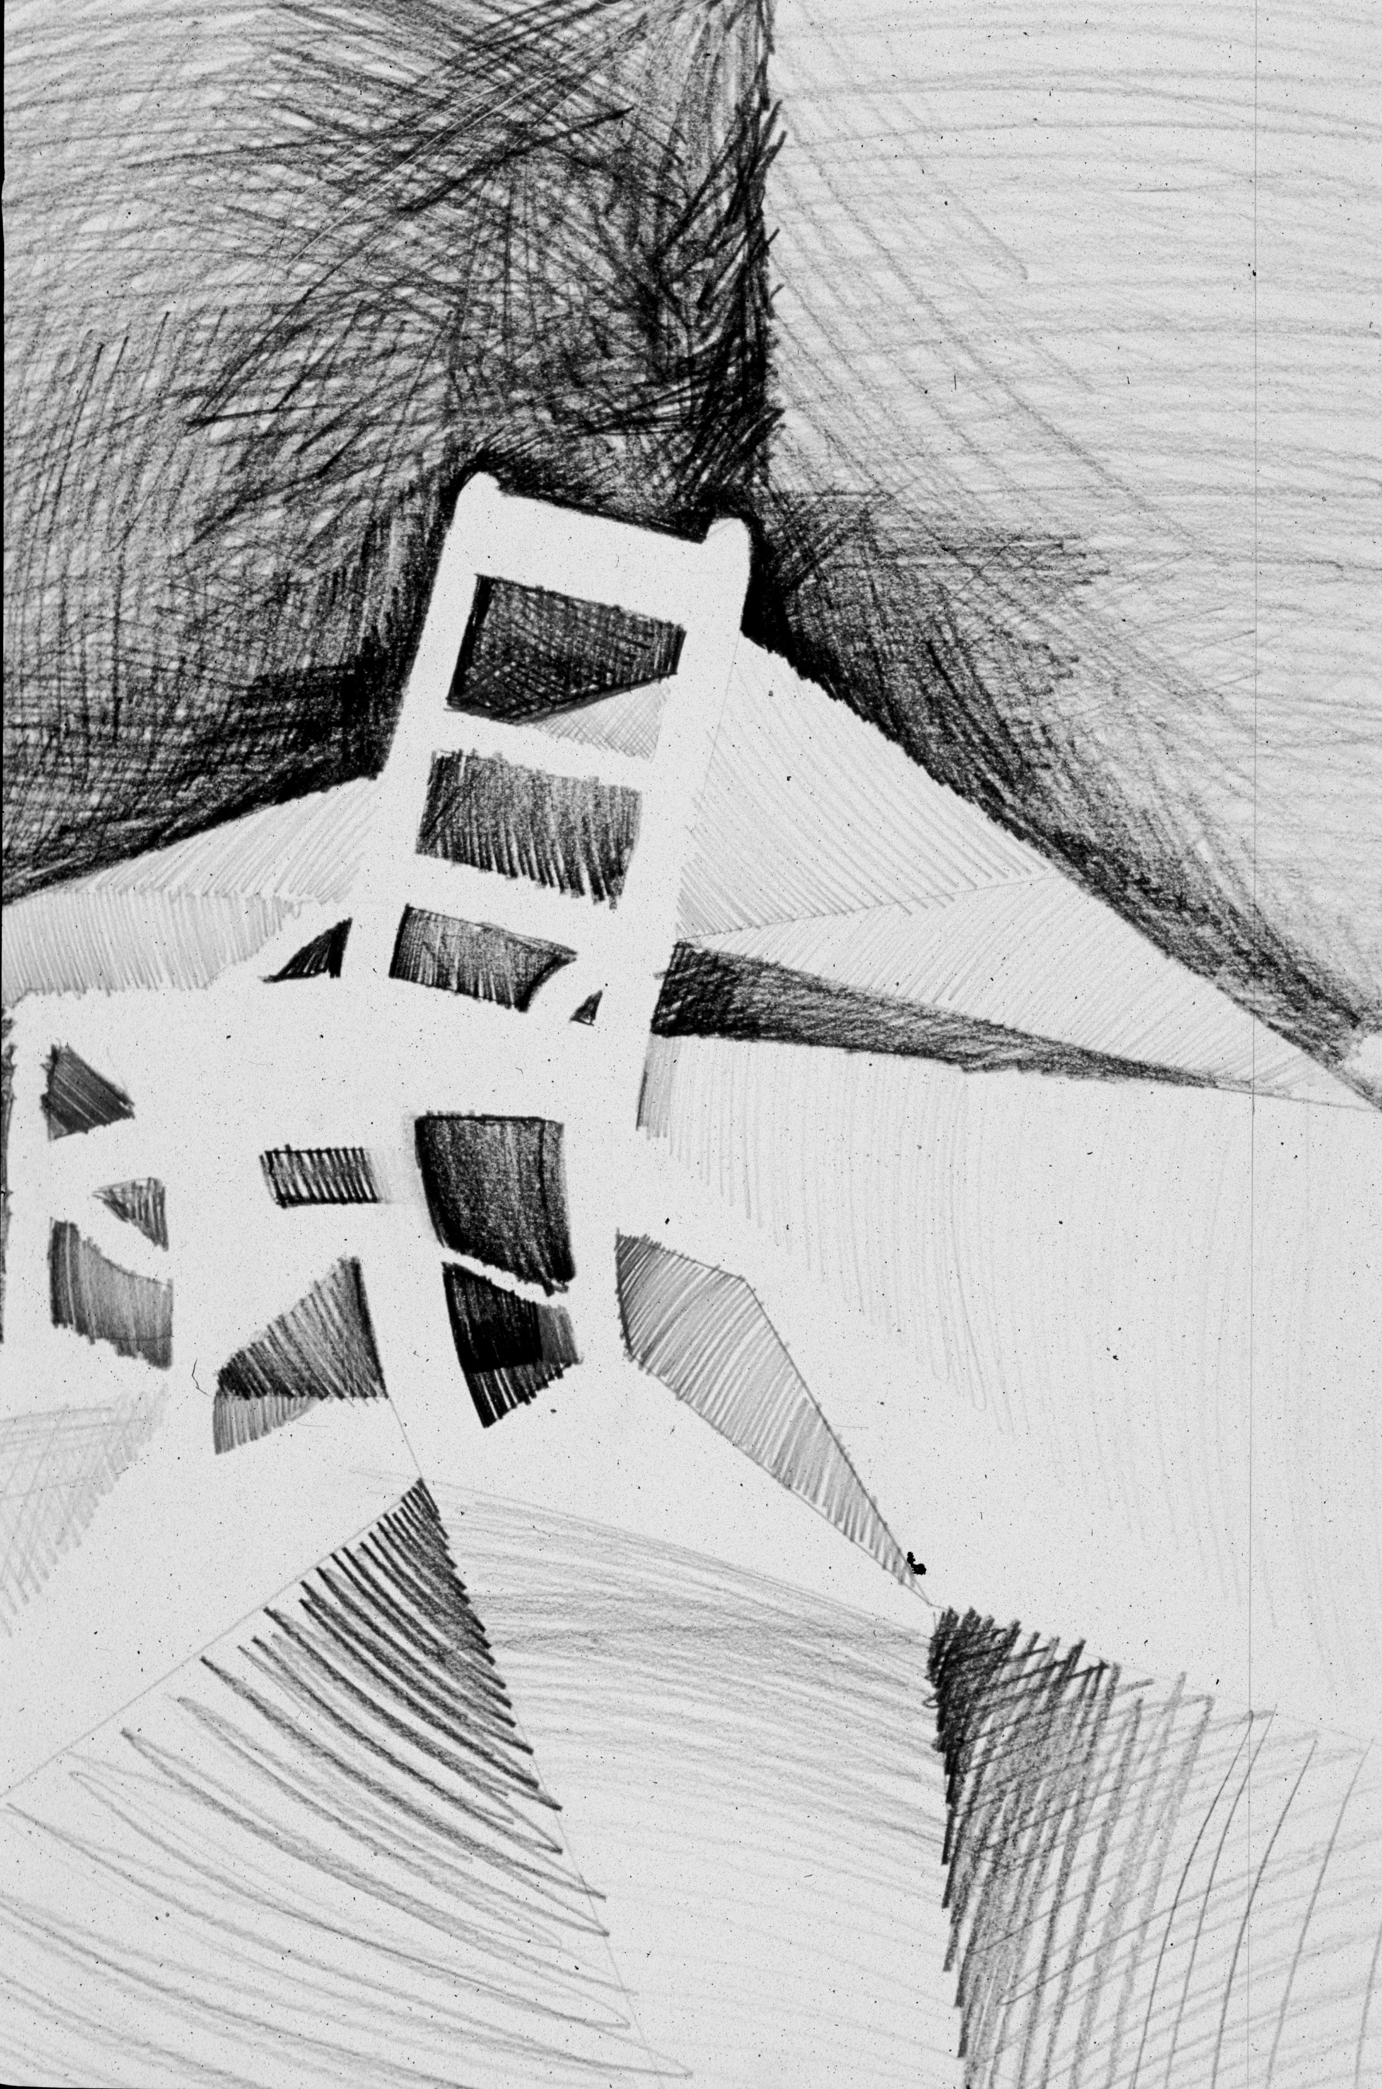

Slide 11
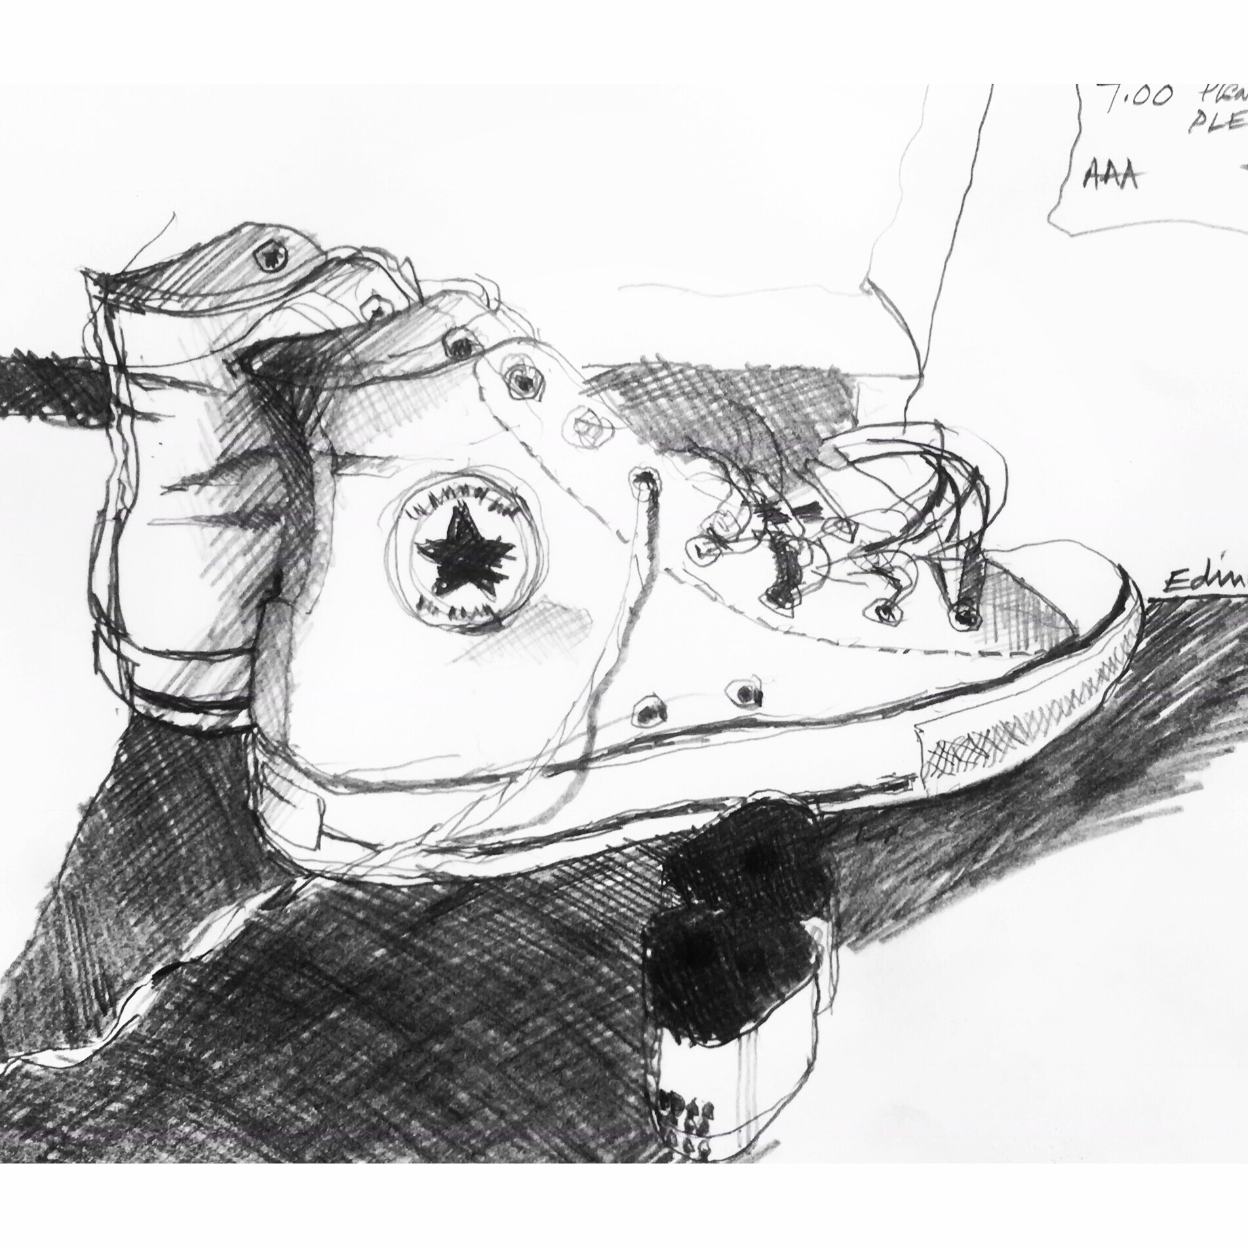
Contrast Boundaries
Phase 3 Now focus on contrast boundaries, a term that describes edges in the still-life set-up that you see as the boundary between two tones or textures. No ‘outlines’ allowed!

Slide 12
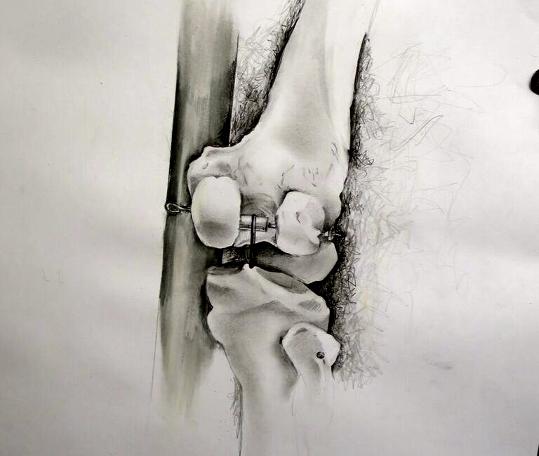

Slide 13
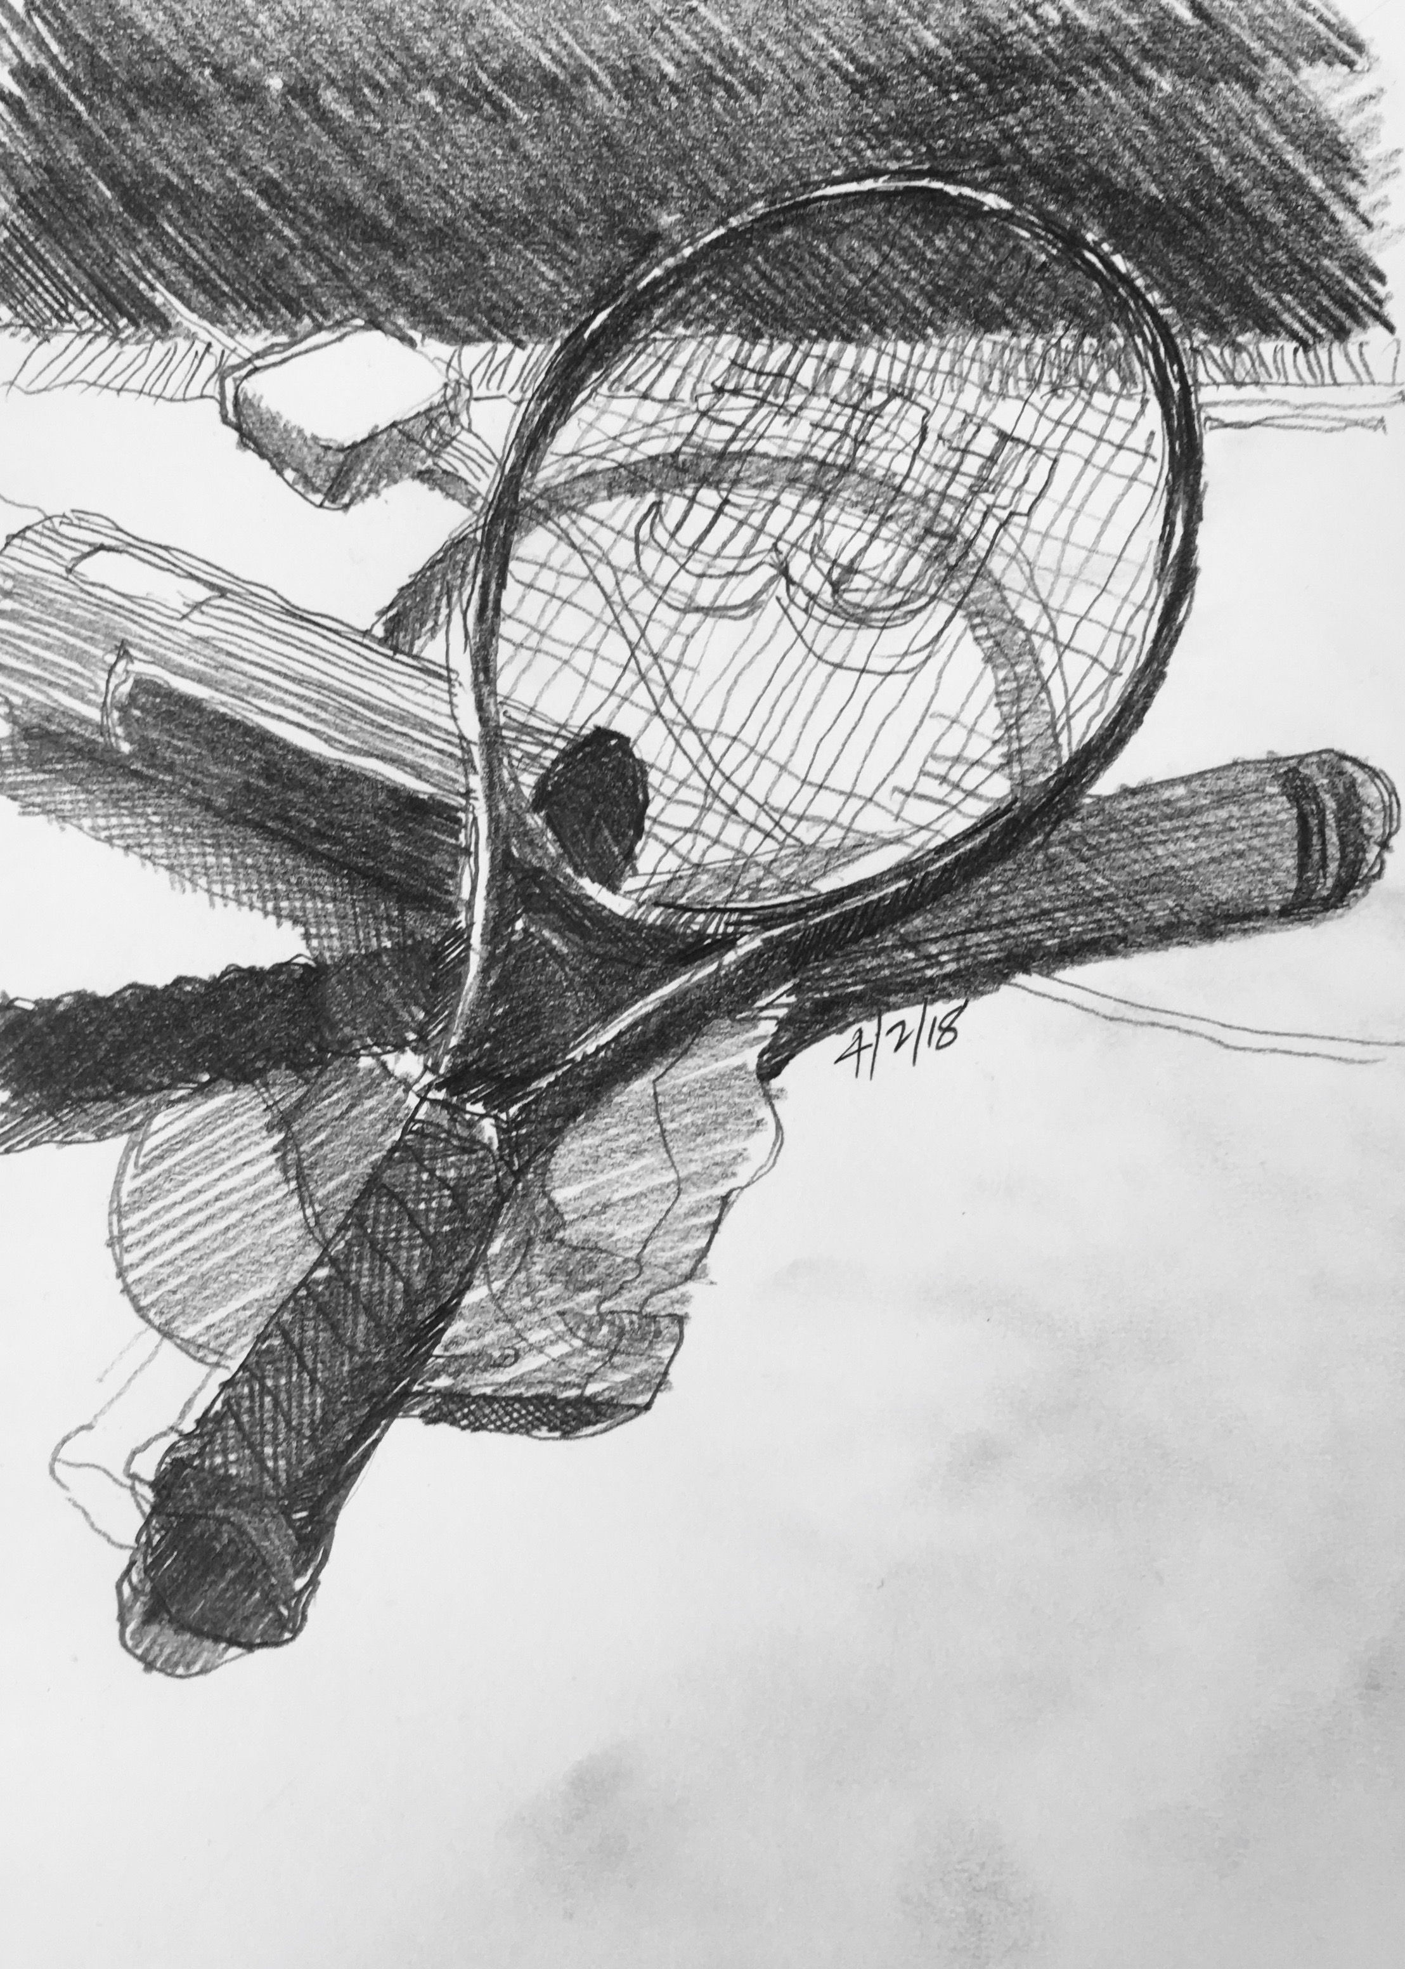
‘T’ and ‘Y’ Junctions
Phase 4
Drawing which shows the T and Y connections in bold line.
(The T and Y patterns where one surface overlaps two others)

Slide 14
T and Y Junctions

Slide 15
Analysis of the Likert Scale questionnaire administered before and after our workshops indicated a positive shit in the students attitudes over the period of the workshops towards the awareness and understanding of the fundamental concepts and strategies covered. This correlates with an increase in confidence towards the construction of drawings. There appeared to be similar positive shifts in both dyslexic/dyspraxic students and non-statemented students: this could be constructed as evidence of the teaching strategies potential to address the issue of inclusivity within the pedagogy of the art school. Our conclusion however inevitably reveals some questions for further examination;
What implications might top-down influences of abstract knowledge, such as rules of perspective, have on laterality? In other words, what knowledge is essential for the activation of expert left-sided circuits and automaticity in the drawing process?
Do drawings have a role to play in evaluating whether the strategies presented here could be a helpful addition to a dyslexic student’s ‘individual support plans’?
In order for drawing to be seen as a process for understanding and representing our world and as a tool for remembering knowledge, what is the best way of raising awareness in schools of the benefit of teaching drawing to learners - particularly visual learners - in a wider class room context, rather than confining it to the art room? Towards this end, an exploration of the role of drawing as a way of knowing, in the context of school biology classes will be continued through the ongoing AHRC funded project, Representing `Biology’ as Process (2017-20) in collaboration with Exeter University.

Slide 16
References
Abdulaal, E. (Ed.) (2016), Moving Forward: Challenges and Transitions, The 10th
British Dyslexia Association International Conference Proceedings. Bracknell: BDA.
Anderson, G. (2017). Drawing as a Way of Knowing in Art and Science. Bristol: Intellect.
Berger, J. (2009). Ways of Seeing. Harmondsworth: Penguin.
Berger, J. (2013) ‘Drawing is discovery’, New Statesman, 1 May, http://www.newstatesman.com/culture/art-and
design/2013/05/john-berger-drawing-discovery.Accessed January 2018.
Eide, B. & F. (2011). The Dyslexic Advantage: Unlocking the Hidden Potential of the Dyslexic Brain. California: Hay Publishing.
Elkins, J. (Ed.) (2007). Visual Literacy (1st edition). New York: Routledge.
Fawcett, A. (Ed.) (2001). Dyslexia: Theory and Good Practice. London: Whurr.
Kozbelt, A. and Seeley, W. (2007). “Integrating Art Historical, Psychological, and Neuroscientific Explanations of Artists’ Advantages in Drawing and Perception,” Psychology of Aesthetics, Creativity, and the Arts. 1(2), 80-90.
Lawrence, J. (2011). History - The Origins of Scotopic Sensitivity, Meares
Irlen Syndrome: https://migraine-dyslexia.com/Meares-Irlen-Syndrome.htm. Accessed January 2018
Ledgard, C. (2015). The Art of Walking into Doors (2015), BBC Radio 4, broadcast date 28.10.15. Available at http://www.bbc.co.uk/programmes/b06d2fxf
Miles,T. & Varma, V. (1995). Dyslexia and Stress. London: Whurr.
Mortimore, T. (2008). Dyslexia and Learning Style: A Practitioner’s Handbook (2nd edition). West Sussex: Whurr.
Polanyi. M. (1976). The Tacit Dimension. London: Routledge & Kegan Paul.
Rankin, Q. Riley, H. Brunswick, N. McManus, C. & Chamberlain. R. (2017). Talking the Line: Inclusive strategies for the teaching of drawing. Drawing: Research, Theory, Practice, 2(2), 287–304.
Ryle, G. (1949). The Concept of Mind. London: Hutchinson.
Tchalenko, J. and Miall, C, (2001): “A Painter’s Eye Movements: A Study of Eye and Hand Movement during Portrait Drawing,” Leonardo 34(1), 35–40.
Warnock, G. (1967). The Philosophy of Perception. Oxford: Oxford University Press.
https://www.gov.uk/government/publications/creative-industries-sector-deal/creative-industries-sector-deal-html
https://assets.publishing.service.gov.uk/government/uploads/system/uploads/attachment_data/file/523024/Creative_Industries_Economic_Estimates_January_2016_Updated_201605.pdf
Drawing Inclusions

