Slide 1
Excuse me, where is the toilet (data)?
http://greatbritishpublictoiletmap.rca.ac.uk
@gbToiletMap
toiletmap@rca.ac.uk
@gaillyk
gail.ramster@network.rca.ac.uk
‘Public Toilets and..’ blog @ http://gailknight.wordpress.com

Slide 2
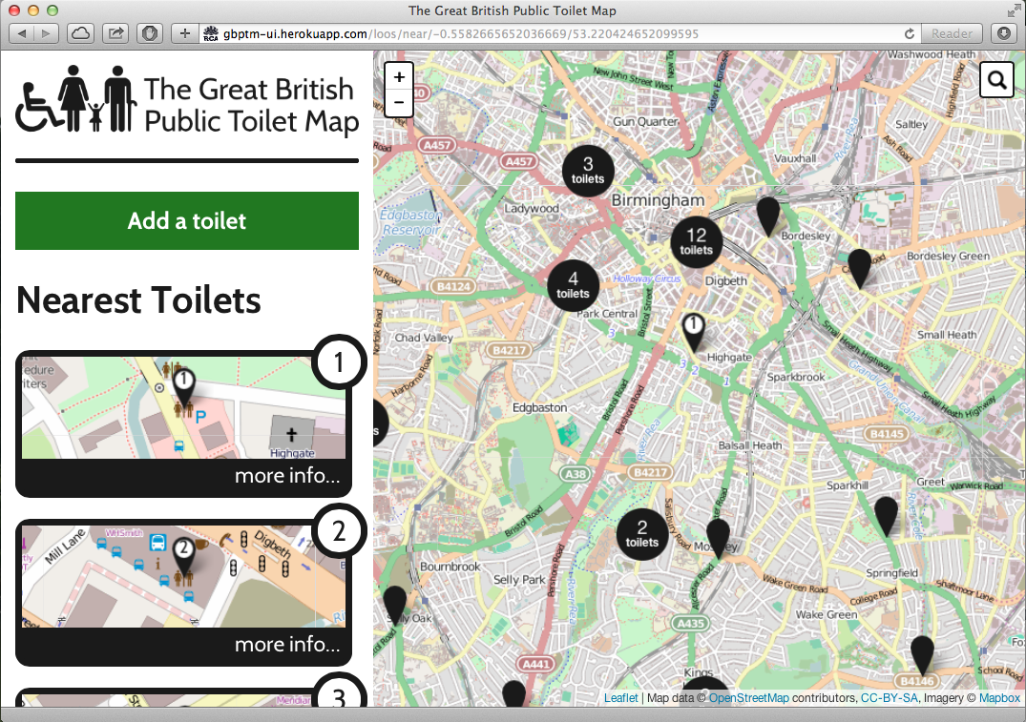

Slide 4
@hhcdesign

Slide 8
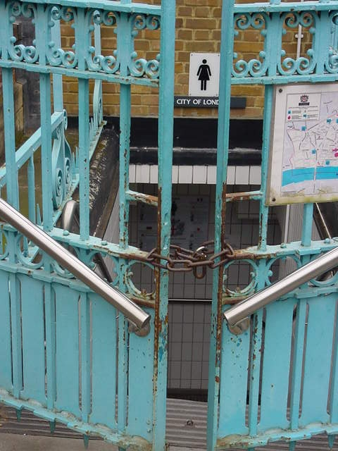

Slide 9
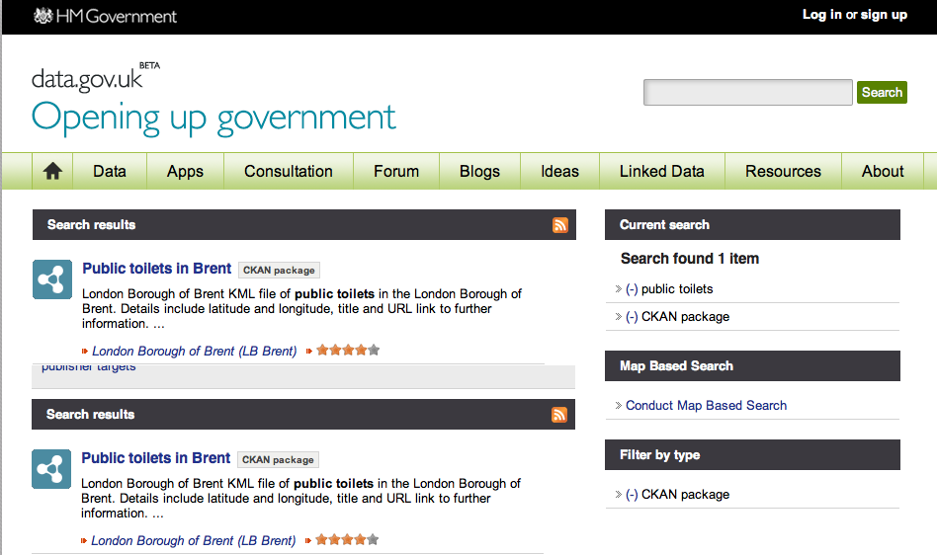

Slide 10
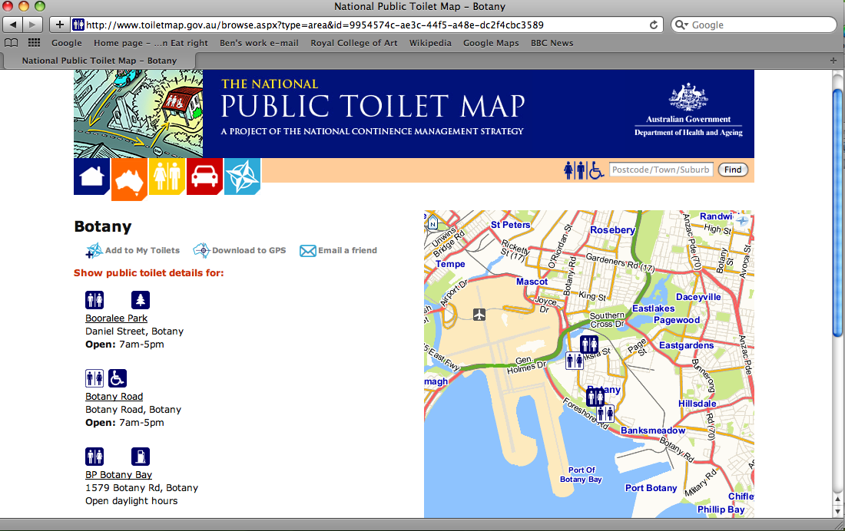
How will the project support itself?

Slide 11
“I think that [proposals for a national database] would run contrary to localism principles, place new burdens on local authorities and increase levels of bureaucracy.”
Andrew Sturnell MP, DCLG

Slide 12
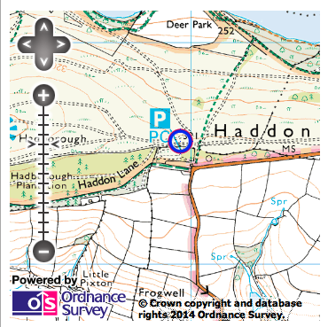

Slide 13
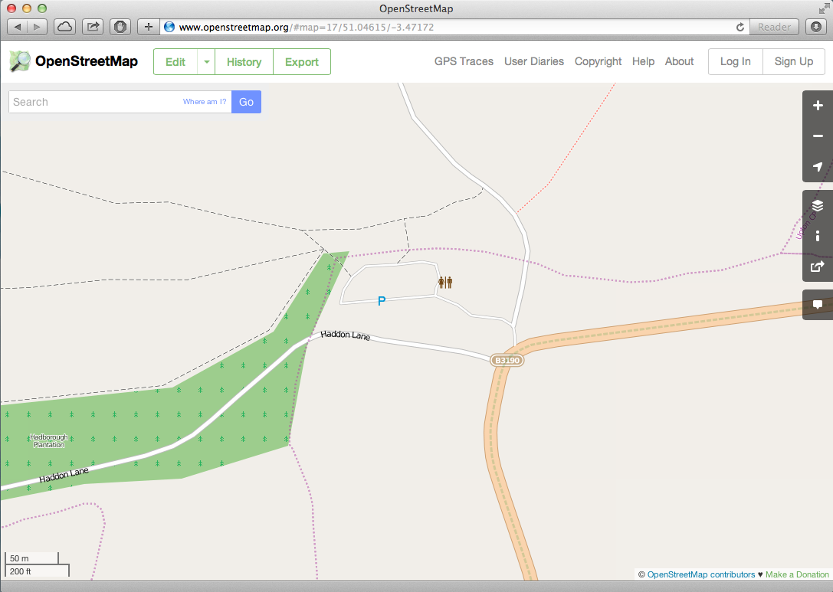

Slide 14
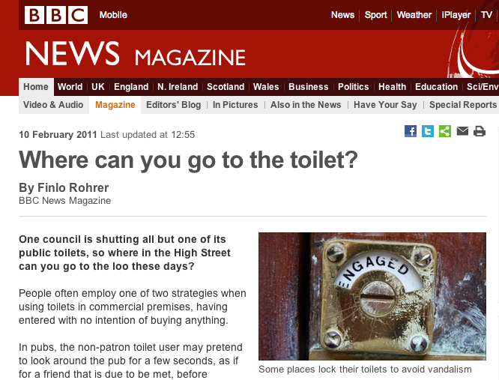

Slide 15
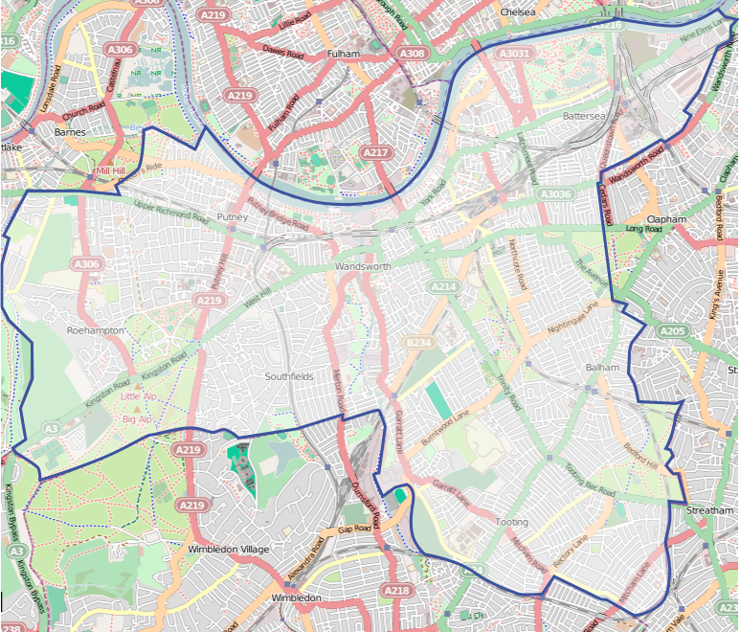

Slide 16
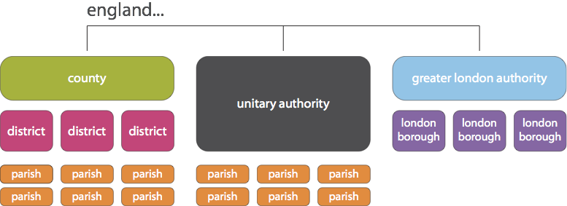

Slide 17
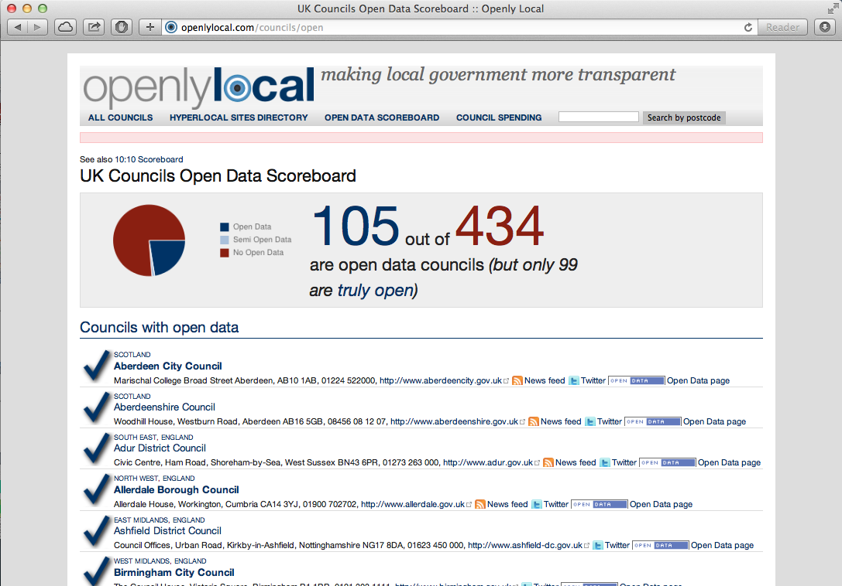

Slide 18
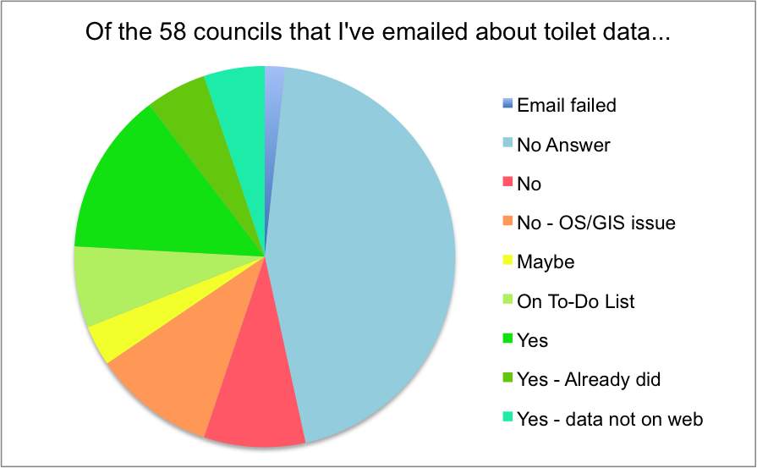

Slide 19
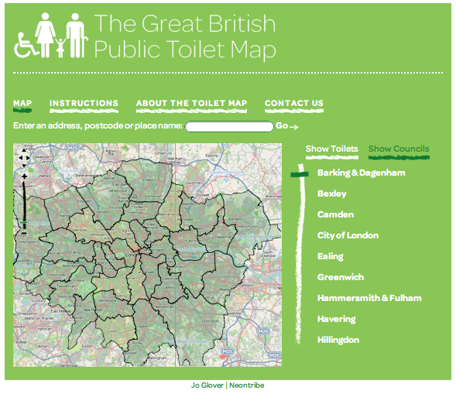
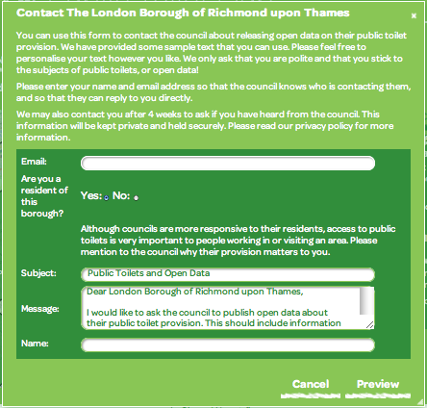

Slide 20
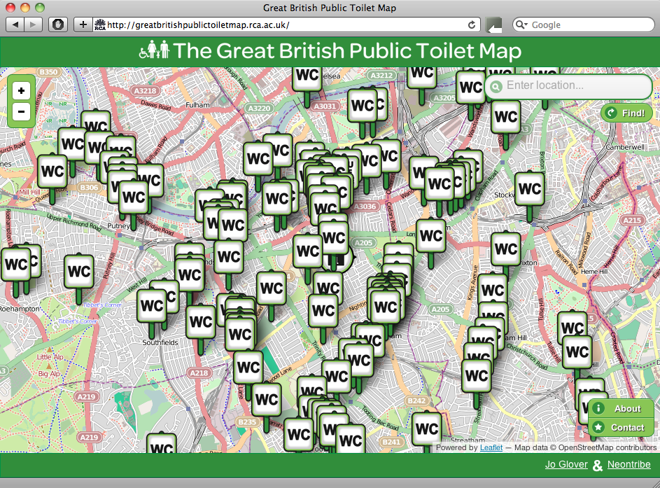

Slide 21
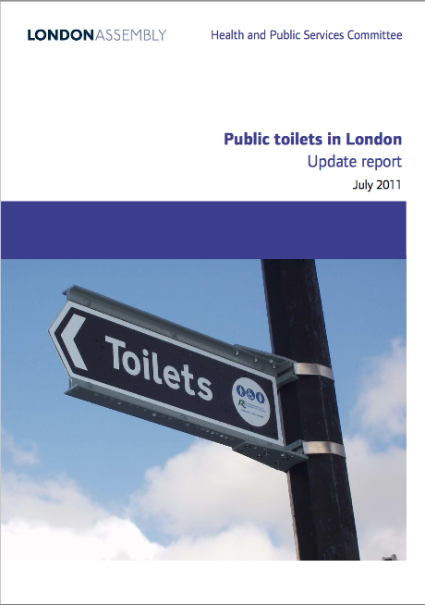

Slide 22
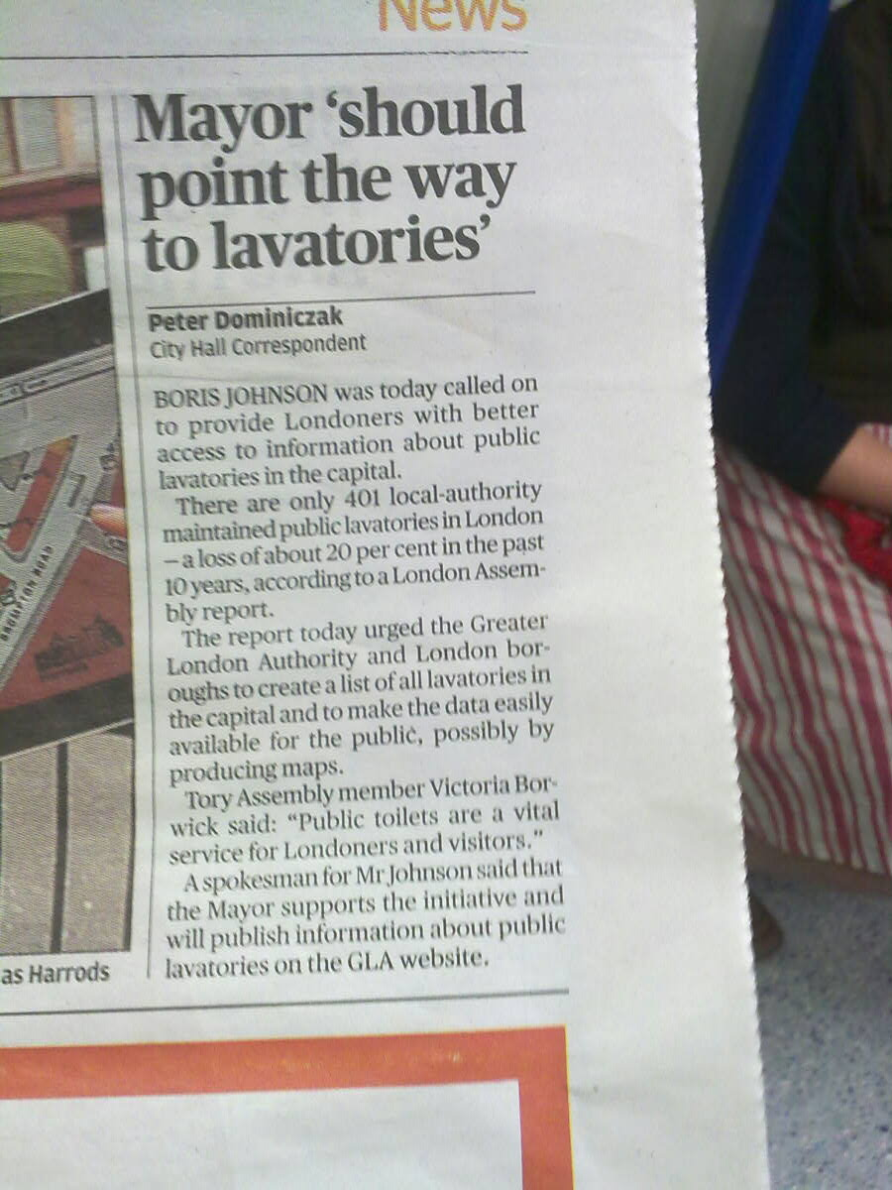
Notes:
Pressure for a similar approach is increasing in the UK. The Greater London Authority, yesterday, published a report asking for councils to publish open data about their toilets so that cohensive and reliable toilet maps of the Capital can be produced before the 2012 Olympics.

Slide 23
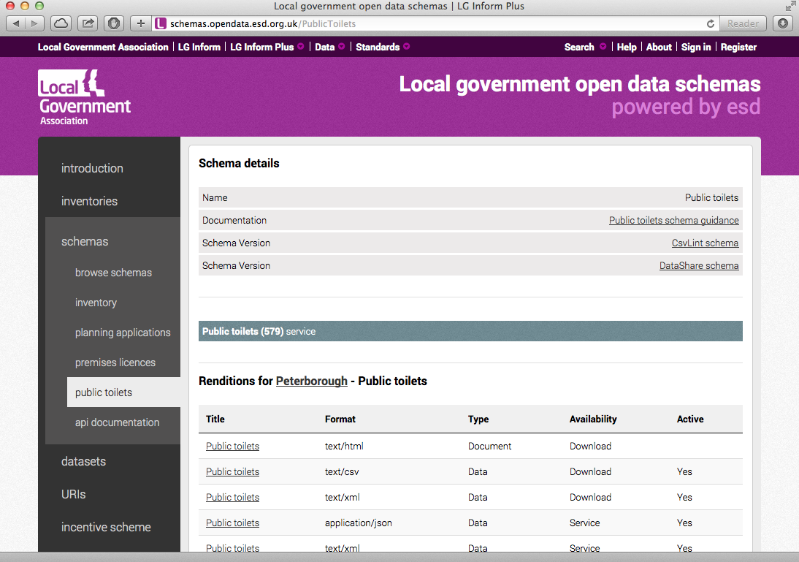
http://schemas.opendata.esd.org.uk/PublicToilets.

Slide 24
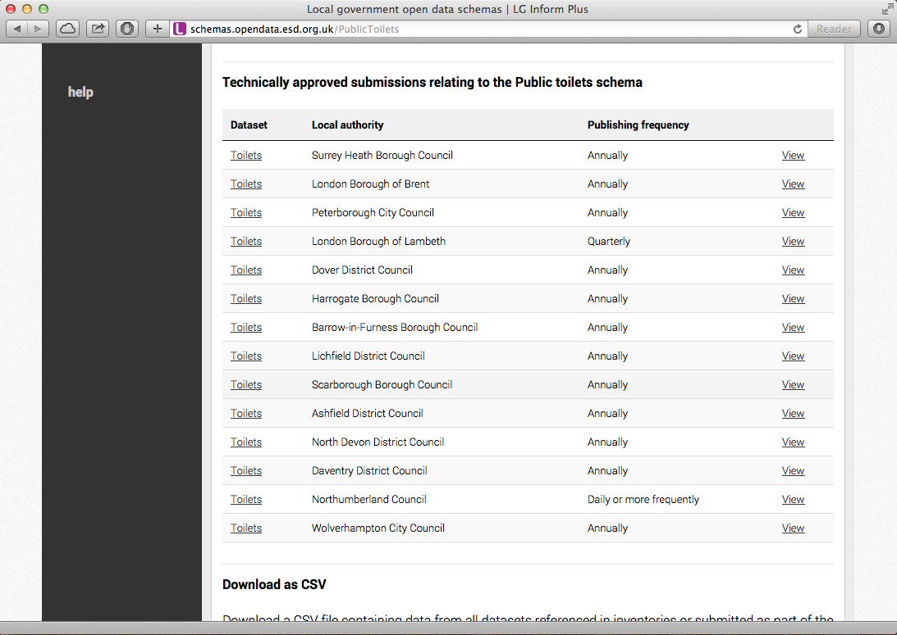
http://schemas.opendata.esd.org.uk/PublicToilets.

Slide 25
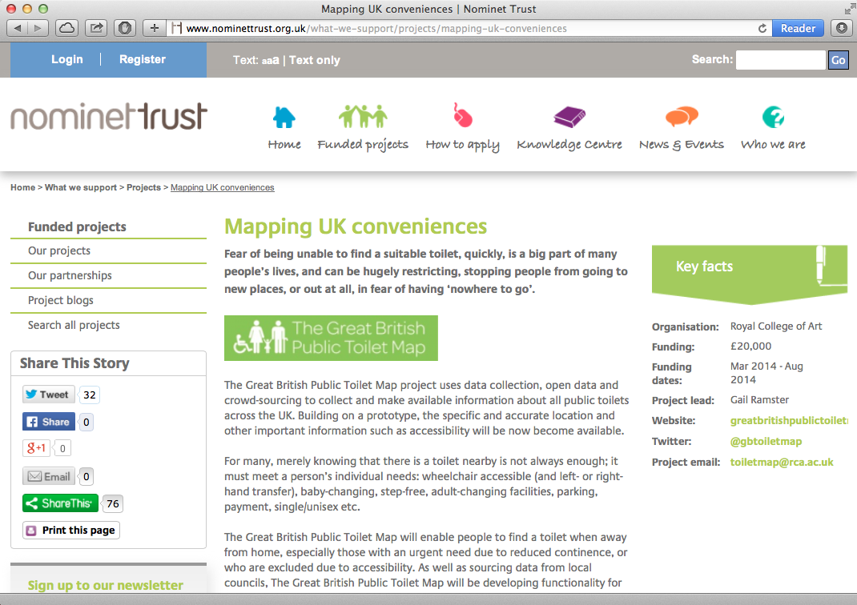

Slide 26
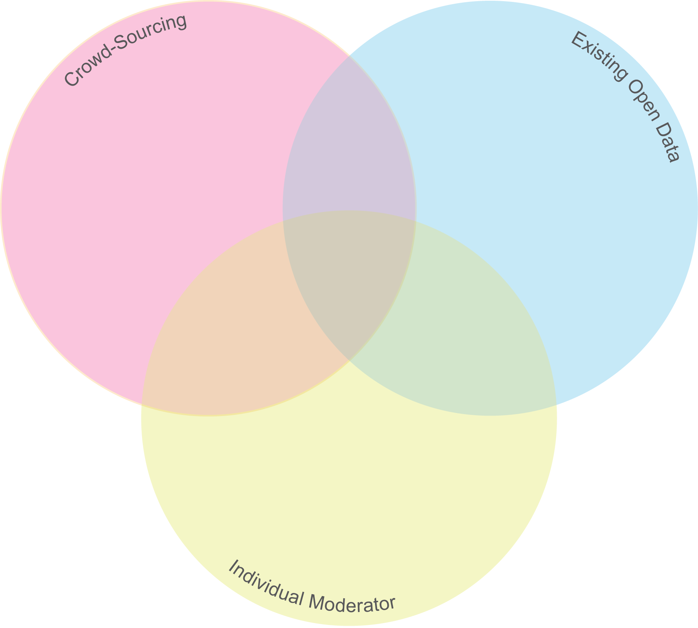
Toilet Finding Apps

Slide 27
Toilet Finding Apps

Slide 29
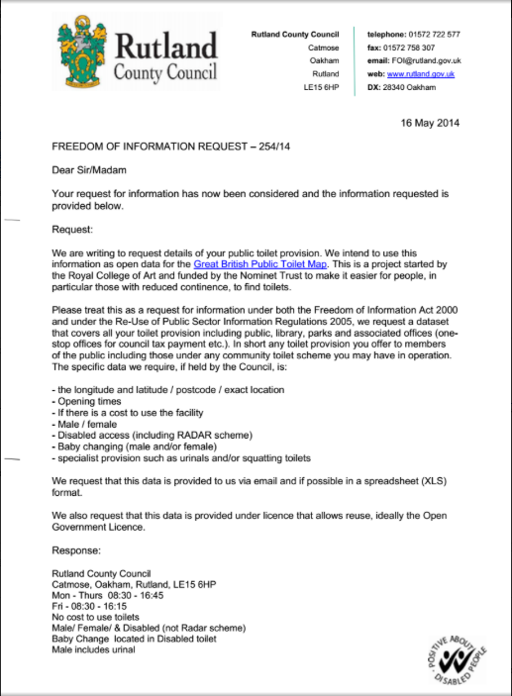

Slide 30
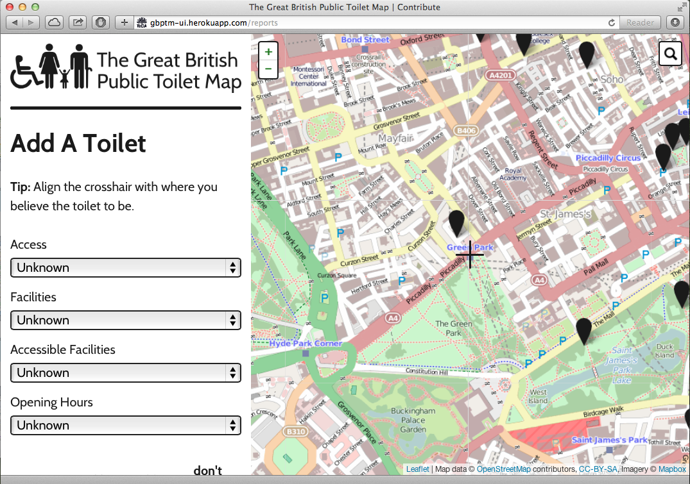

Slide 31
http://greatbritishpublictoiletmap.rca.ac.uk
@gbToiletMap
toiletmap@rca.ac.uk
@gaillyk
gail.ramster@network.rca.ac.uk
‘Public Toilets and..’ blog @ http://gailknight.wordpress.com

Slide 33
Develop a business model to make the map sustainable
Establish open data and commercial licensing
A print version
Images / Photos of toilets

