Slide 1
Colum Lowe
partner
Why Design Matters in Healthcare

Slide 2
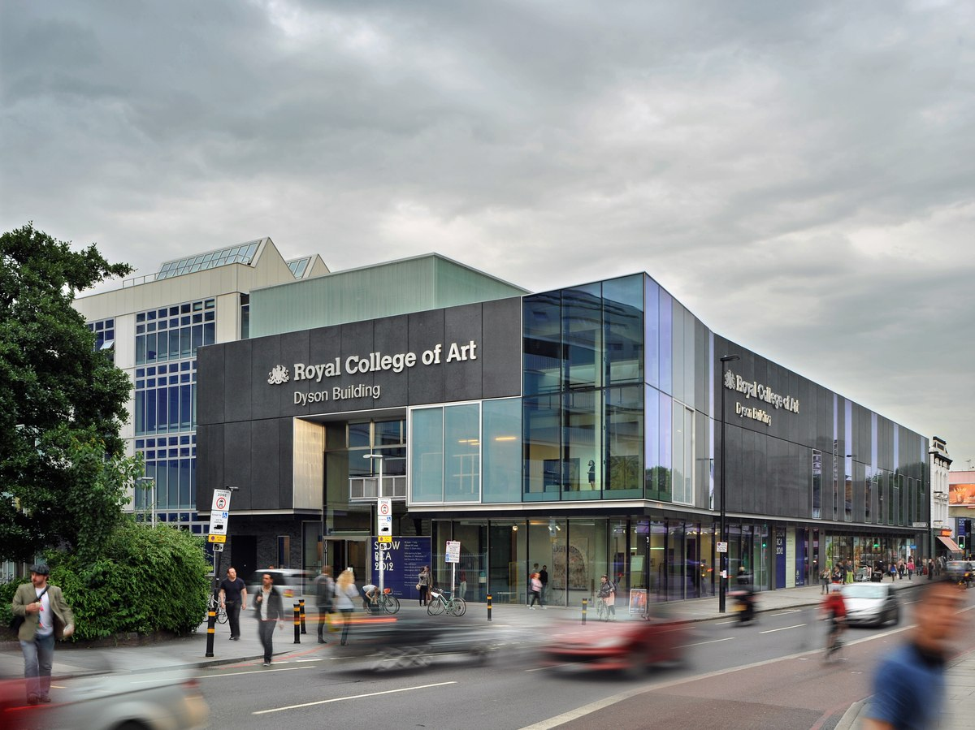

The Helen Hamlyn Centre for Design
Notes:
Based in London at the Royal College of Art is the world’s only entirely postgraduate community of innovators in art and design, The Helen Hamlyn Centre for Design undertakes design research and projects with industry that will contribute to improving people's lives.

Slide 3
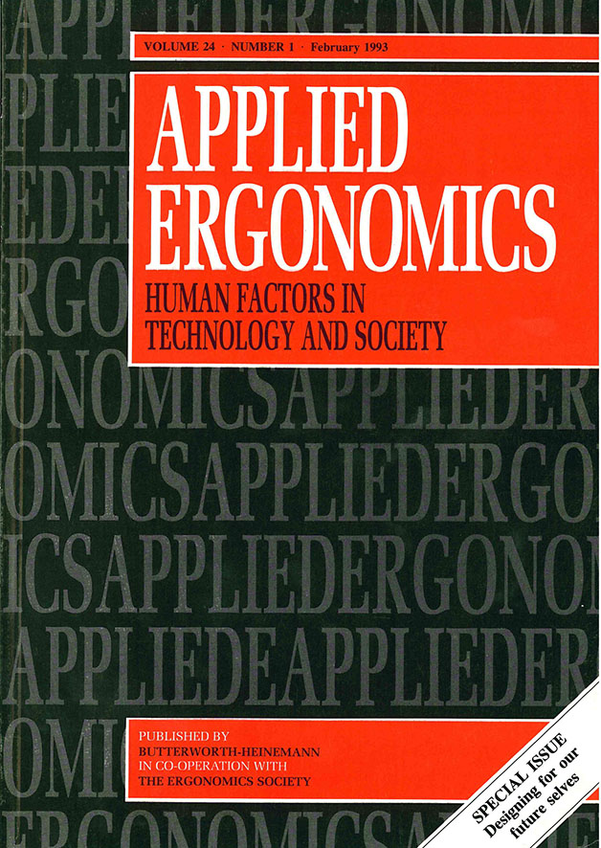
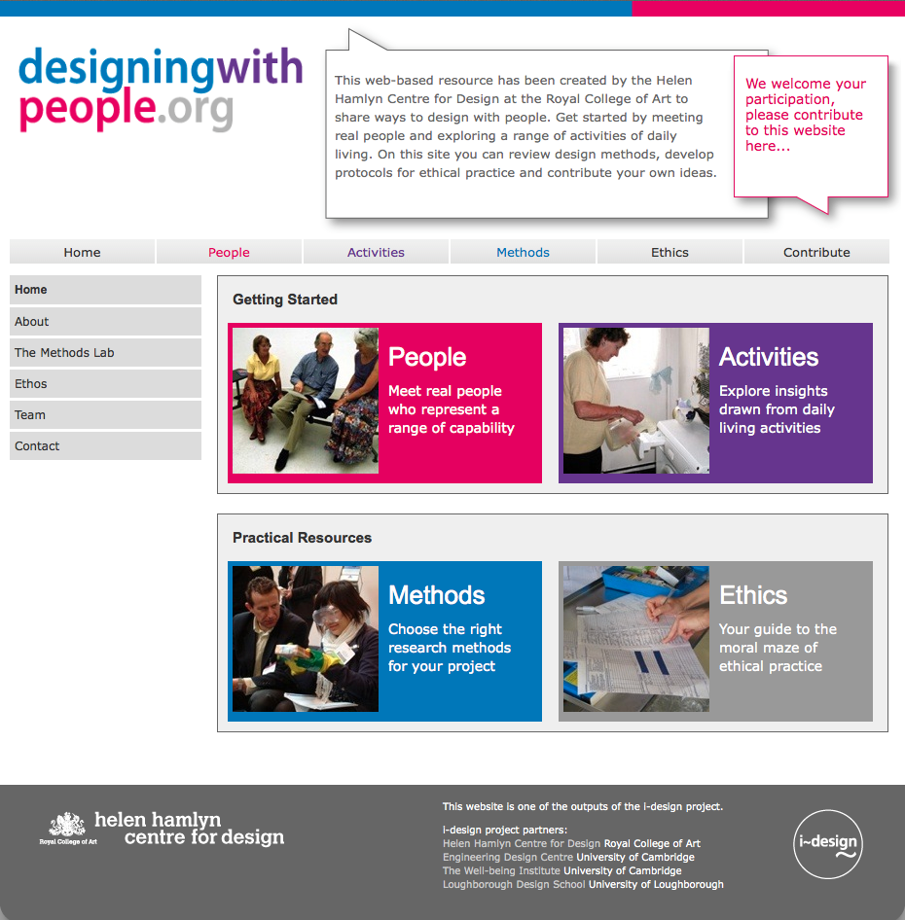
25-year History
Notes:
The Centre has been going for nearly 25 years and our aim is to wake design up to demographic change and healthcare needs. We invented the term inclusive design in 1994 at the Applied Ergonomics conference as you see on the left. Since then we have constantly been developing methods for people-centred design and innovation …. But not keeping them to ourselves. We are an open door, open source organization so we share them with everyone; through workshops, publications, education and websites. Designers, architects, clinicians and business people have all benefitted. You can see here on the right our Designing with People website, which acts as a tool for designers to explore their own ways to design with people.

Slide 4
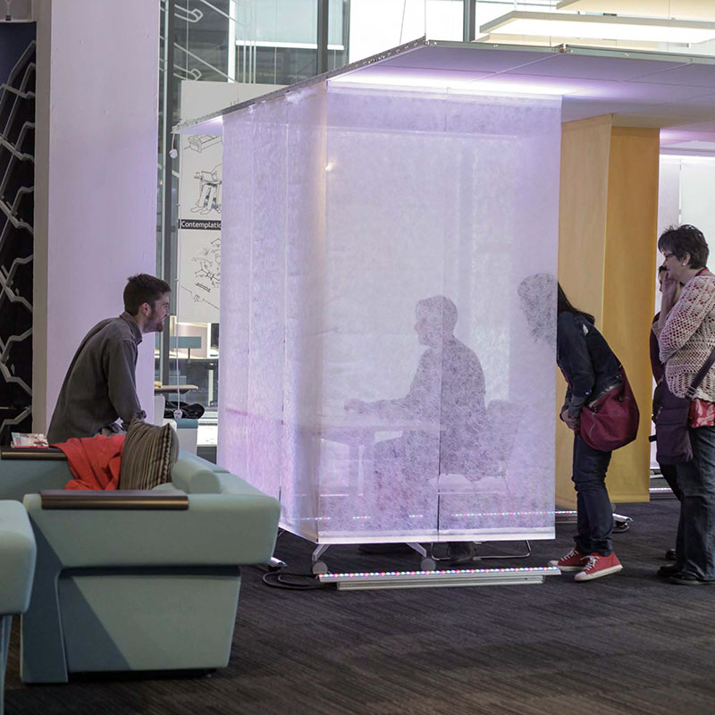
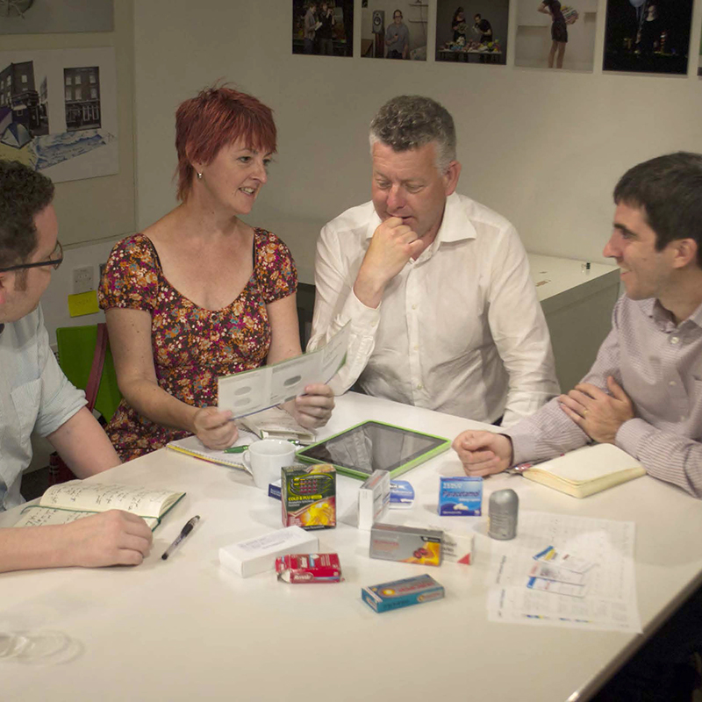
Business Driven
Notes:
We work in three spaces. Firstly, the Business-driven space.
We have completed over 200 projects with major health and tech manufacturers and makers. Glaxo Smith Kline, Johnson and Johnson,
Samsung, Panasonic and Bupa have all worked with us in this space. And we have trained over 160 designers and then sent them off to spread the word.

Slide 5
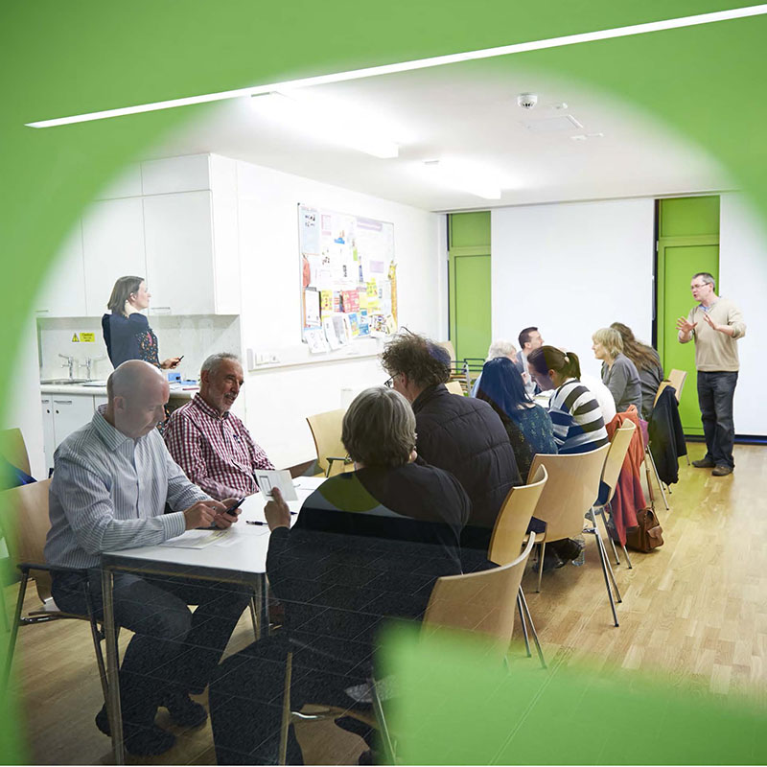
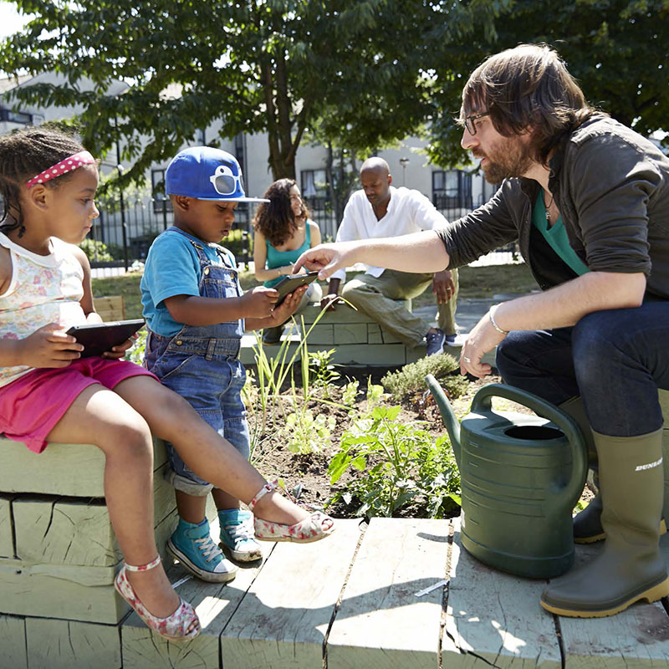
Community Facing
Notes:
We are also community-facing. Working at a grassroots level to co-create solutions. Here you can see some of the communities we have worked with. For example, on the right is a project from South London looking at the therapeutic benefits of gardening with people aged 2 to 92.

Slide 6
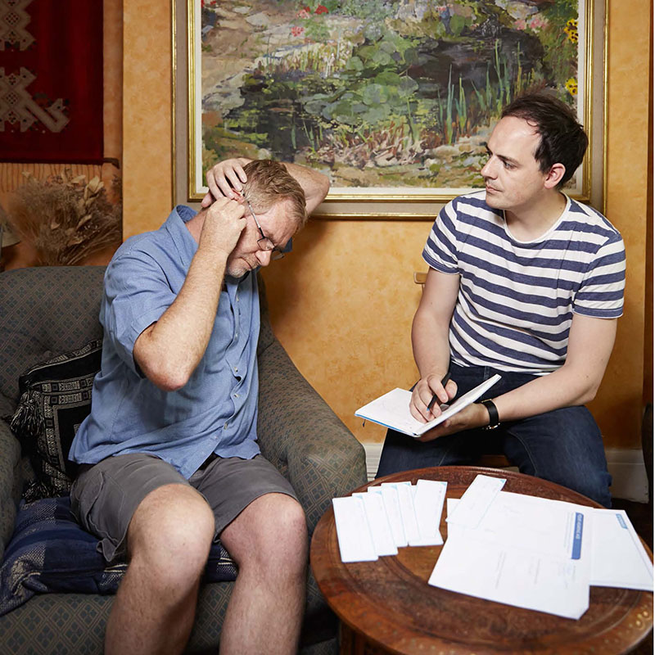
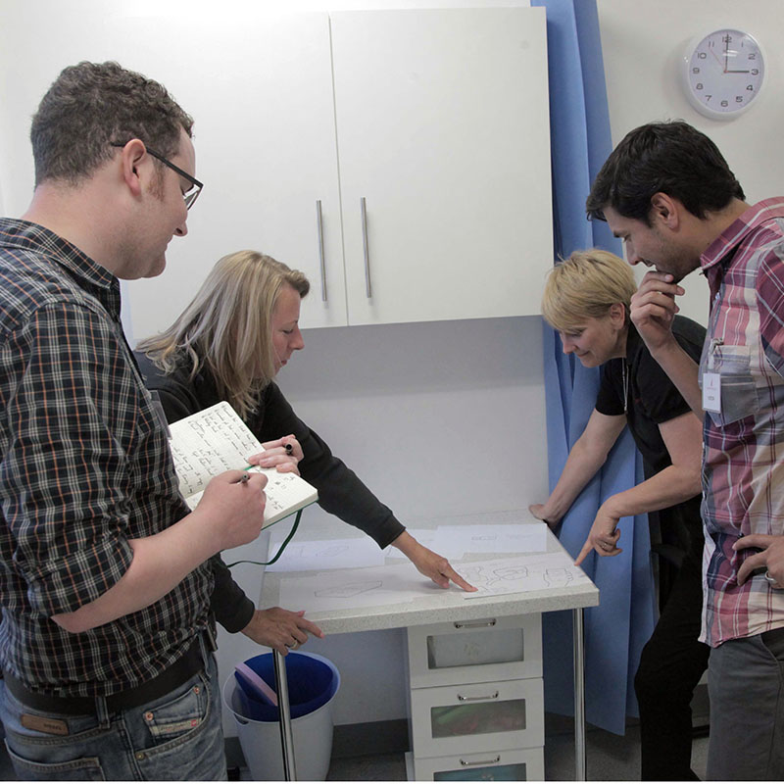
Public Facing
Notes:
The third area is public-facing. Engaging with the public sector is all important … to influence governments, to support hospital trusts and health systems, to influence policy and to benefit society.

Slide 7
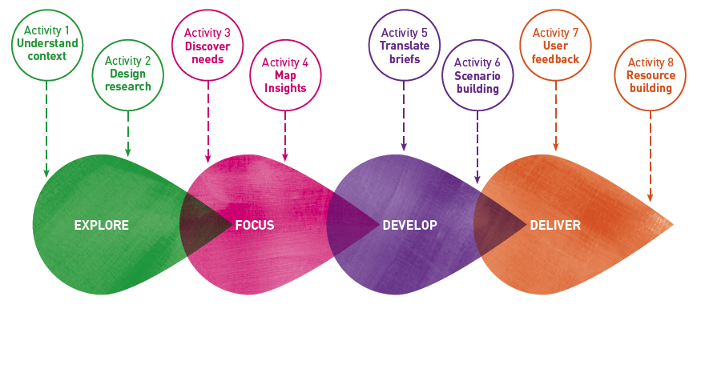
4 Stage Process
Notes:
Our practice is grounded in theory. All projects follow a modified four stage process that we developed with the Design Council. We begin with exploration of an issue with users, focus it down into a brief, then develop design ideas, and finally deliver creative and innovative solutions.

Slide 8
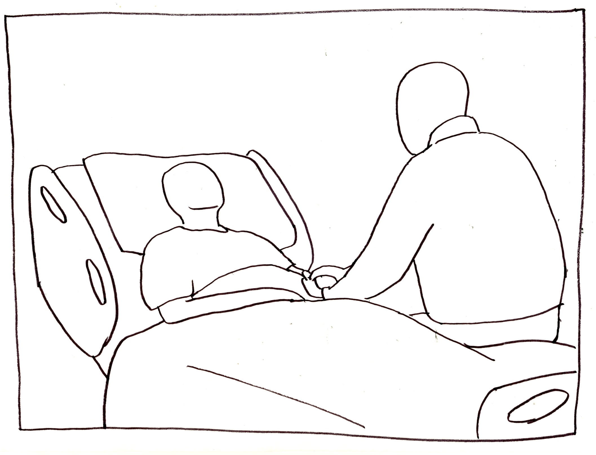
Hospital scenario
Notes:
Split into three groups:
Infection control
Medication
Communication
Listen out for errors specific to your groups
Take notes

Slide 9
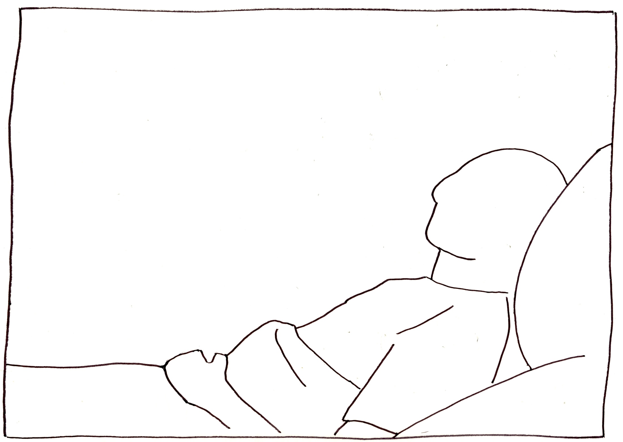
1. Mr Smith has had successful surgery to remove bowel cancer.
- Antibiotics
- Chest physiotherapy
- Neighbouring patient has known infection
Notes:
Mr Smith
Mr. Smith is in hospital. He has had successful surgery to remove his bowel cancer, and is now recovering on Charles Pannett ward. He is mobile, and recovering well. However, it was a big operation, and so is on antibiotics, and the doctors have also ordered some chest physiotherapy as his lungs are not in great shape – he is a smoker.
The patient in the room next door is known to have MRSA.
We pick up the story early the following morning before breakfast.

Slide 10
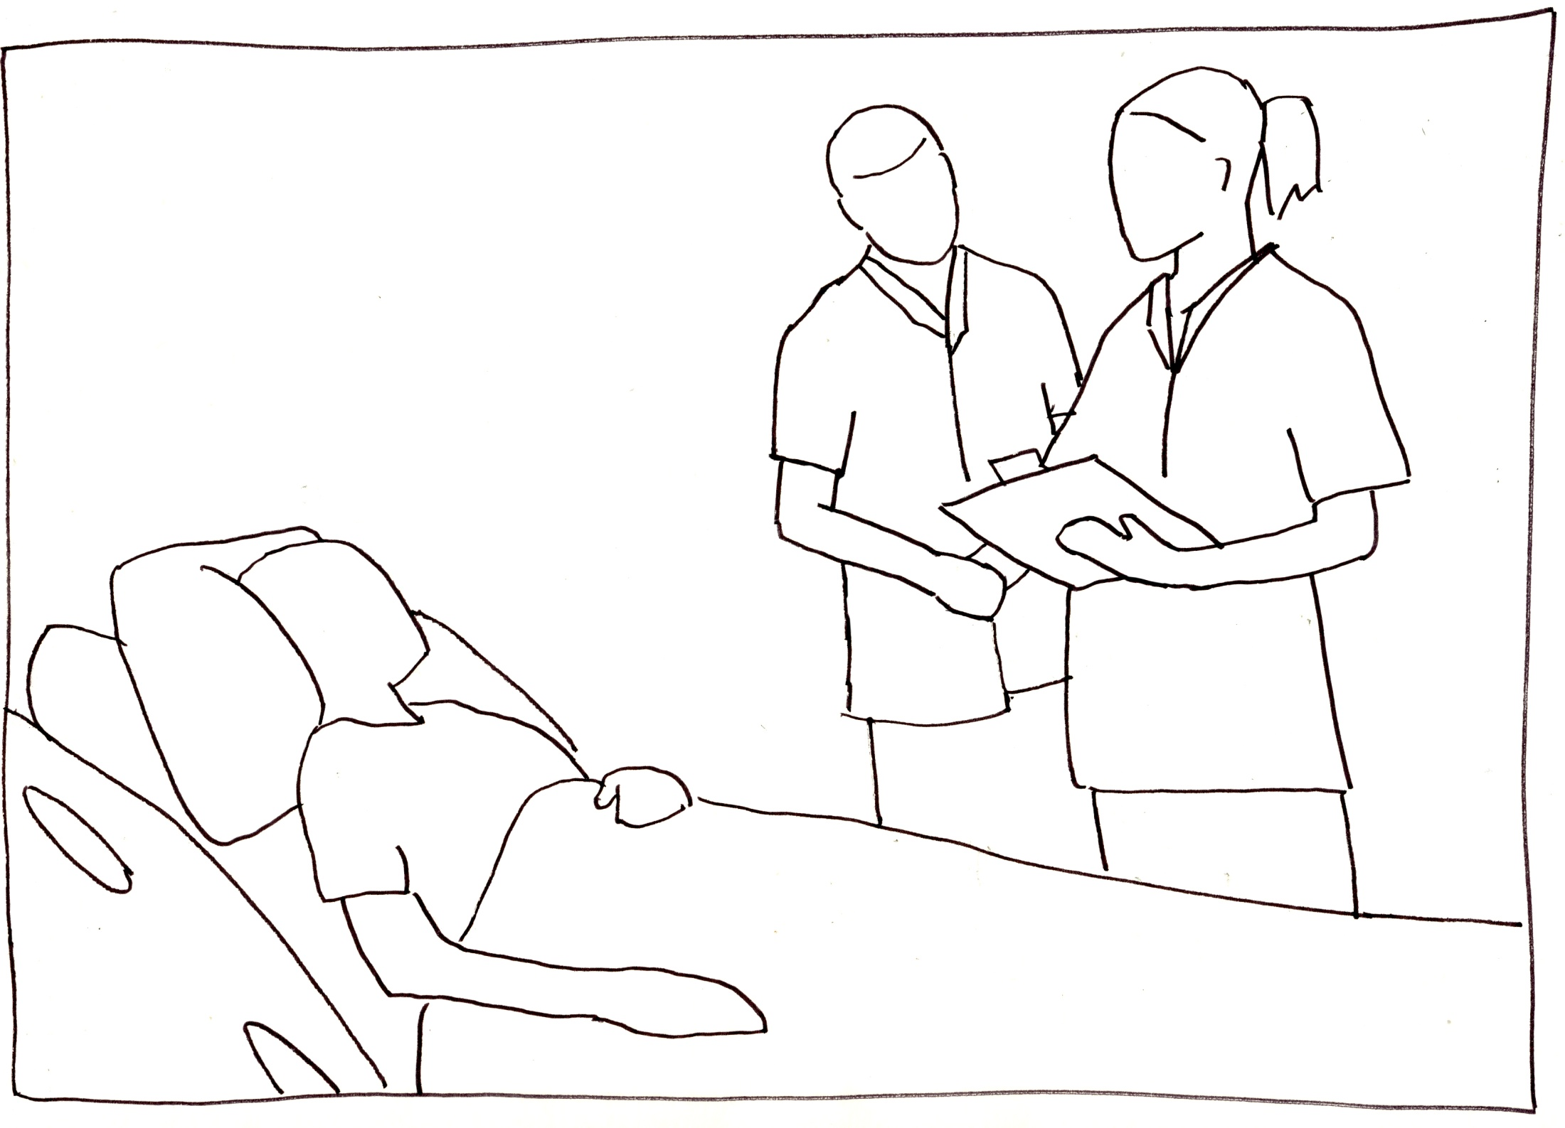
2. Nursing handover
Notes:
Nursing handover
At half past seven in the morning, the night nurses end their shift by handing over all the relevant information to the day nurses. They go through the details by Mr. Smith’s bed, and successfully go through everything, but forget to mention the chest physiotherapy ordered by the doctors.
(COMMUNICATION ERROR - Chest physio needed, not passed on to nurse; physio not called; breathing impaired)

Slide 11
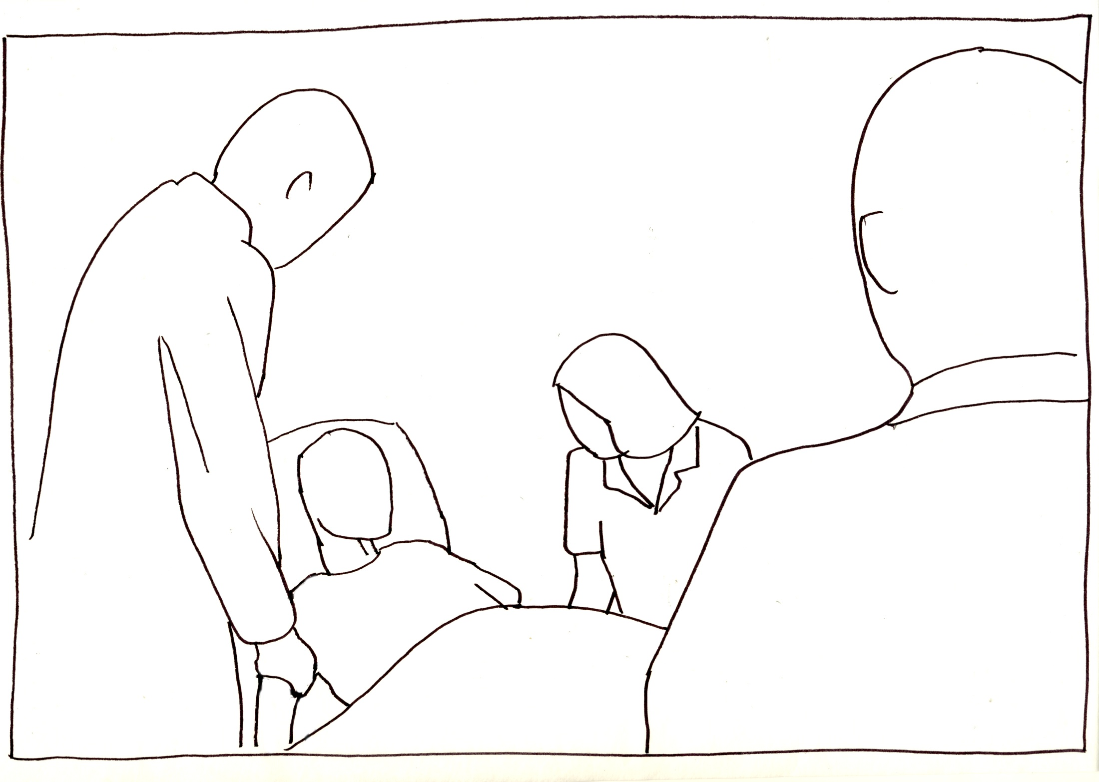
3. Doctors’ ward round
Notes:
Doctor’s ward round
At eight o’clock, the doctors come round on their ward round. They move from patient directly to patient, and examine Mr. Smith.
(INFECTION CONTROL ERROR – no hand sanitation between patients, no gloves/apron for MRSA patient – potential infection)

Slide 12
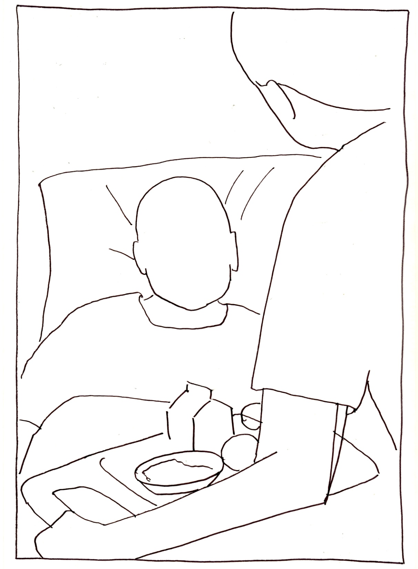
4. Breakfast
Notes:
Breakfast
Shortly afterwards, breakfast is served. Again, staff move directly from Mr. Smith’s neighbour to him, pushing the food trolley and handing out food on trays.
(INFECTION CONTROL ERROR – no hand sanitation between patients, no gloves/apron for MRSA patient, and trolley/equipment not cleaned between patients – potential infection)

Slide 13
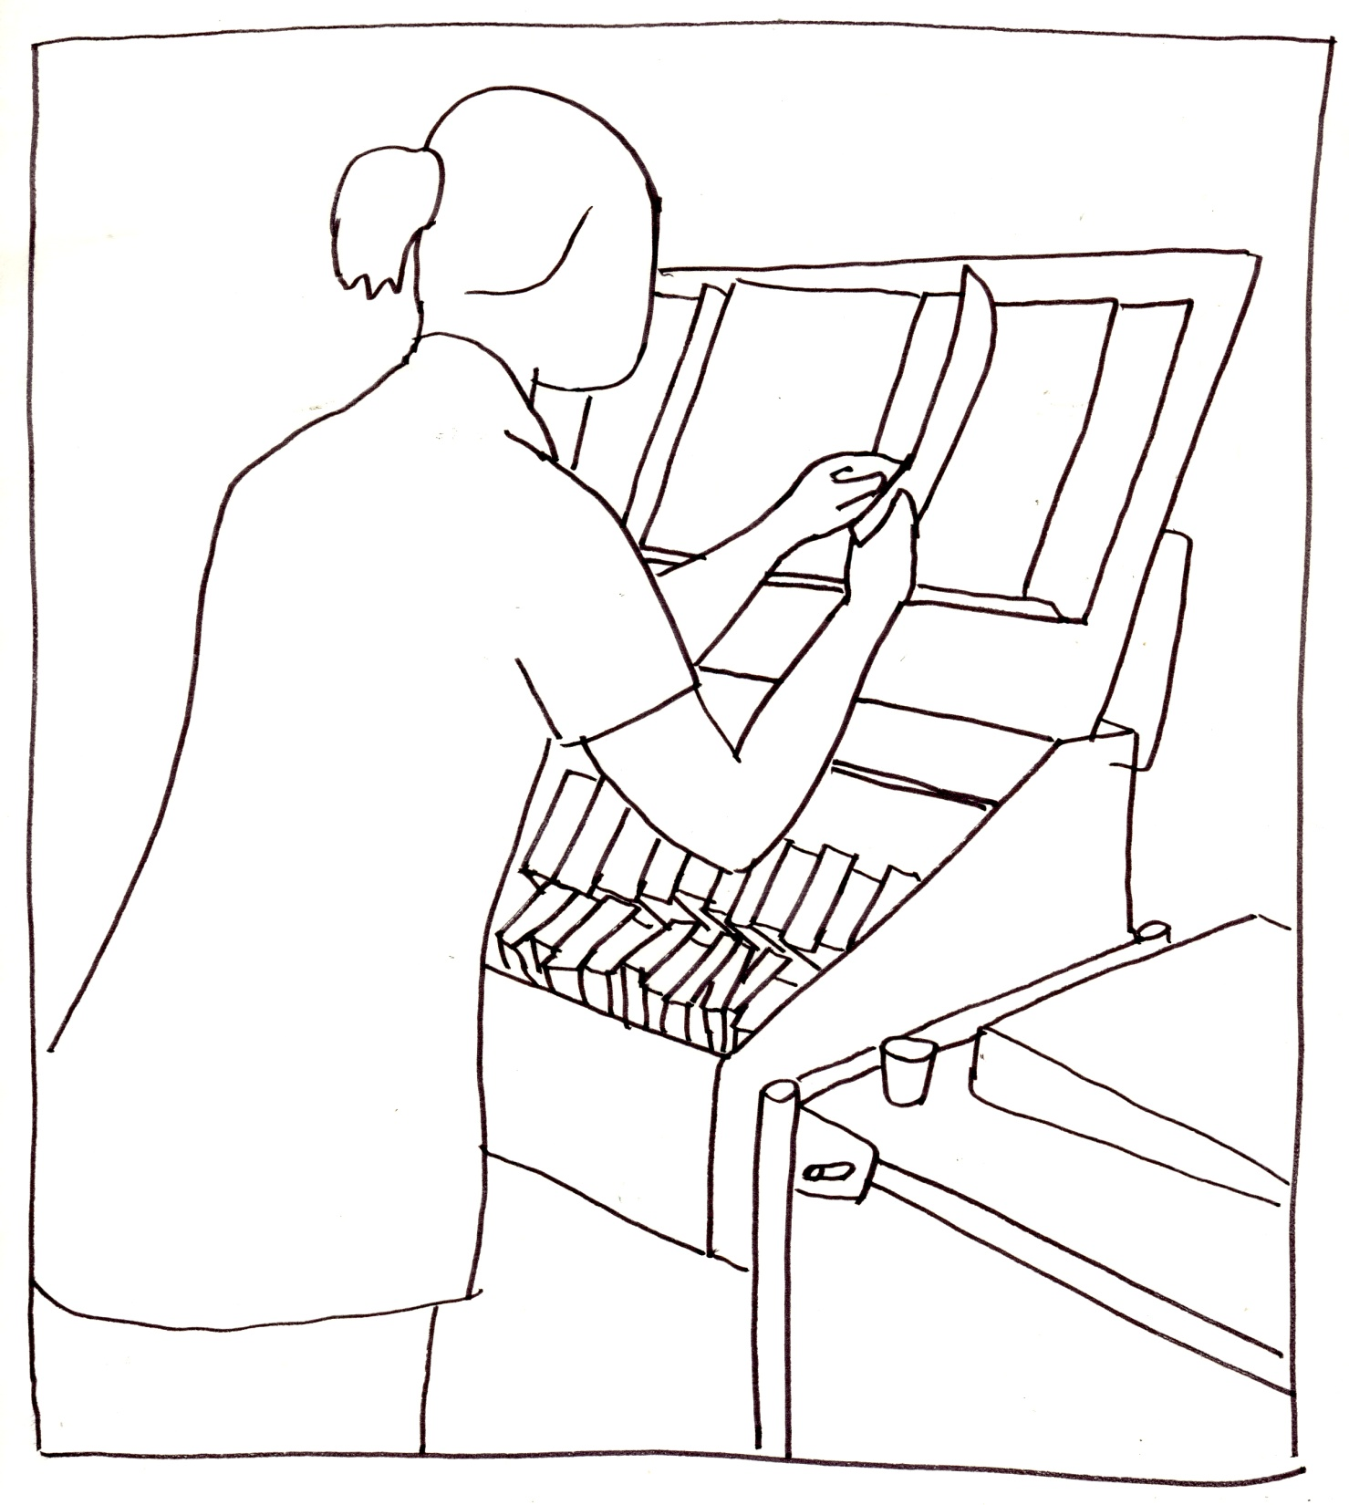
5. Drugs round
Notes:
Drugs round
The nurse comes round on the first drug round of the day. Mr. Smith has been prescribed antibiotics, but the nurse can’t find these particular ones and has to order some from the hospital pharmacy. Because she doesn’t give Mr. Smith his drugs, she leaves the chart unsigned.
(POTENTIAL MEDICAL ERROR – unsigned chart means nobody knows if patient has received drug – possibility of missed dose or double dose)

Slide 14
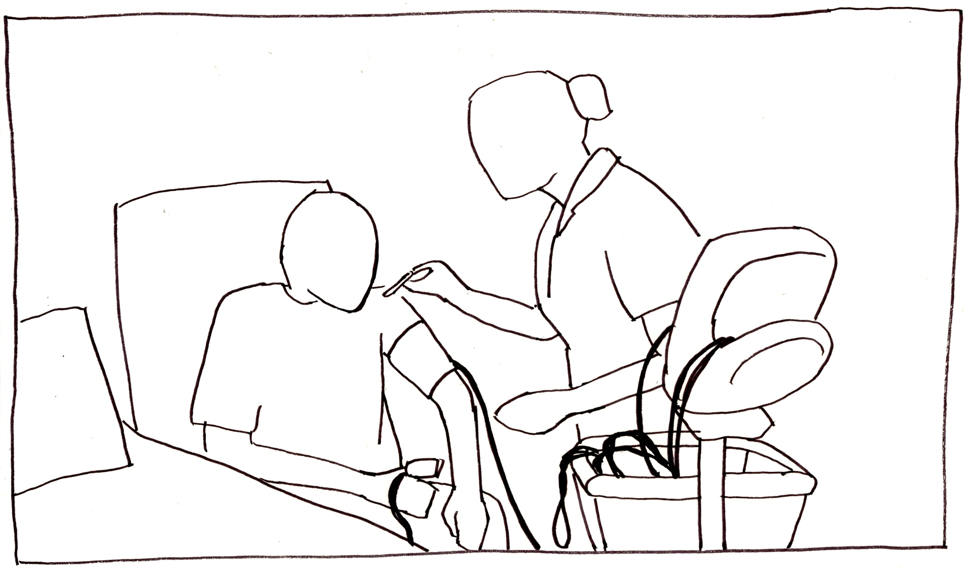
6. Vital signs round
Notes:
Vital Signs round
Another nurse begins a routine observations or vital signs round. She measures Mr. Smith’s blood pressure, pulse, the oxygen levels in his blood, and his temperature. She forgets to measure is breathing rate, one of the best measures of a patient’s condition.
(GENERAL OR COMMUNICATIONS ERROR – respiratory rate is often neglected and an important indicator of deterioration)

Slide 15
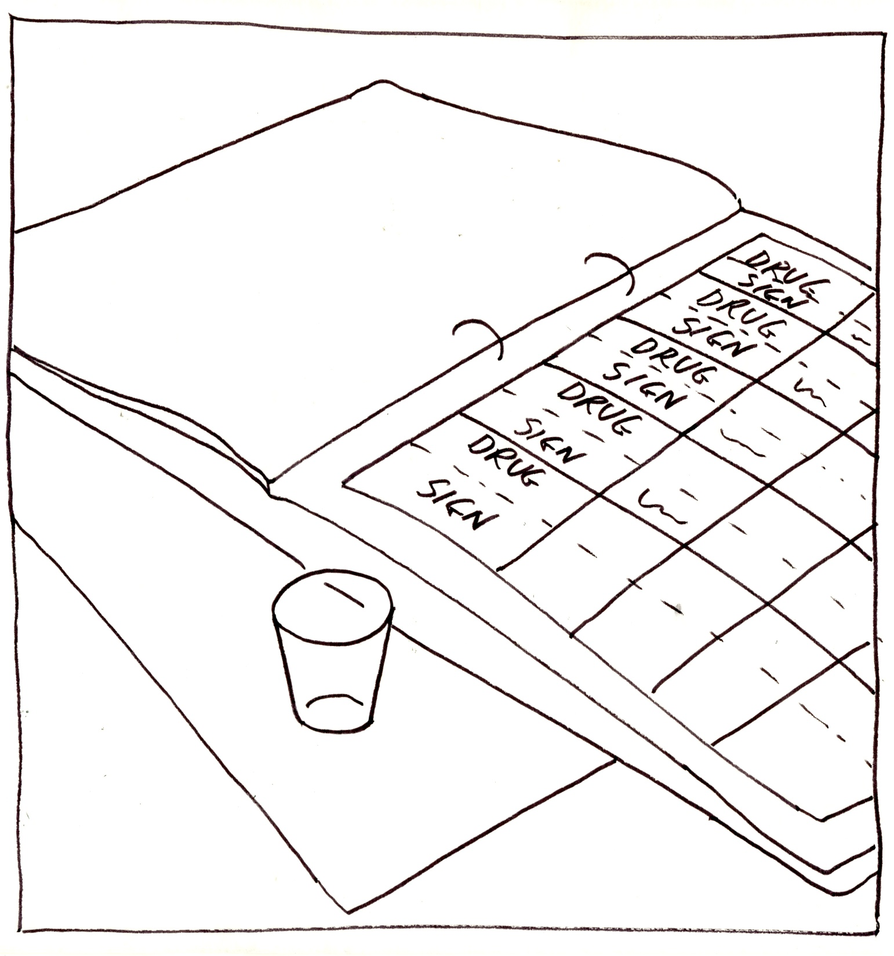
7. Drugs round
Notes:
Drugs round
At 12 o’clock, another nurse comes to give Mr. Smith his tablets on the lunch time drug round. The antibiotics have now arrived, and are given to Mr. Smith who takes them. The nurse notices that the chart was not signed from the previous round, but assumes that it must have been given and signs it anyway.
(MEDICATION ERROR – because the previous drug round has now been signed for, there is no record that Mr. Smith missed his previous dose of antibiotics)

Slide 16
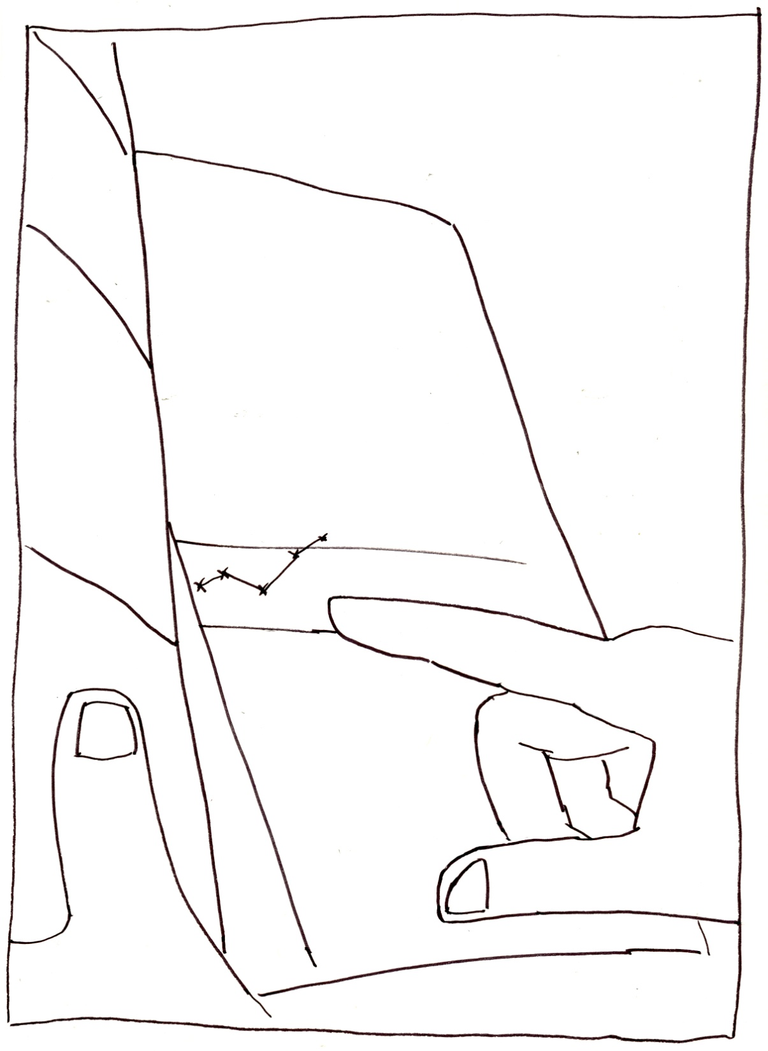
8. Vital signs round
Notes:
Vital Signs round
On the next vital signs round, the nurse notices that Mr. Smith’s breathing is raised. She isn’t sure if this is normal for Mr. Smith, and doesn’t want to disturb the senior nurse unnecessarily as the staff are particularly busy today.
(COMMUNICATIONS ERROR – power distance and an overstretched ward mean that vital information doesn’t get passed on)

Slide 17
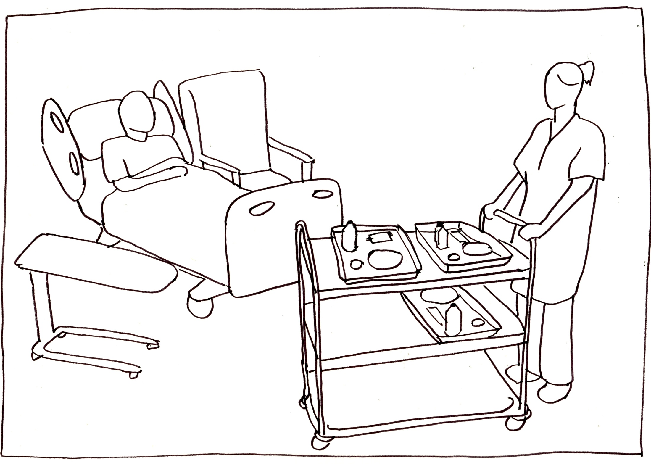
9. Lunch
Notes:
Lunch
Lunch is served. Just as at breakfast, the trolley moves directly from patient to patient, and trays are handed out.
(INFECTION CONTROL ERROR – no hand sanitation between patients, no gloves/apron for MRSA patient, and trolley/equipment not cleaned between patients – potential infection)

Slide 18
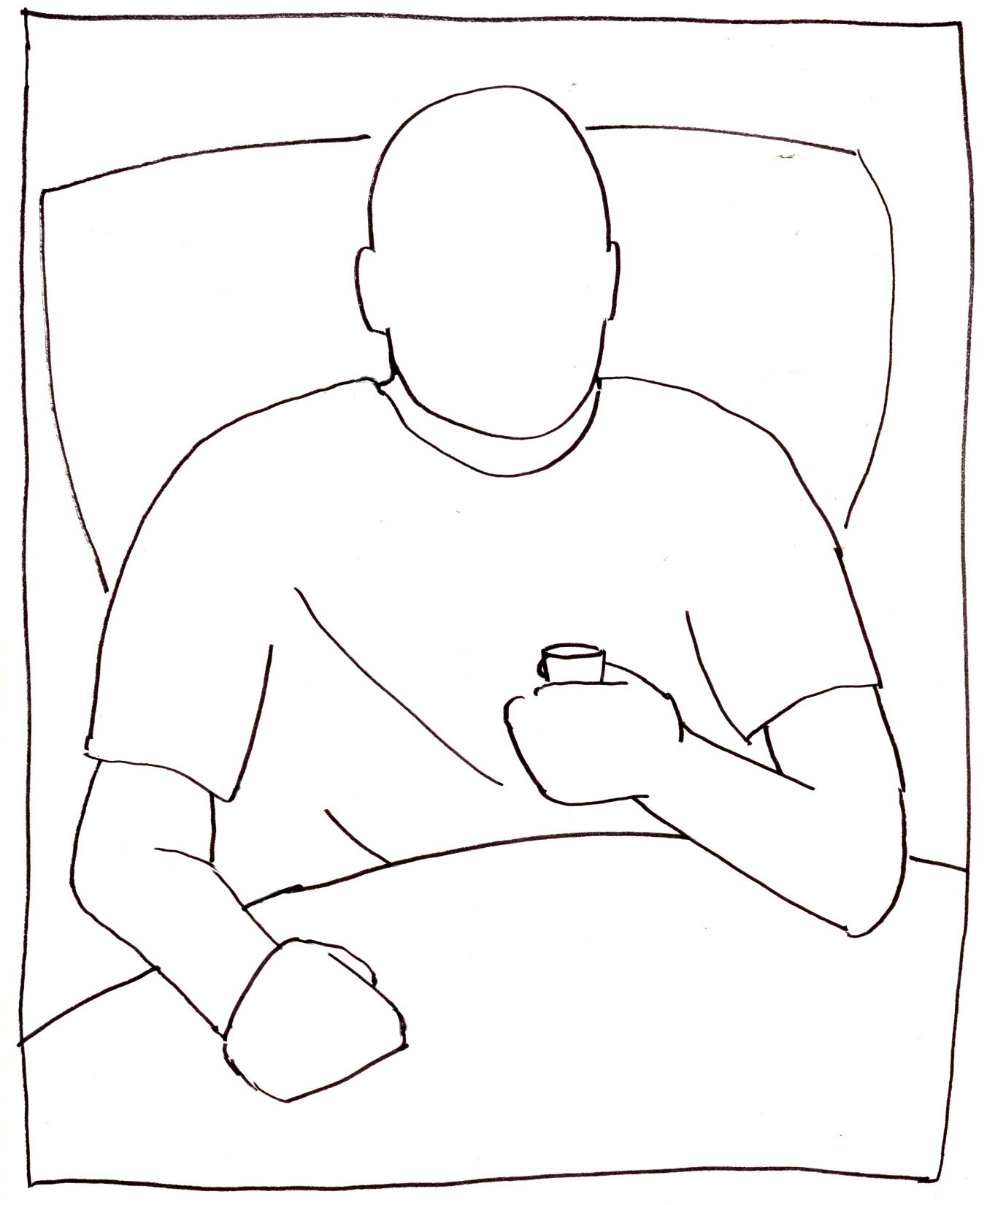
10. Drugs round
Notes:
Drugs round
During the afternoon drugs round, Mr. Smith is given his antibiotics. He is feeling unwell, and thinks it may be down to the new antibiotics he has to take. He decides to not take his pills, as he fears he may be allergic.
(MEDICAL ERROR - Nurse does not witness Mr. Smith taking pills. Nobody knows that another dose has been missed. Patients should have their medication explained and have ample opportunity to voice their concerns)

Slide 19
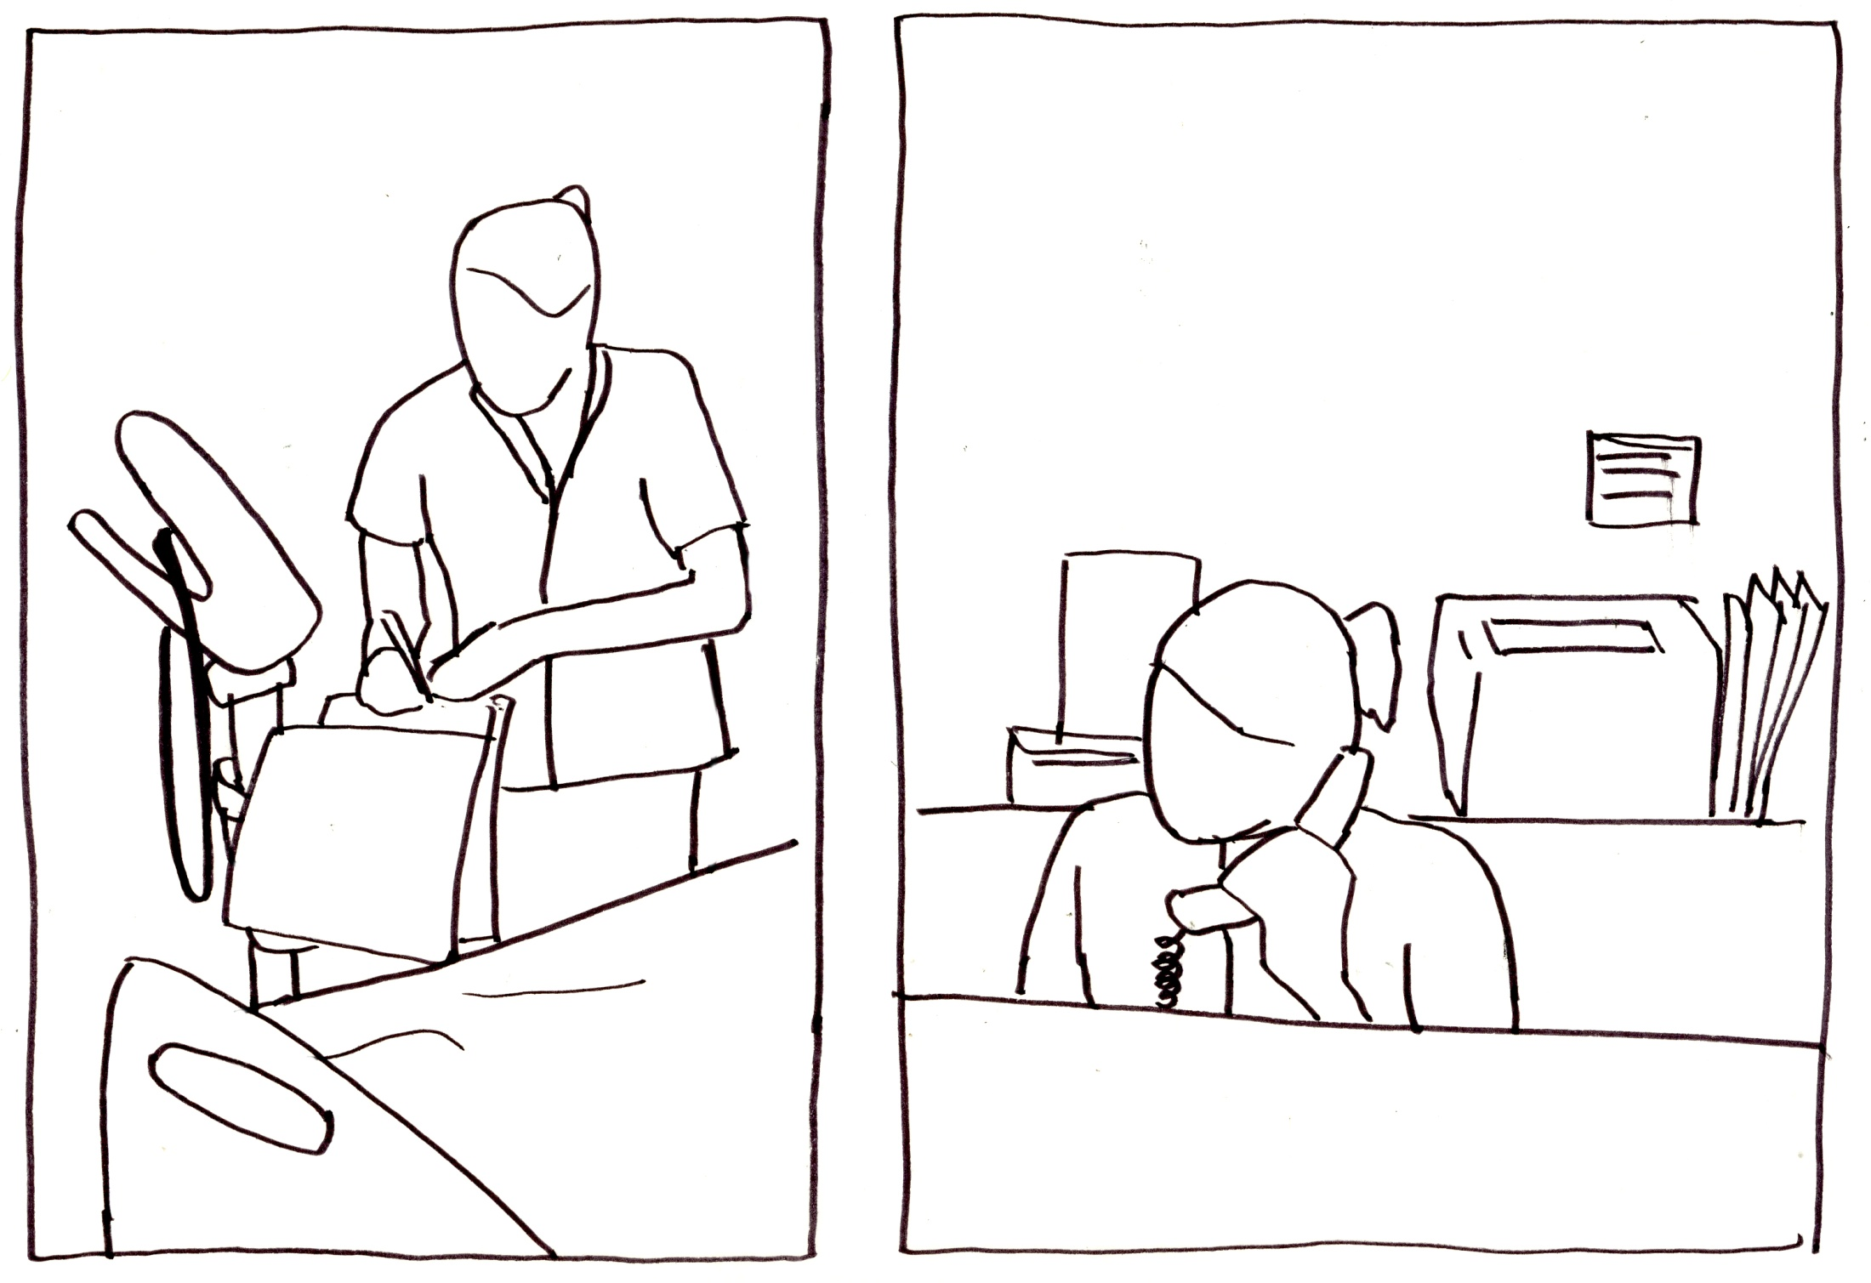
11. Vital signs round
Notes:
Vital Signs round
At the 2pm vital signs round, the nurses note a deterioration in Mr. Smith’s condition. He has a low blood pressure, a fast pulse, and a high temperature. The nurses decide to call the doctor to come and see Mr. Smith. However, no names are mentioned, so when a doctor does eventually arrive, they see the wrong patient.
(COMMUNICATIONS ERROR – This apparently happens all the time. Names must be given higher importance)

Slide 20
12. Visitors
Notes:
Visitors
Mr. Smith has visitors, and they are concerned at his condition. They hold his hand to reassure him.
(INFECTION CONTROL – visitors can transmit infections from the patient’s own environment to the body)

Slide 21
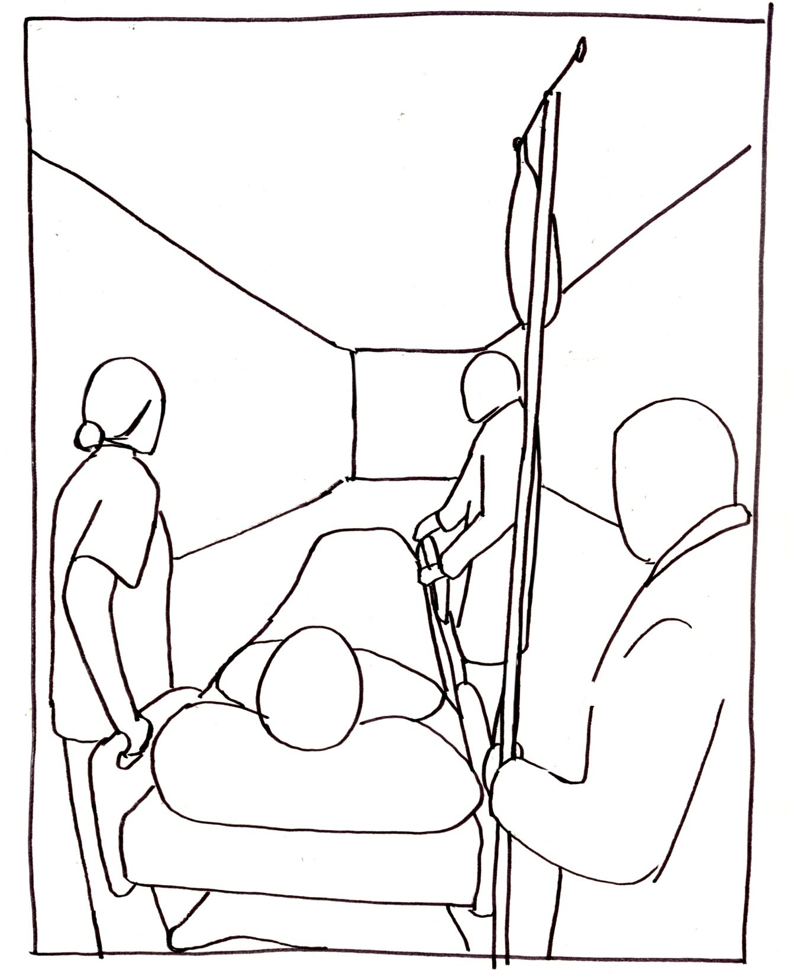
13. Transfer
Notes:
Transfer
By 4 o’clock, Mr. Smith is feeling more unwell, and calls nurse again. This time, the message gets through to the doctor who says a chest x ray is needed, and Mr. Smith is sent to ITU with suspected pneumonia.

Slide 22

Small groups
Identify top three errors in your theme (10 mins)
Think about causes of these errors (10 mins)
Come up with design solutions (20 mins)

Slide 23
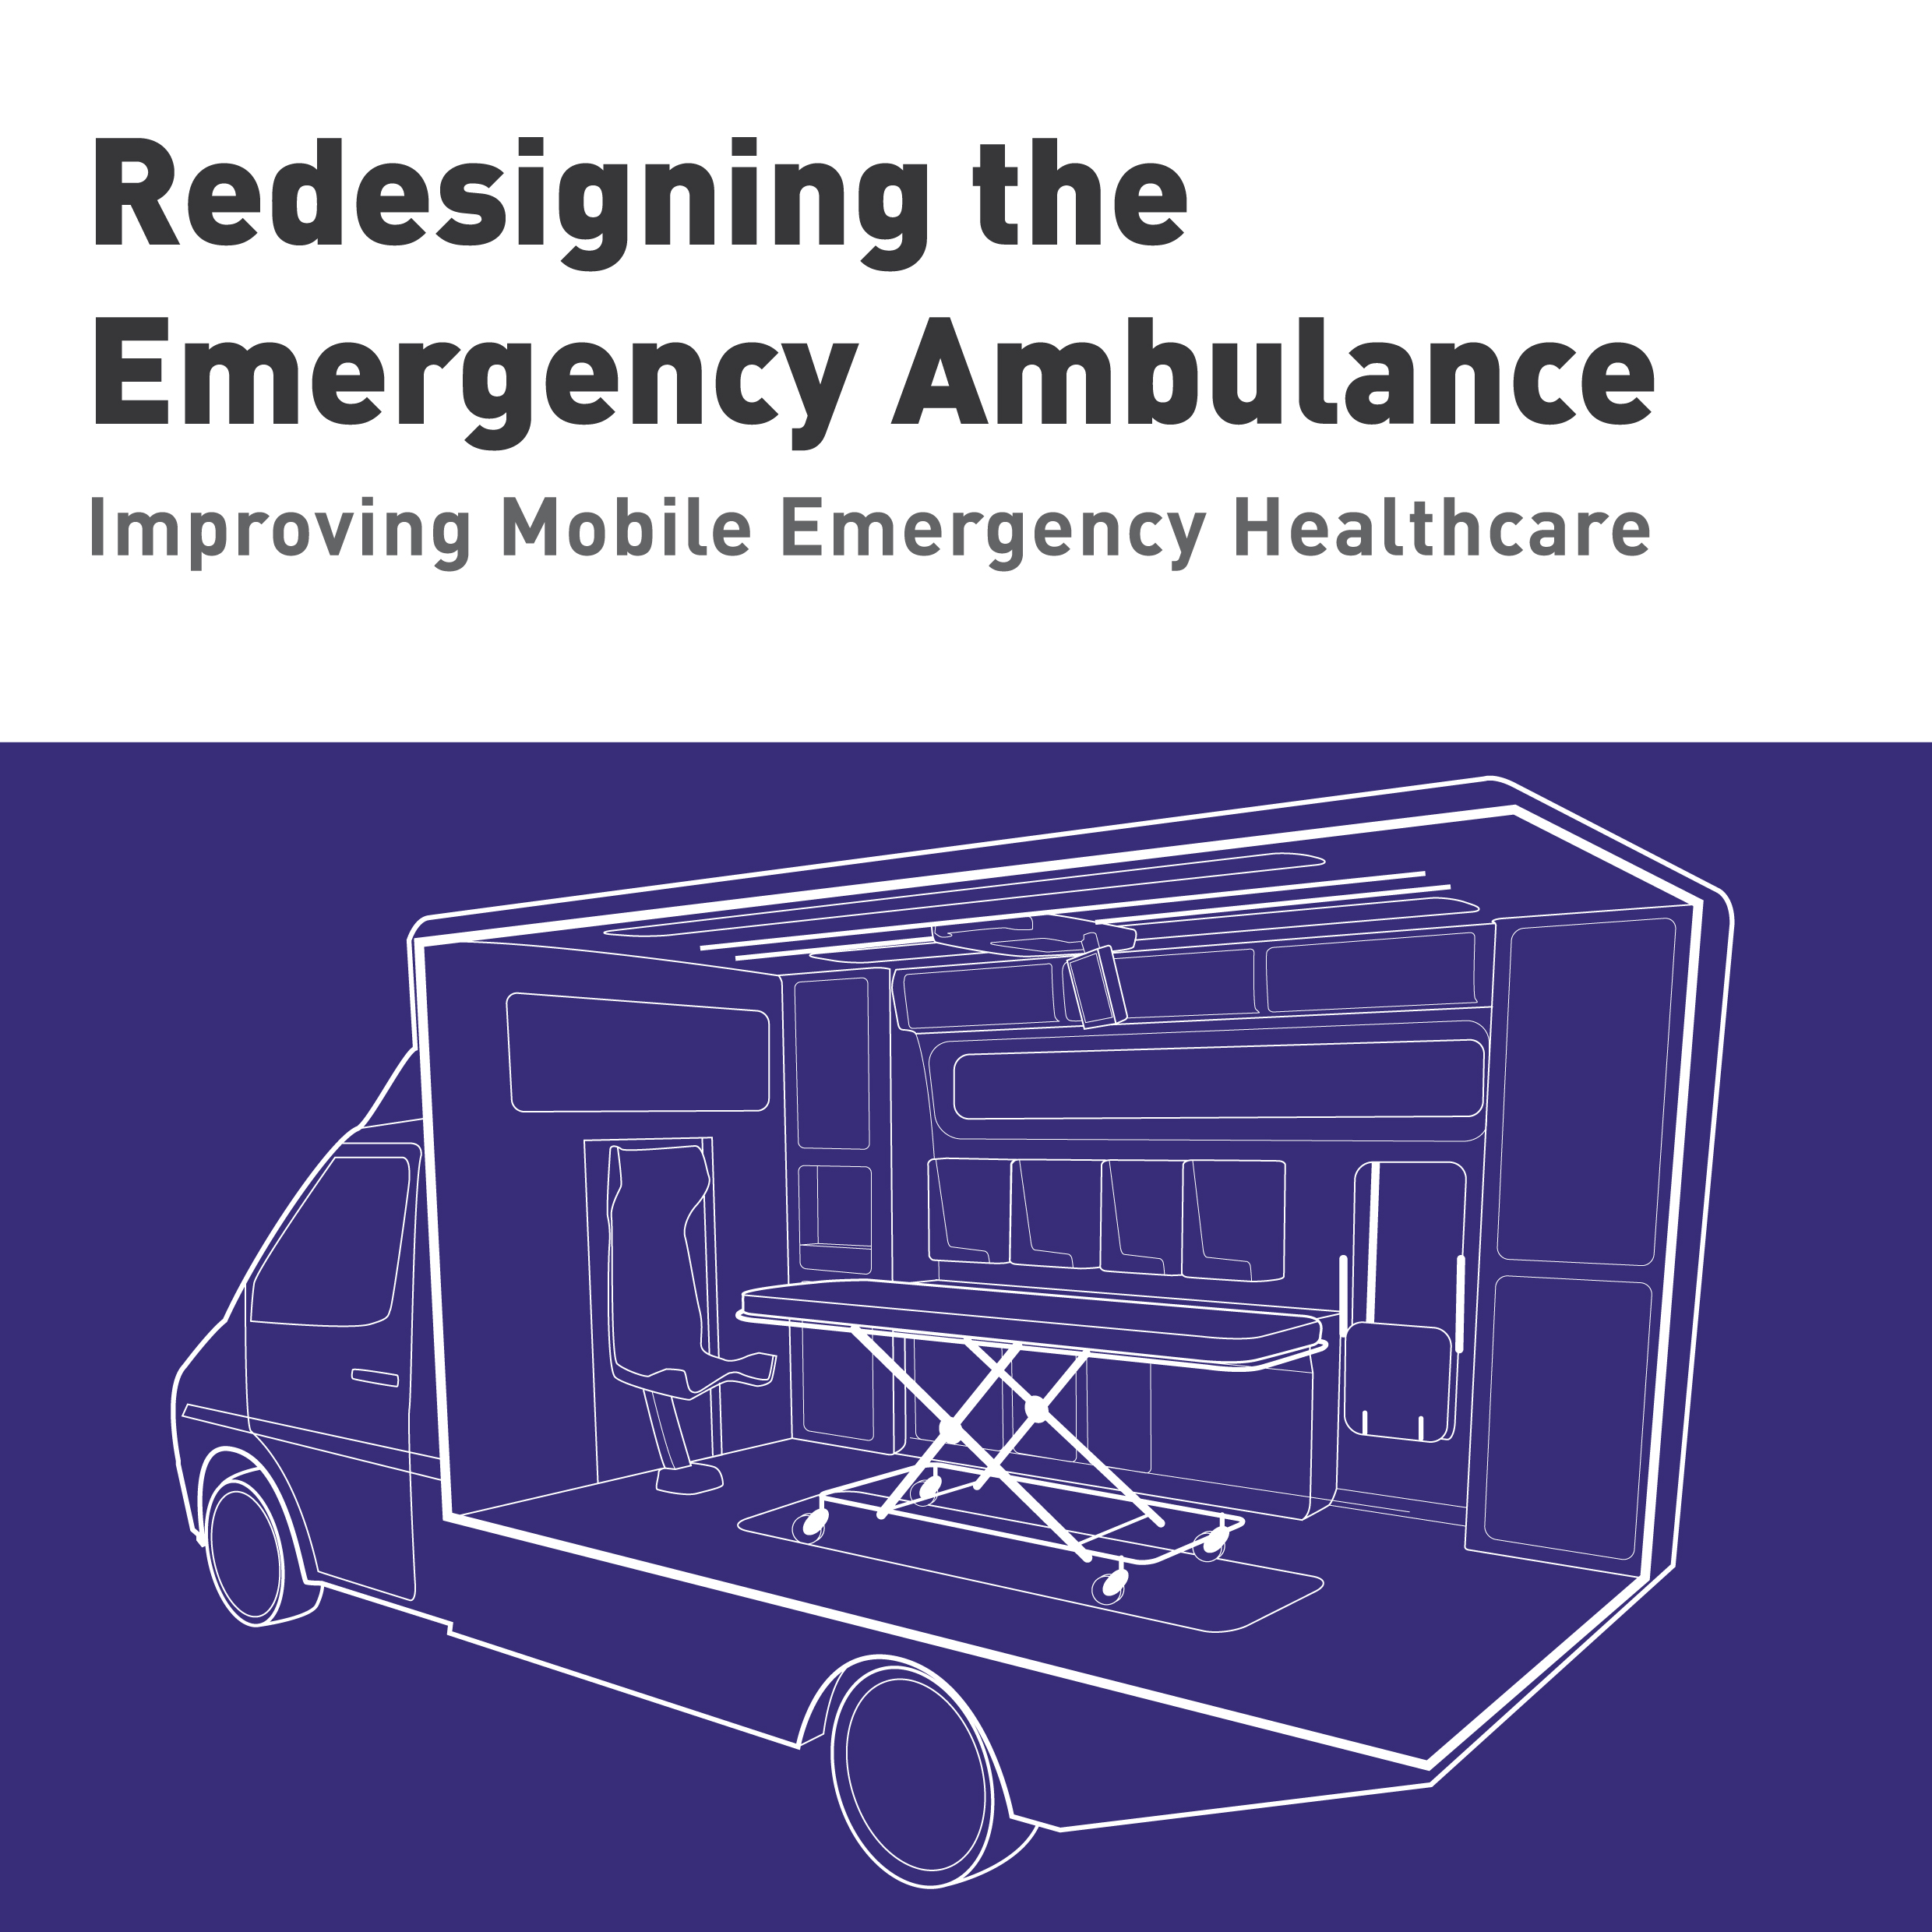
Notes:
So we have started with the ambulance
we have been exploring the idea of how better care can reduce hospital trips. The aim is to provide a treatment space fit for 21st century practice
The team anticipated that we could improve patient and clinician safety, enhance clinical functionality and reduce operational costs for the NHS

Slide 24
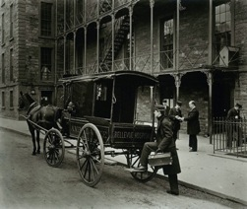
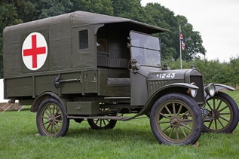
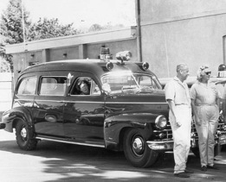
Ambulance design evolution
1895 New York
1916 World War I
1948 New York
Notes:
If we look at how ambulances have evolved we can see that they started as a way to transport injured soldiers to a safe place for treatment, maybe as far back as Roman times
we can see in the images that at they started being horse carts, then we ditched the horses and put a combustion engine in, and maybe then we made them more stylish to keep up with the times.
But the main function of the service was simply to move people from A to B with minimal treatment in between
Today, however, with increasing health service demands and reduced budgets the service needs to be a lot more efficient, save money where it can but still provide world-class treatment

Slide 25
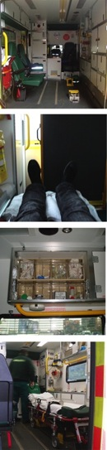
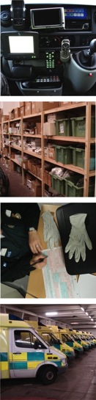
Design challenges
1. Hygiene and cleaning
5. Equipment integration
2. Patient experience
6. Stock control
3. Layout and arrangement
7. Communication
4. Accessibility to patient
8. Sustainability
Notes:
The rideouts and review of our previous research pinpointed 8 design challenges having to do with hygiene and cleaning…

Slide 26
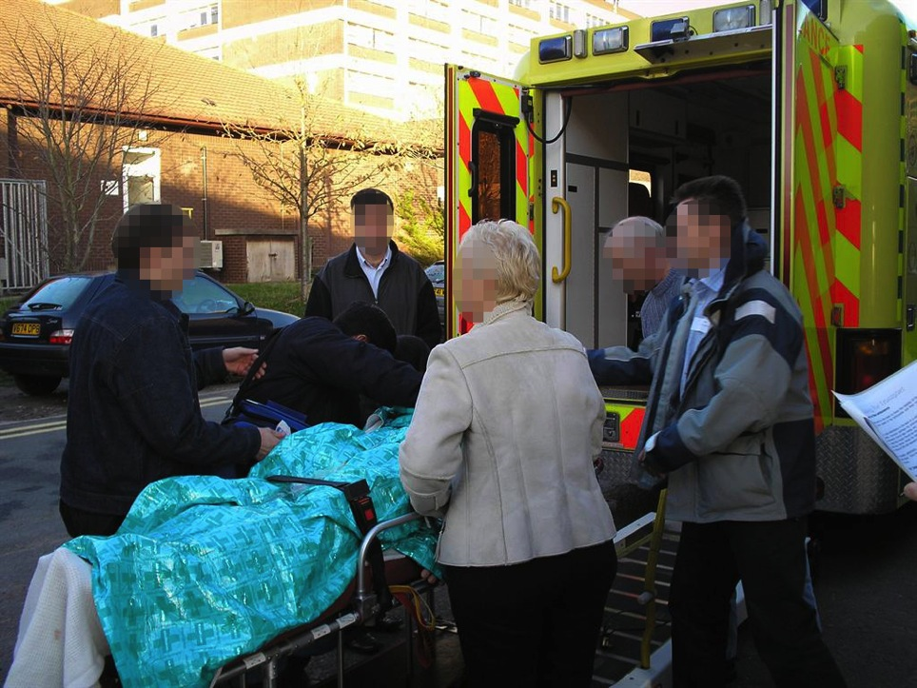
Ride outs
Notes:
Our work started by going out on multiple occasions on 12 hour shifts with paramedics on both boxed ambulances and first responder vehicles to witness first hand the realities of the service

Slide 27
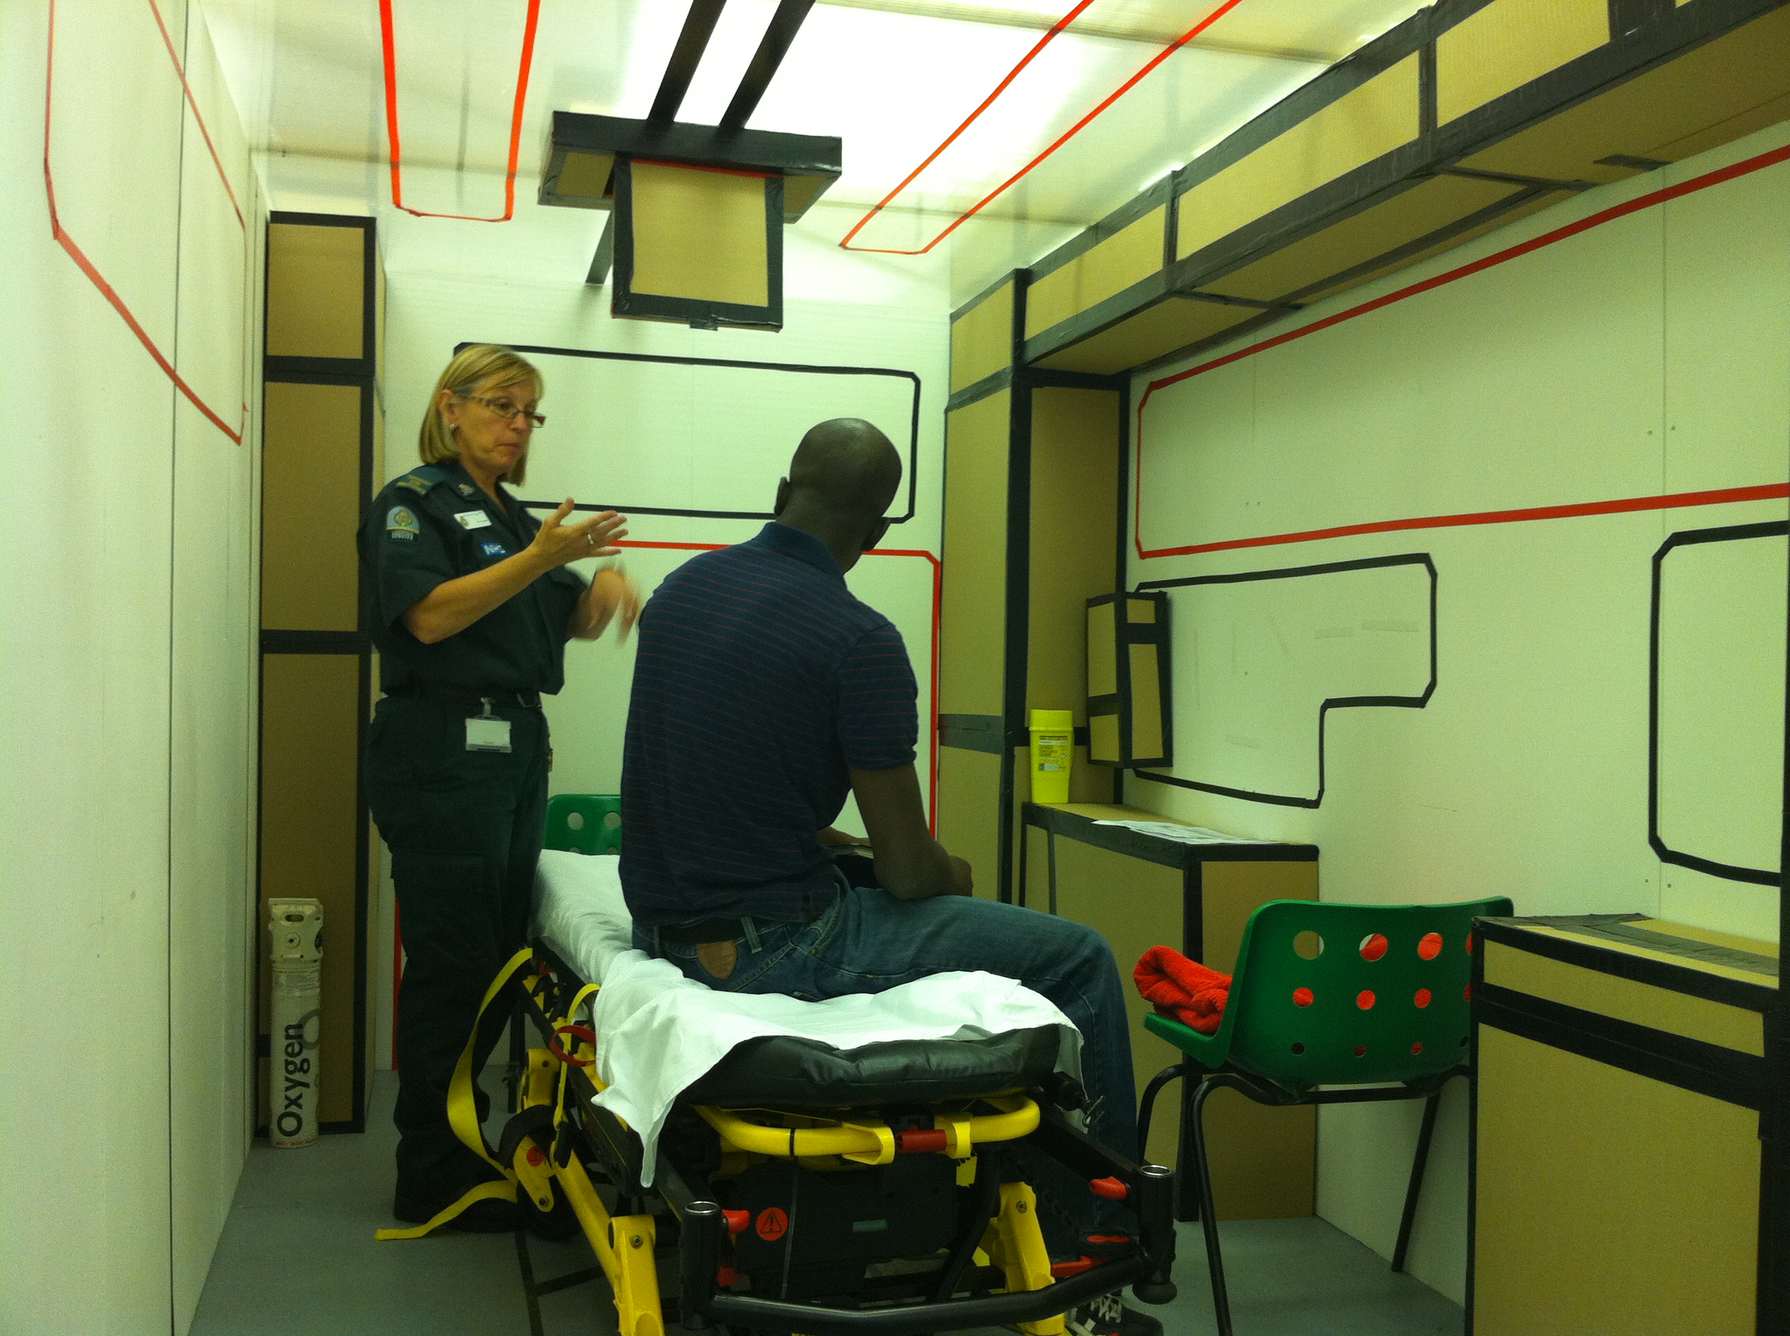
1:1 mock up
Notes:
We created a 1:1 mockup of the ambulance space and invited paramedics for interviews and to role play clinical scenarios. Using cardboard allowed us to roughly try out ideas during our conversations and make changes as we spoke

Slide 28
Comparing old vs. new
Notes:
We devised two clinical scenarios designed to put to test our attempts to improve the efficiency, ergonomics, infection control and patient safety. Ensuring that the tests could be measureable, repeatable and consistent for each crew.

Slide 29
Median time taken to complete task
Notes:
Here are some of the results of the tests. We can see that the paramedics reduced times to complete treatment tasks in the new design to about half in some instances

Slide 30
Median number of contamination episodes
Notes:
There were about 30% fewer contamination episodes and around 60% fewer incidents that are likely to lead to contamination episodes

Slide 31
Median technical skills score
Notes:
There was also a slight inprovement in technical skills during the cardiac scenario

Slide 32
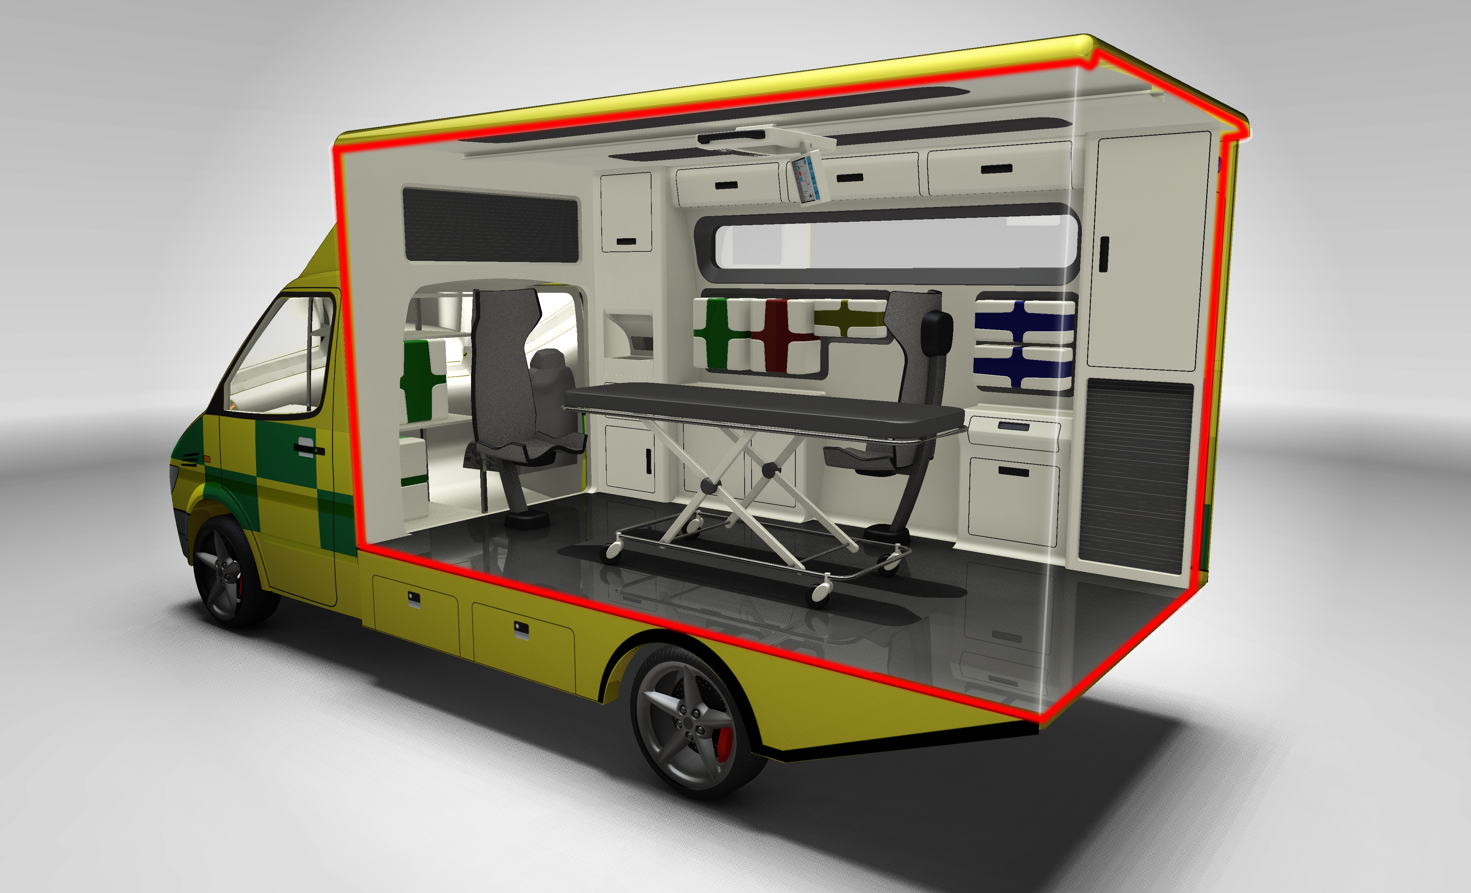
Refinement
Notes:
Distilled to one through the feedback of 39 different ambulance crews and patients

Slide 33
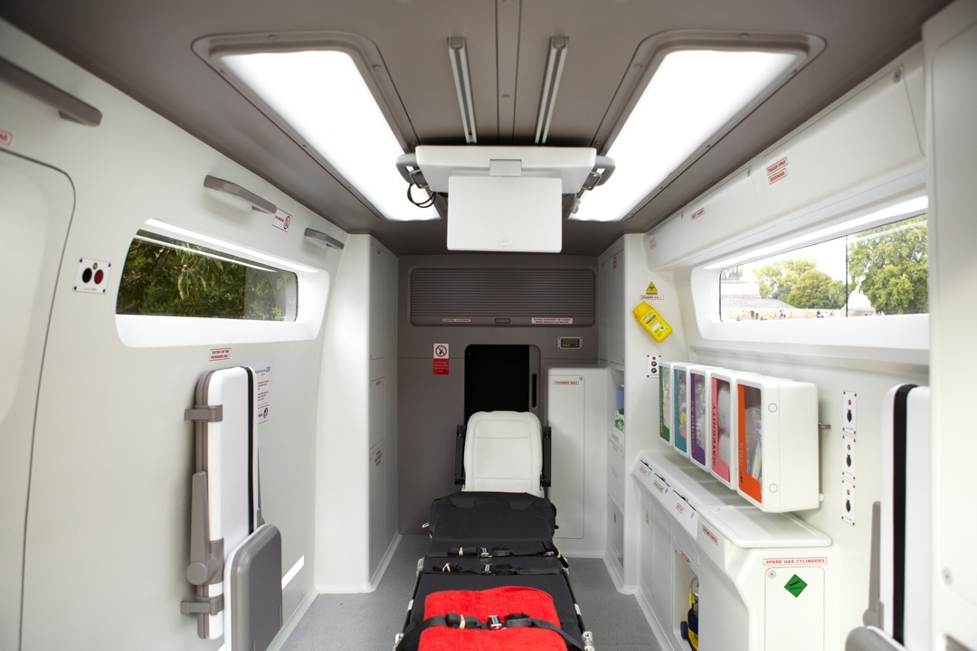
Improved interior
Notes:
The interior is designed to be easy to clean by avoiding corners and crevices where dirt collects, this demonstrates significant improvements in infection control. The interior is better lit, has a better ambience and is less intimidating for patients and relatives. It also provides a sensation of amplitude even though the new interior has the same footprint as the old one.

Slide 34
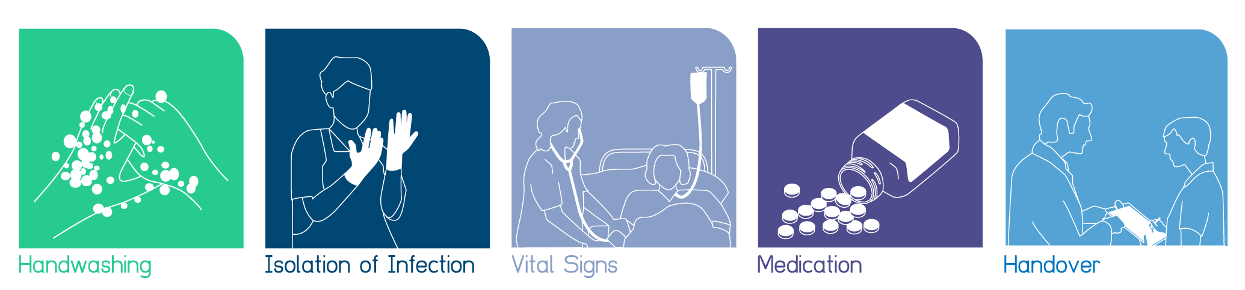
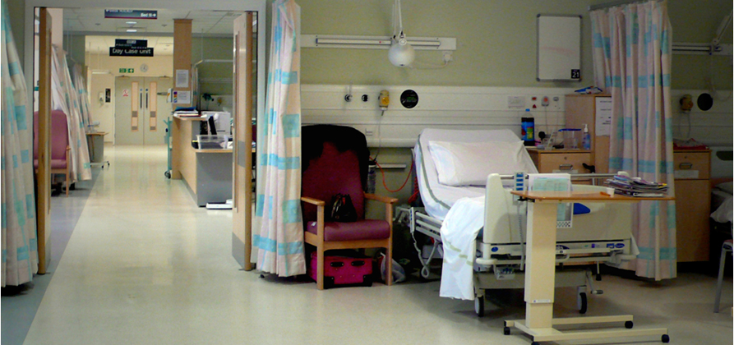

Slide 35
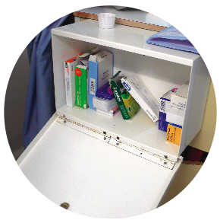
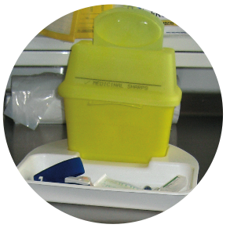
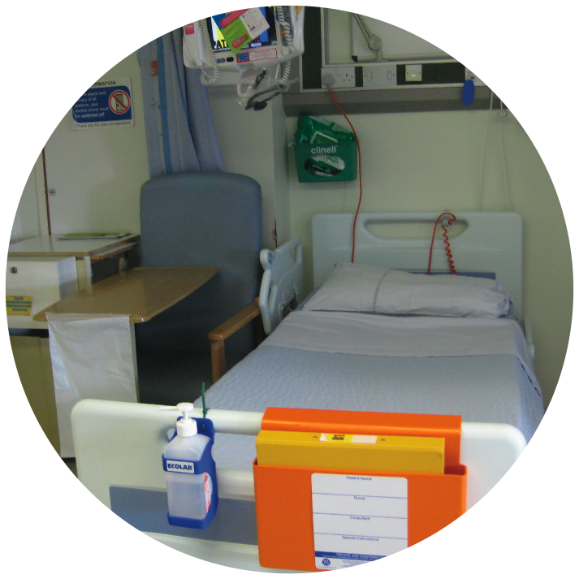
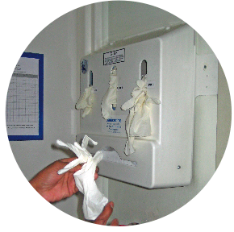
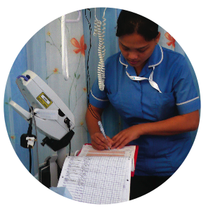
2
1. Patient medication locker
1
2. Nowhere to put sharps bin
3. Gloves and apron out of bedspace
4. No flat surface for writing
4
3

Slide 36
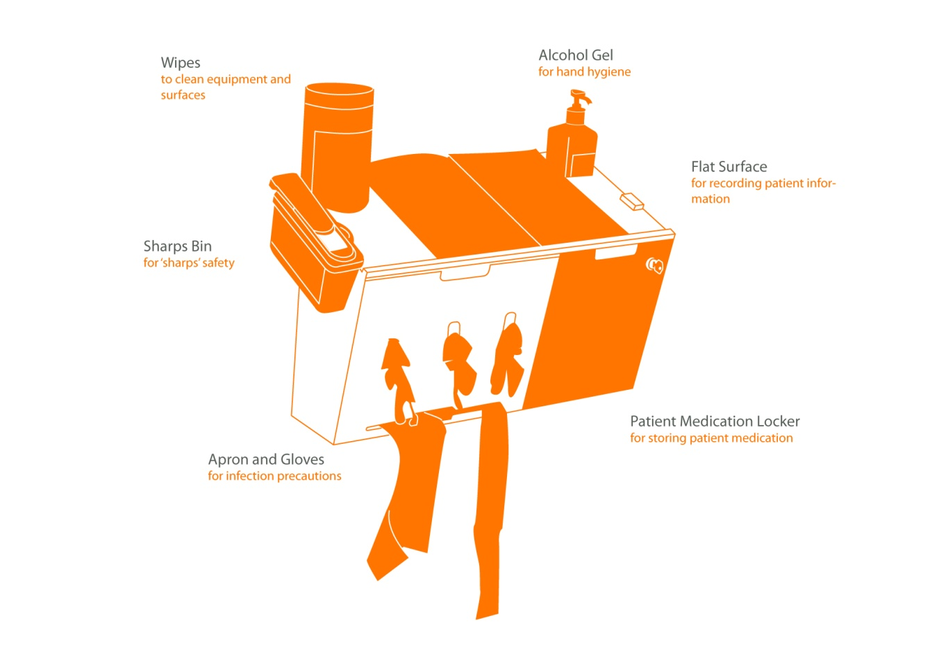

Slide 37
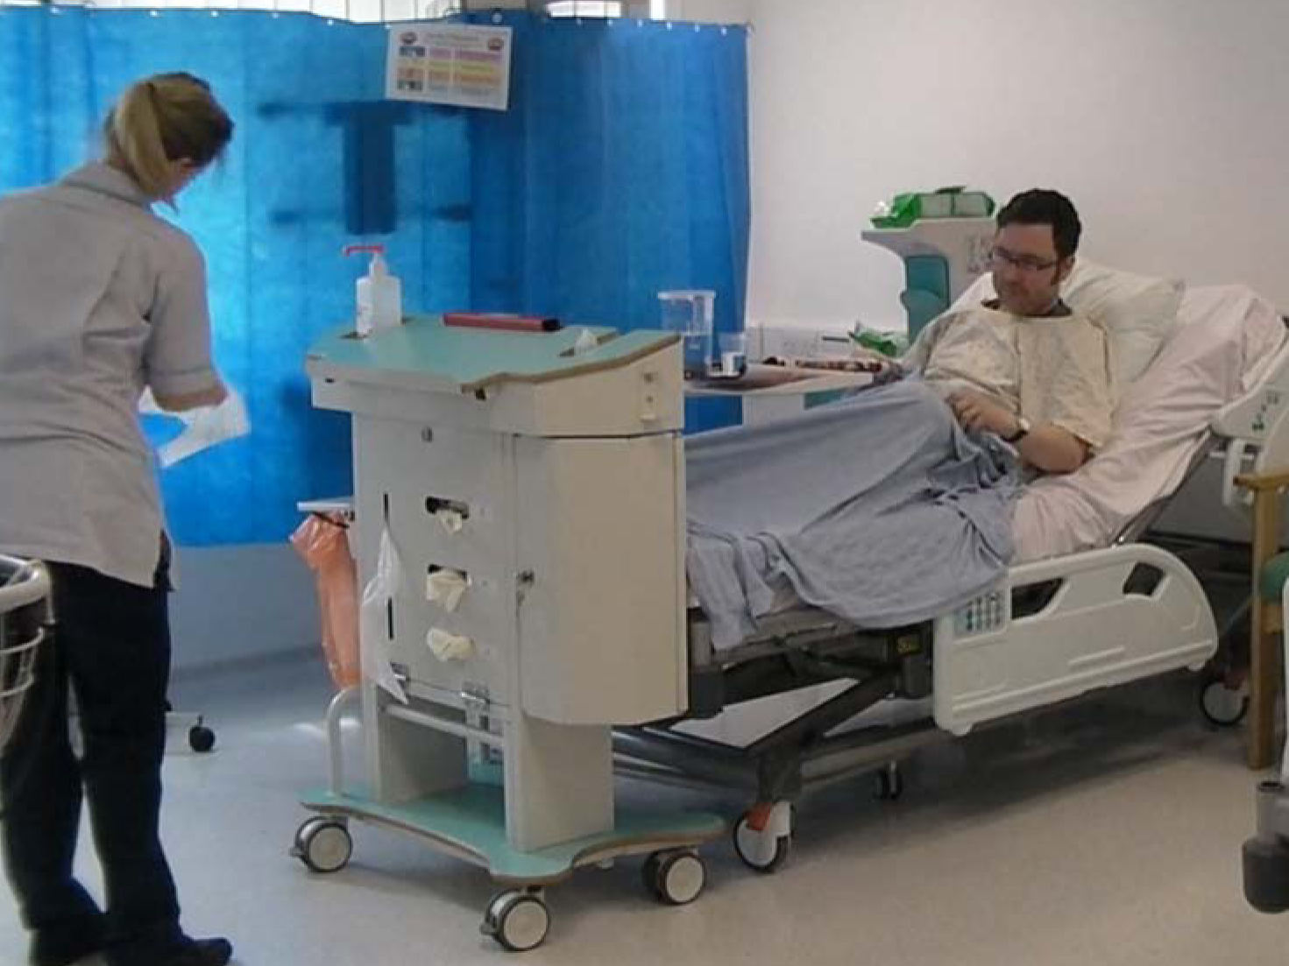

Slide 38

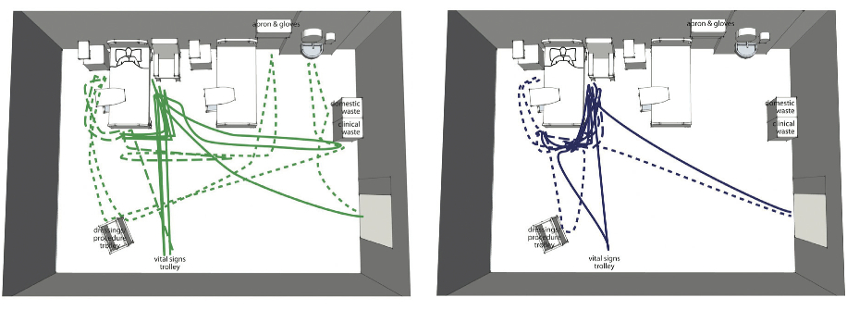
Simulation study: link analysis

Slide 39
